Slide 1
PRAY FOR VIETNAM

Slide 2
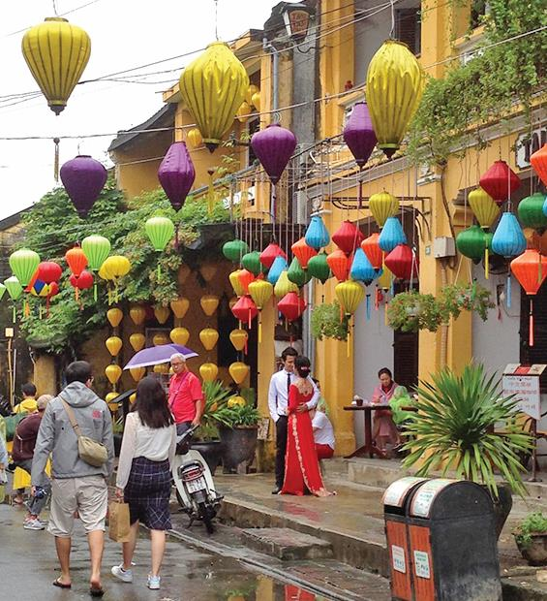
Be on your guard;
stand firm in the faith;
be courageous; be strong.
Do everything in love.
1 Corinthians 16:13–14

Slide 3
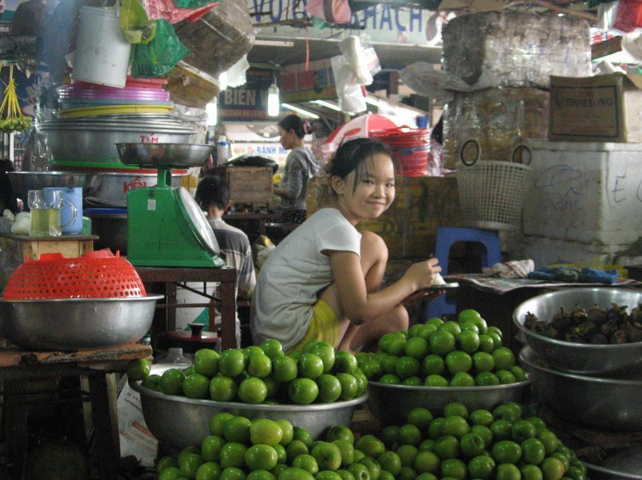
By faith in our loving heavenly father and empowered by his Holy Spirit, we trust God for:
An established multi-ethnic team, vibrantly witnessing to the gospel through character, word and action in Vietnamese communities where Christ is least known.
God’s people in local, indigenous, mission-minded and growing churches, to make disciples of Jesus within Vietnam and beyond.

Slide 4
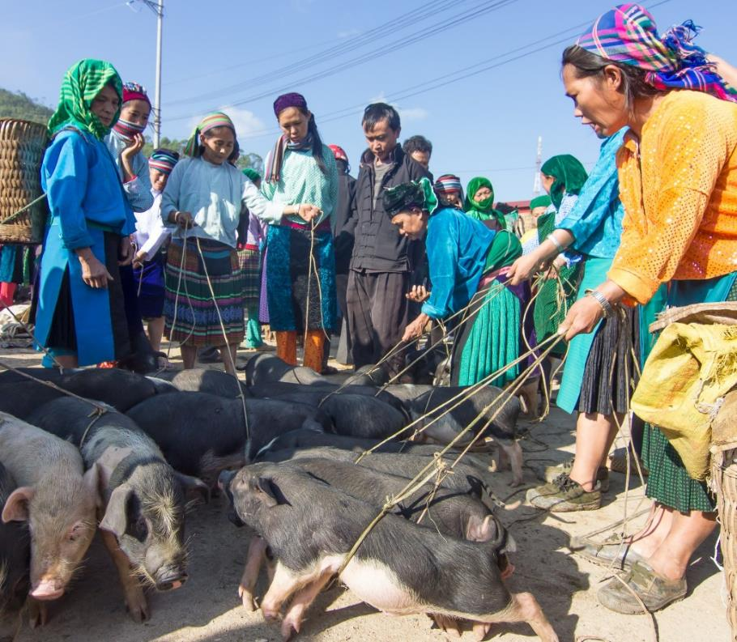
COMMUNITIES WHERE CHRIST IS LEAST KNOWN
The Kinh
The Kinh Vietnamese make up 86% of Vietnam’s 96 million people. They are the majority ethnic group.
Only around 1% of Vietnamese in the south identify as evangelicals. The registered church is more established, and is made up of a number of denominations.

Slide 5
COMMUNITIES WHERE CHRIST IS LEAST KNOWN
The Kinh
More than half of Vietnam’s population is under 30 years of age. They are seeking identity and purpose through education and employment.

Slide 6
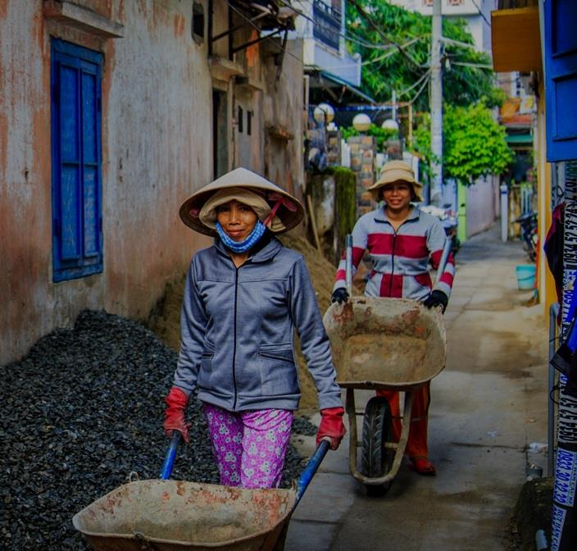
COMMUNITIES WHERE CHRIST IS LEAST KNOWN
Please pray…
Pray for the nation. As Vietnam becomes more industrialised, may this provide opportunities for missional business, engaging universities, and educational initiatives, through which the people will find true purpose in Christ.

Slide 7
COMMUNITIES WHERE CHRIST IS LEAST KNOWN
Please pray…
Pray for government officials and military personnel (who are pillars in Vietnamese society) to look favourably upon Christians.
Pray for the Lord’s provision of new workers who will thrive in Vietnam and will be able to make disciples in culturally appropriate ways.

Slide 8
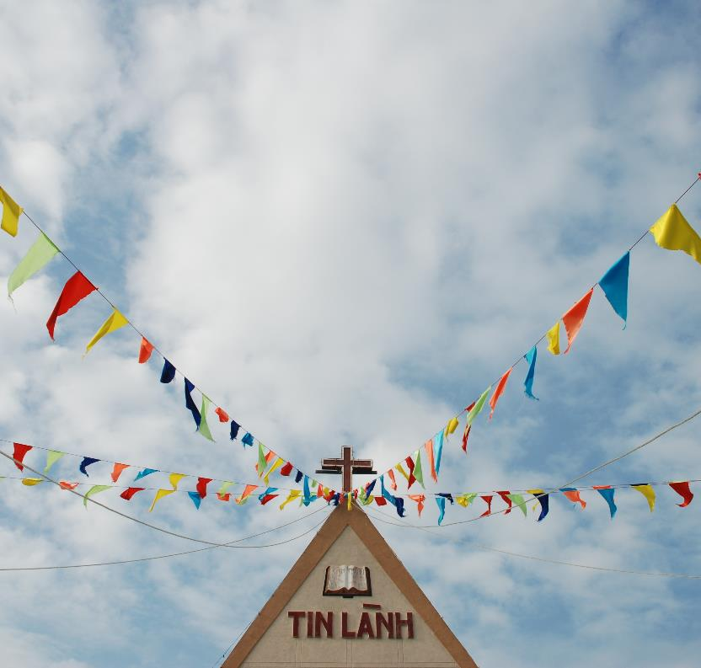
COMMUNITIES WHERE CHRIST IS LEAST KNOWN
Please pray…
Pray for believers and local churches to reach out to those who have yet to hear of Jesus. Pray for unity between leaders of various registered and unregistered denominations.
Pray for the training of Vietnamese Christians to equip their own people and develop leaders.

Slide 9
COMMUNITIES WHERE CHRIST IS LEAST KNOWN
Please pray…
Pray for opportunities to begin work with northern ethnic minority communities that have no church.
Pray for courage and perseverance for those facing opposition and persecution for their faith.

Slide 10
MINISTRIES IN VIETNAM:
Equipping Leadership development, theological and missiological education
Pastoral Caring for those coping with surgeries, loss, hospice care and other traumatic circumstances.
Outreach Missional businesses and campus ministries

Slide 11
Thank you for your prayers
For more information, prayer resources, or if you are interested in serving, please visit sim.co.uk

