Slide 1
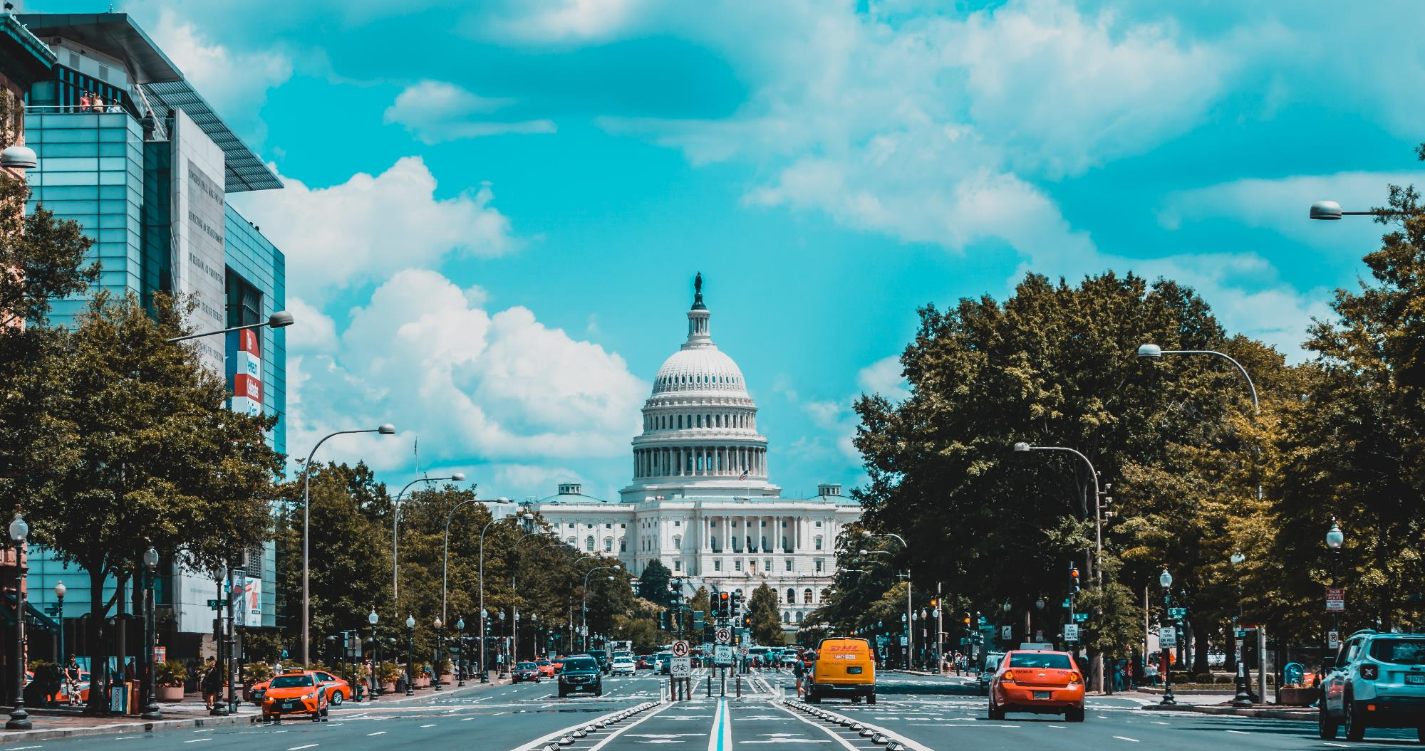
Pray for the USA

Slide 2
As you help us by your prayers. Then many will give thanks on our behalf for the gracious favour granted us in answer to the prayers of many.
2 Corinthians 1:11

Slide 3
With prayer and care, SIM USA strive to respond to need, proclaim the gospel, and equip the church.
They are passionate about assisting the church in the USA as they partner with the global church.

Slide 4
Pray for communities where Christ is least known
After India and China, the USA has the most unreached peoples within their borders.*
Some US counties have no known believers.
In some communities, believers in Jesus are shunned or harassed, and churches struggle to stay open.
We continue to see the movement of great numbers least-reached people into many of our urban centres.
PRAY
Courage, wisdom and sensitivity for believers.
That people who don’t know Jesus or his word will engage in Spirit-prepared conversations with open hearts and minds.
*Unreached Peoples, Least-Reached Places; JD Payne

Slide 5
Prayer requests from
our SIM team
PLEASE PRAY FOR
God’s help to strategically engage with new realities and opportunities.
Discernment, creativity and God’s provision of resources to help us enhance partnerships with the US church and expand its capacity to make Jesus known.
Growth in the multicultural, multi-talented community of people we partner with and send.
100 new long-term workers per year going with SIM USA by 2024.
Wisdom and grace to steward well all that has been entrusted to us.

Slide 6
Thank you for your prayers
For more information, prayer resources, or if you are interested in serving, please visit sim.co.uk

