Slide 1
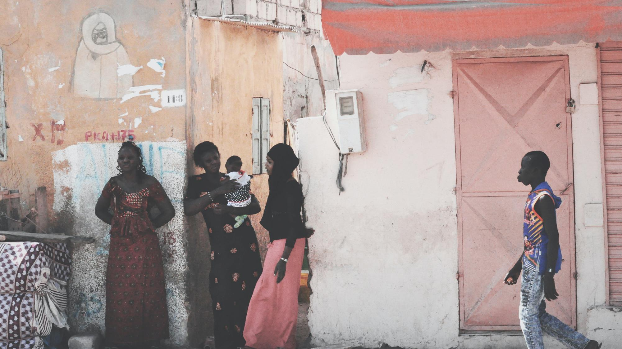
PRAY FOR SENEGAL
Photo by Francesca Noemi Marconi on Unsplash

Slide 2
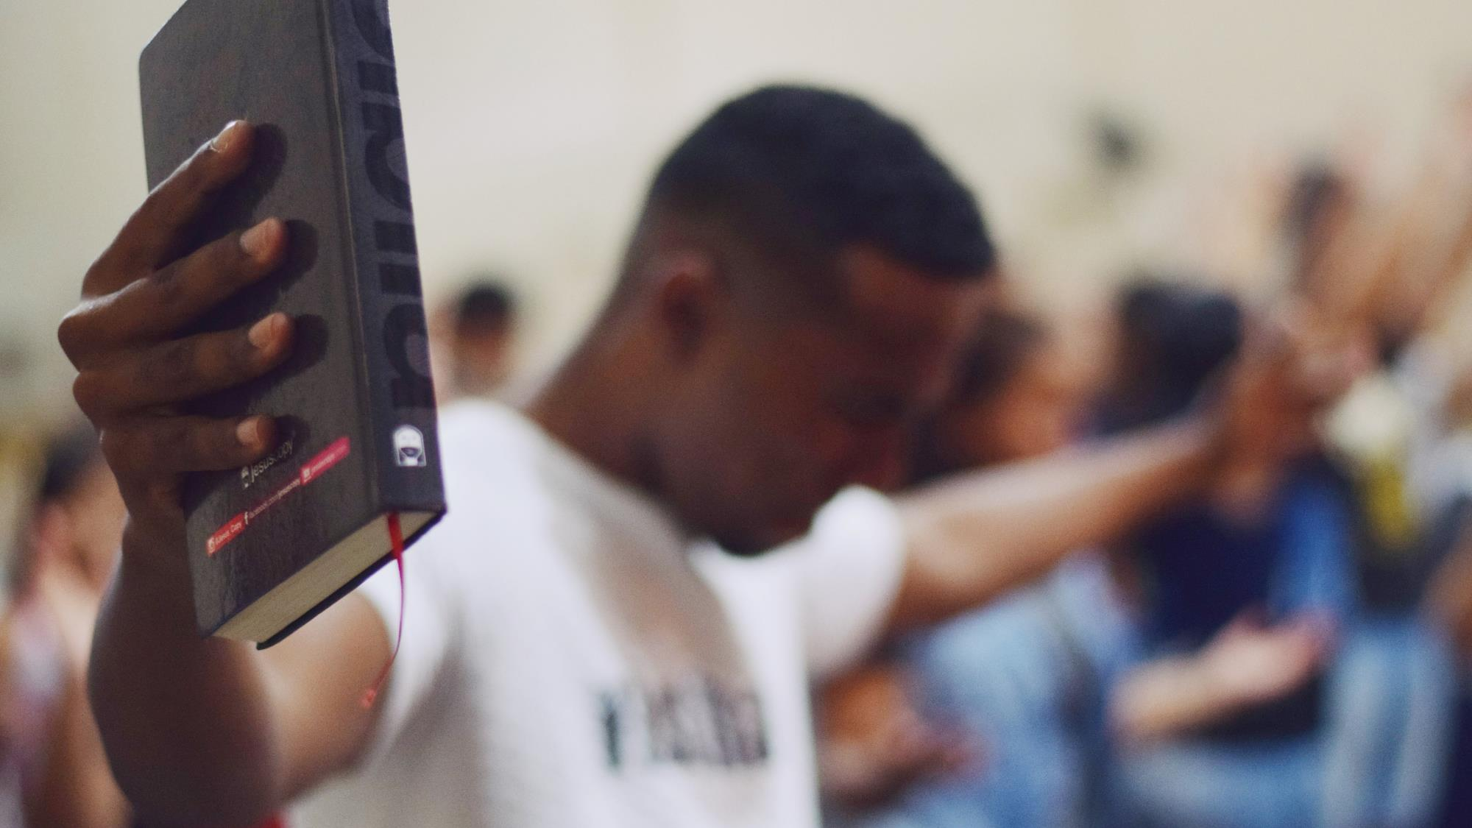
HEAL ME LORD, AND I WILL BE HEALED;
SAVE ME AND I WILL BE SAVED,
FOR YOU ARE THE ONE I PRAISE.
JEREMIAH 17:14
Photo by Igor Rodrigues on Unsplash

Slide 3
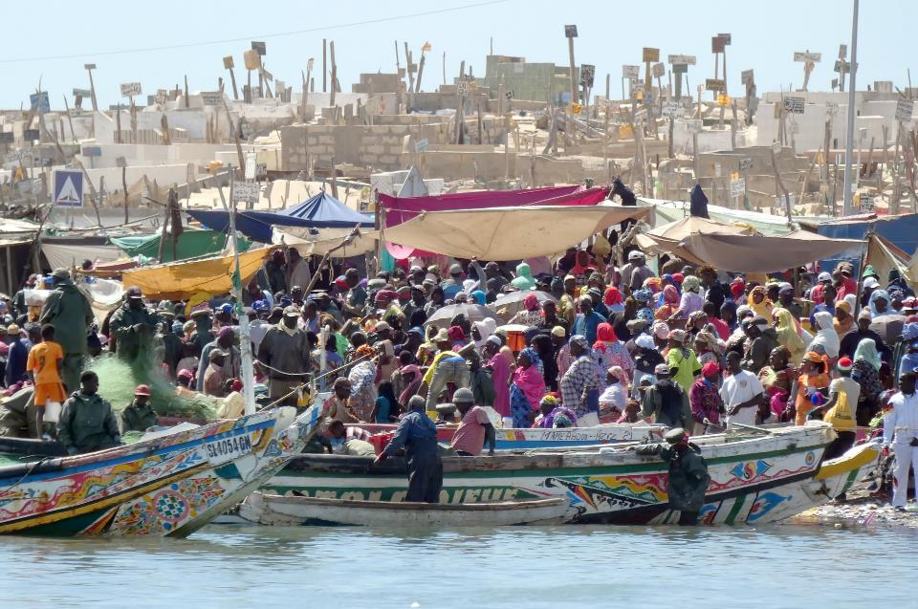
COMMUNITIES WHERE CHRIST IS LEAST KNOWN
THE WOLOF
There are five million Wolof in Senegal.
Only 300 follow Jesus.
The rest follow Islam. Most commonly a form of folk Islam.
https://pixabay.com/photos/senegal-st-louis-market-fish-crowd-4613072/

Slide 4
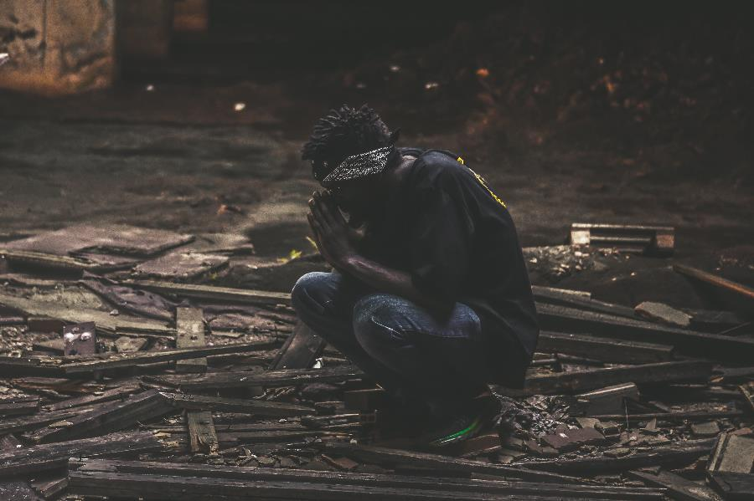
COMMUNITIES WHERE CHRIST IS LEAST KNOWN
THE WOLOF
There is a saying in Senegal that to be Wolof is to be Muslim.
Those who have decided to follow Christ face persecution.
At times this is physical, but it regularly social when they are excluded from their communities.

Slide 5
PRAY WITH THE TEAM
That many Wolof will come to believe in Jesus, and for strong Wolof churches to grow.
Many are attracted to the gospel but find the idea of leaving their religion to be overwhelming. Pray for Spirit’s work in their lives.

Slide 6
PRAY WITH THE TEAM
For Wolof Christians to persevere and witness, so that their faithfulness to Christ may point many others to Him.
That the LORD will give the SIM Senegal team wisdom; that He will bless and use each ministry.
For God to answer prayers for both physical and spiritual healing among the Wolof.

Slide 7
THANK YOU FOR YOUR PRAYERS
For more information, prayer resources, or if you are interested in serving, please visit sim.co.uk

