Slide 1
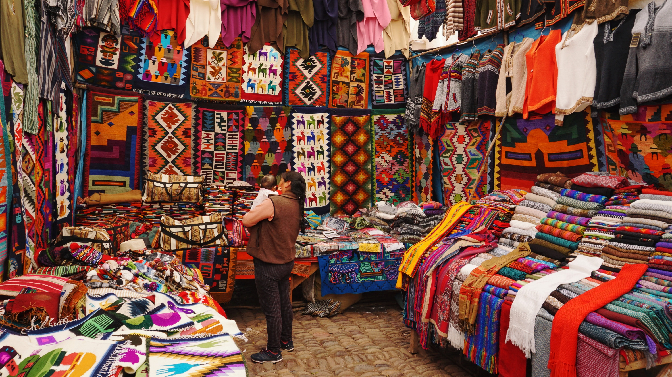
Pray for Peru
Image by Peter Livesey

Slide 2
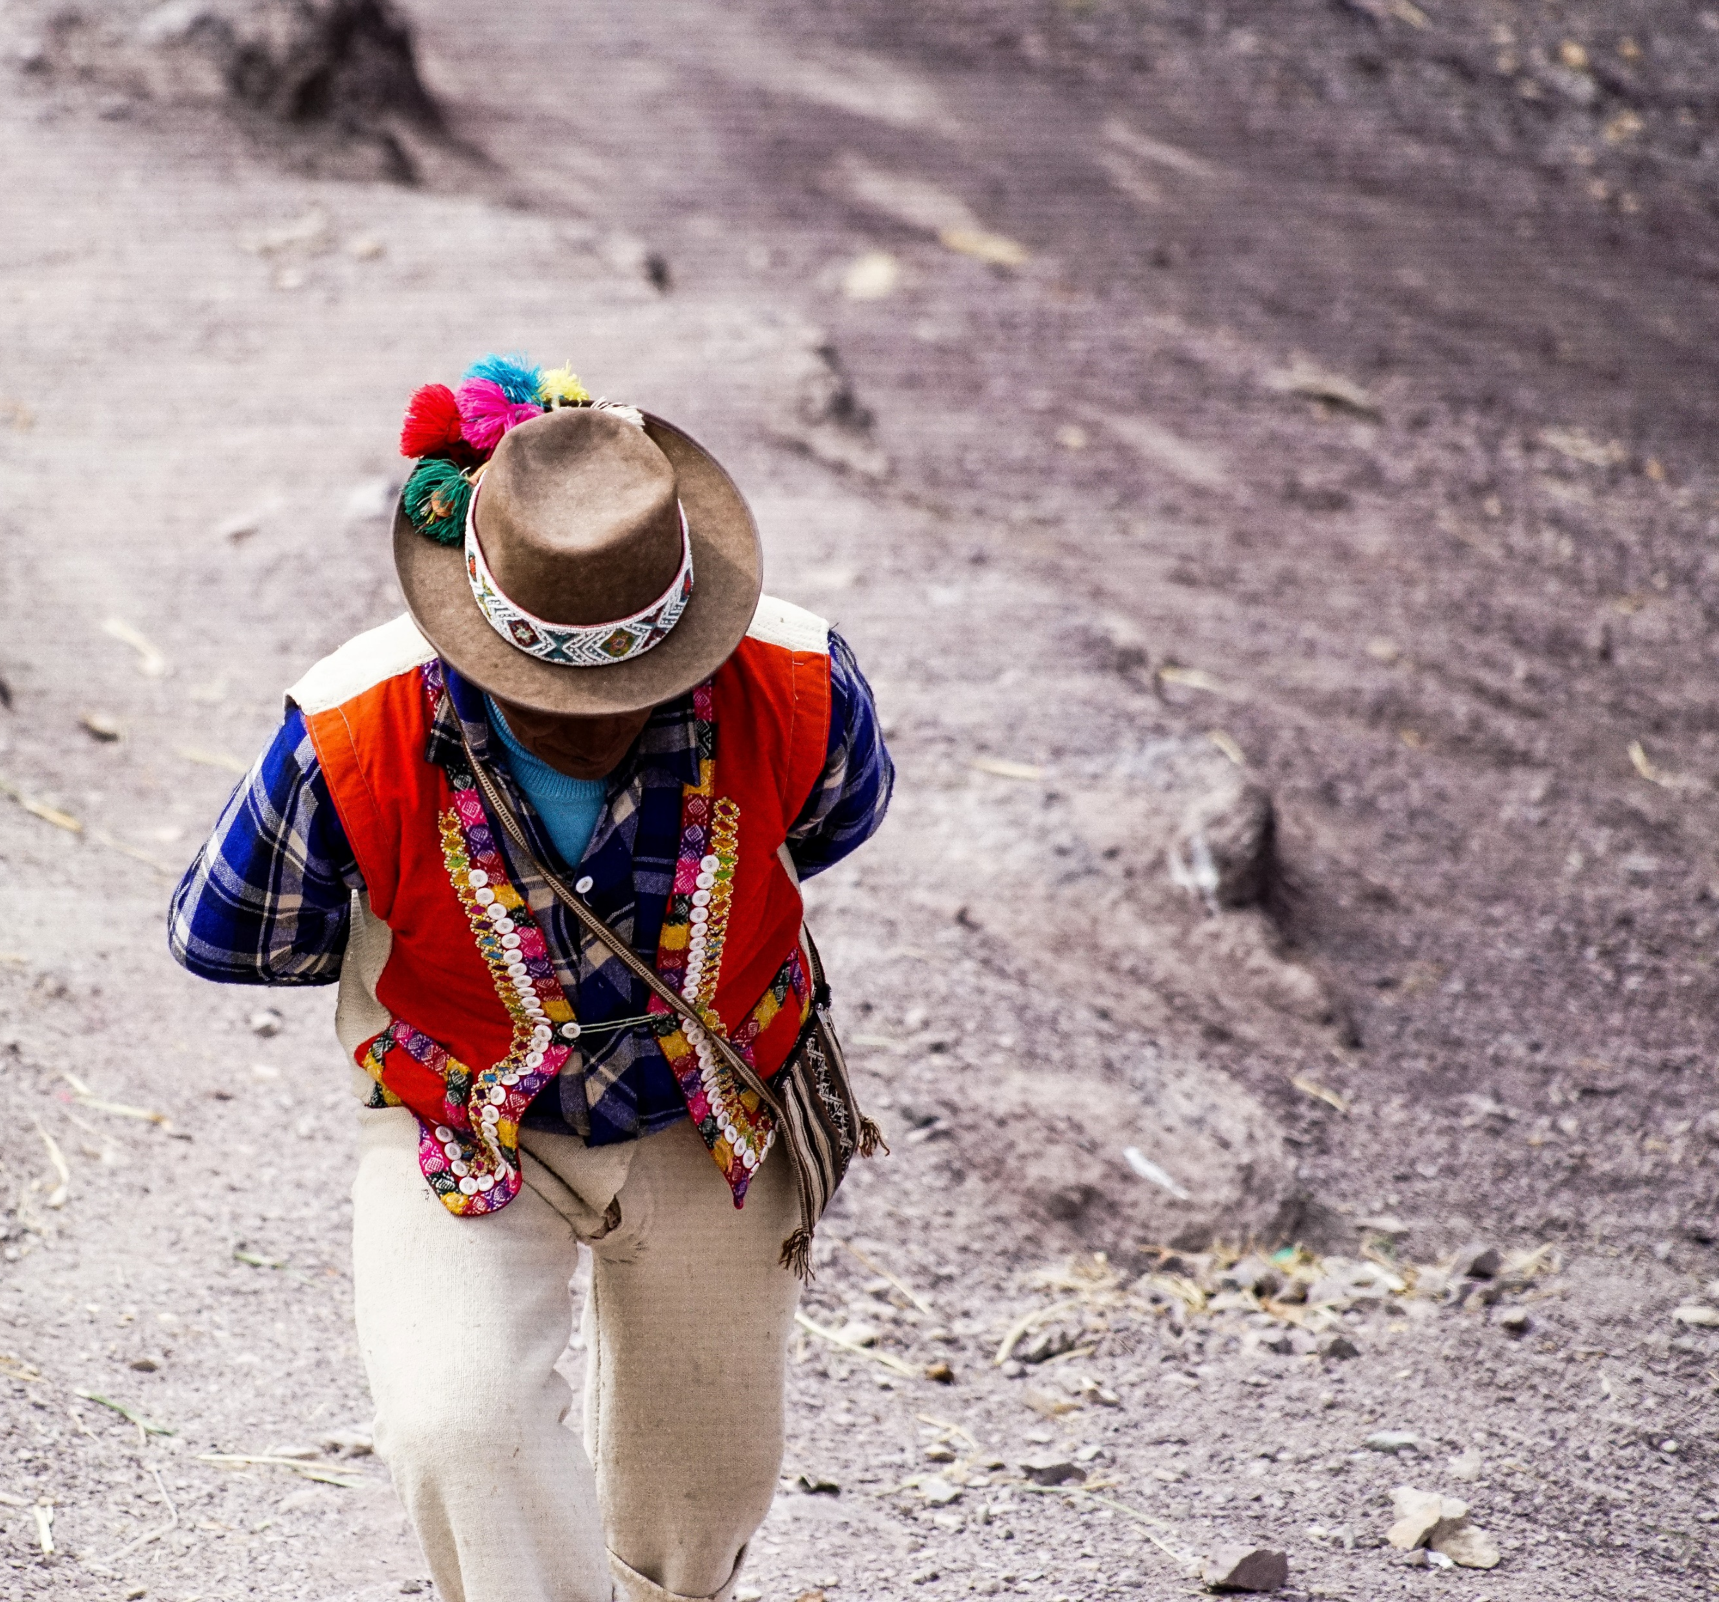
For we are God’s handiwork, created in Christ Jesus to do good works, which God prepared in advance for us to do.
Ephesians 2:10
Photo by Frederico Scarionati

Slide 3
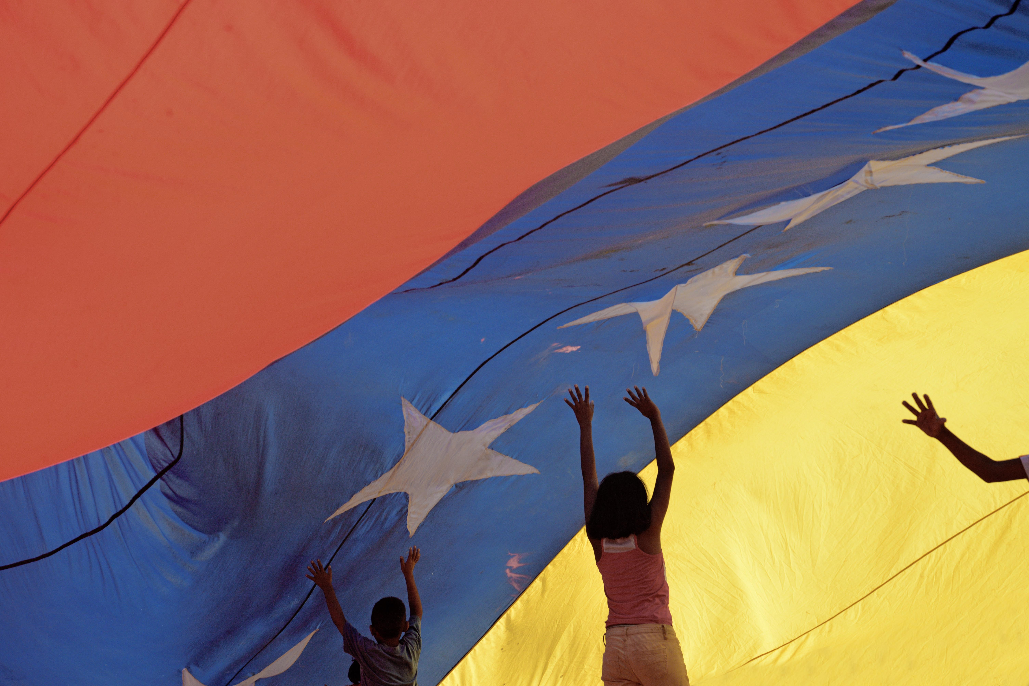
Pray for communities where Christ is least known
Venezuelan refugees in Arequipa
There are at least 12,000 Venezuelan refugees living in Arequipa, due to economic problems in Venezuela.
Living conditions are difficult. Before COVID-19, many sold
sweets or plastic bags on the street.
On 16 March 2020, Peru declared a state of emergency
due to COVID-19 and put in place a strict quarantine.
People were only allowed out of their residences if they
were buying food, getting medicine, or seeking medical
attention. Overnight, the income of those who live day-to-
day selling goods was slashed.
Photo by Ronal Labrador

Slide 4
Pray for communities where Christ is least known
Venezuelan refugees in Arequipa
Our team has been partnering with a local church and
a group of Venezuelan Christians to provide emergency
food relief to those now without income due to the
quarantine.
In the first week of this relief project, we created 150 packages of food with a message of God’s love. By summer, we were making over 800 packages each week.
Through these packages, many have become open to hearing about the gospel. Our team is finding ways to continue ministry among refugees on a longer term basis
Photo by Ronal Labrador

Slide 5
Pray for communities where Christ is least known
PLEASE PRAY FOR
Wisdom for those leading the refugee food aid project, and for God to continue to provide all that is needed for the program to continue.
That the recipients might be open to hearing of God’s love for them.
Guidance on how this ministry can grow beyond the COVID-19 crisis.
The raising up of godly and faithful leaders in the Peruvian church, and for the ministry of theological education in training and equipping these leaders.
The many Peruvians who are getting to know Christ through our ministries, that they will grow in their faith and become steadfast and responsible leaders whose lives will be testimonies in their communities.

Slide 6
Thank you for your prayers
For more information, prayer resources, or if you are interested in serving, please visit sim.co.uk

