Slide 1
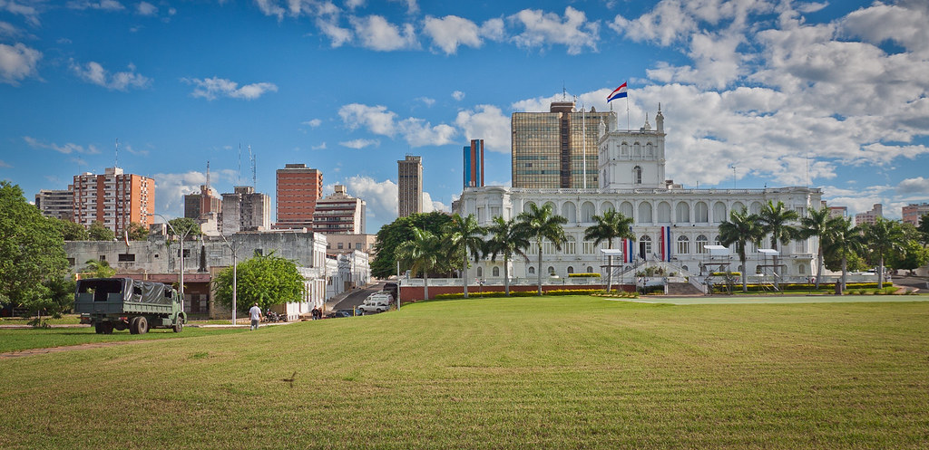
PRAY FOR PARAGUAY

Slide 2
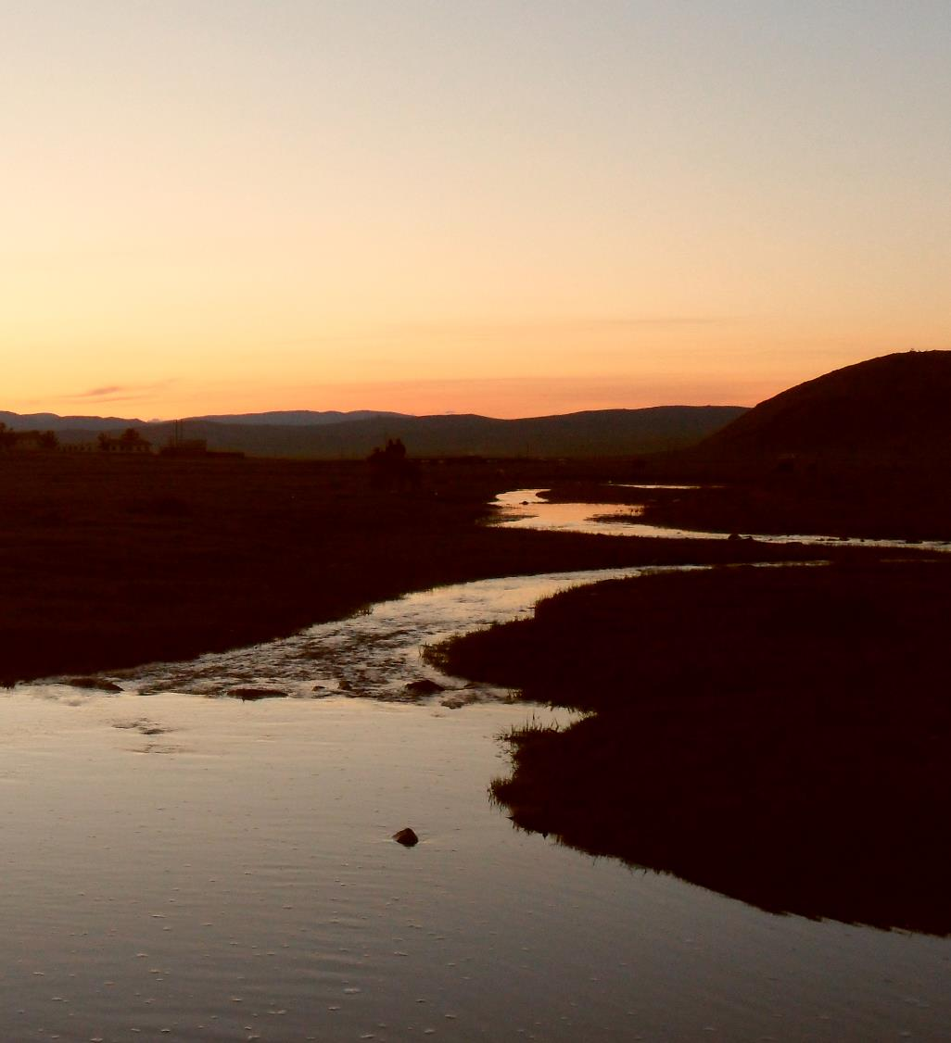
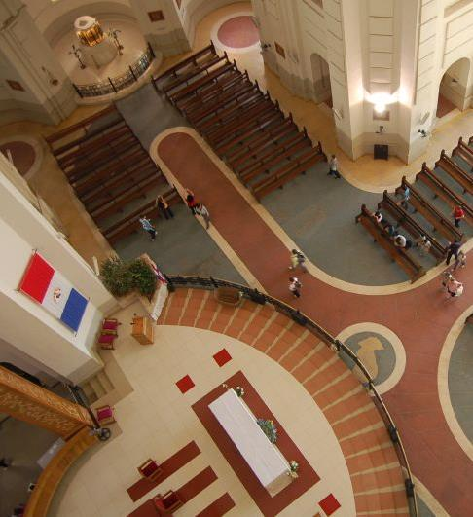
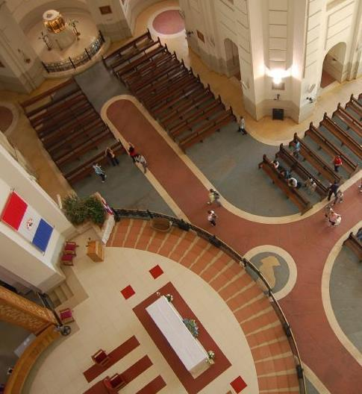
For Christ’s love compels us, because we are convinced that one died for all, and therefore all died.
2 Corinthians 5:14

Slide 3
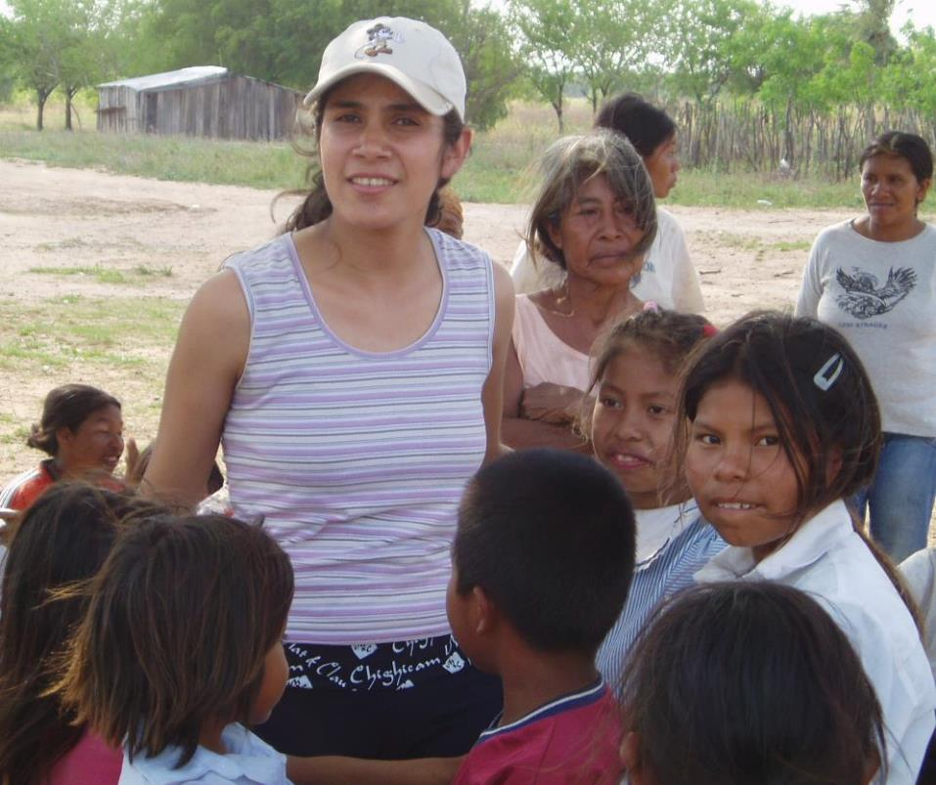
As a multi-skilled ministry team, SIM Paraguay:
share the gospel message.
train believers to serve and lead local churches.
help churches send his people to where he is calling them to serve.

Slide 4
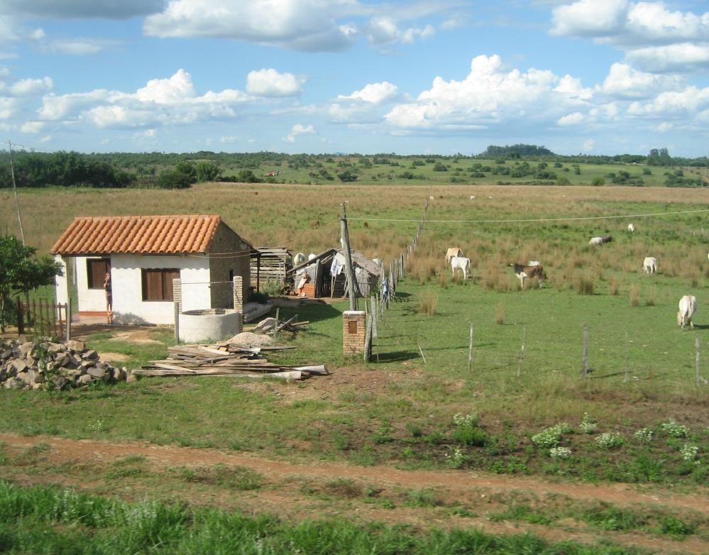
COMMUNITIES WHERE CHRIST IS LEAST KNOWN
Rural farmers
Nearly half of Paraguay’s population are rural farmers. They are oral learners in the Guaraní language.
SIM Paraguay are placing missionaries where Bible-teaching churches do not yet exist to build relationships and serve community needs.

Slide 5
COMMUNITIES WHERE CHRIST IS LEAST KNOWN
Rural farmers
Using oral methods, church planting teams can evangelise, disciple and train church leaders.

Slide 6
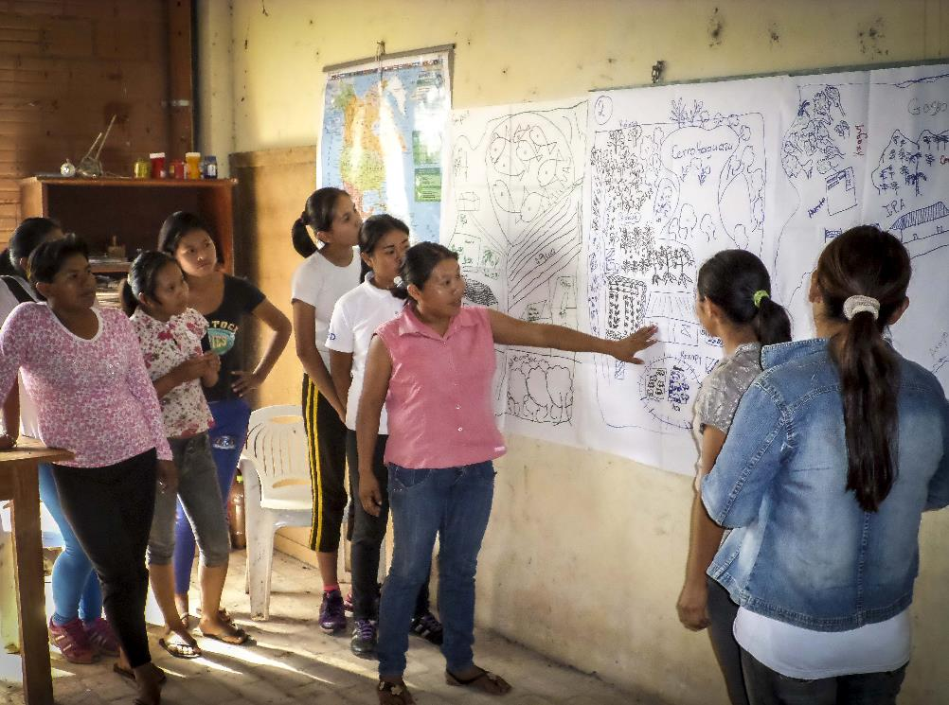
COMMUNITIES WHERE CHRIST IS LEAST KNOWN
Young churches with young faith
Half of Paraguay’s population are under 20 years old.
Many evangelical churches are no older.

Slide 7
COMMUNITIES WHERE CHRIST IS LEAST KNOWN
Young churches with young faith
It is critical that these young churches are equipped to teach and disciple the next generation.
SIM Paraguay is training church leaders in youth and camp ministry.

Slide 8
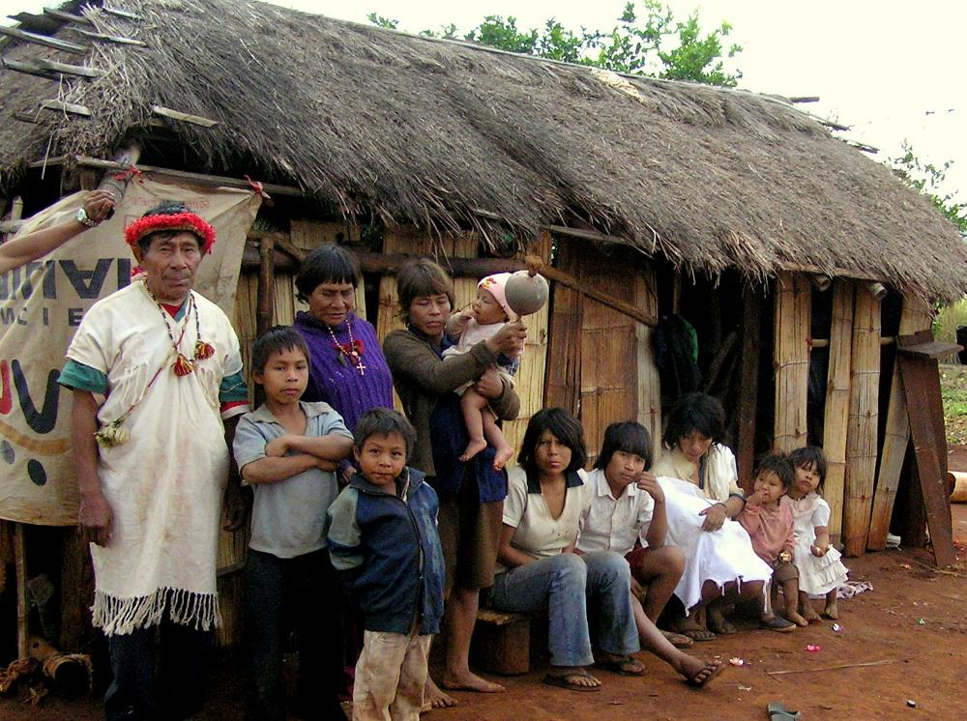
COMMUNITIES WHERE CHRIST IS LEAST KNOWN
Indigenous communities
People belonging to most of the indigenous groups in Paraguay live and die with almost no access to God’s good news.

Slide 9
COMMUNITIES WHERE CHRIST IS LEAST KNOWN
Indigenous communities
SIM Paraguay is:
partnering with other missions to record scriptures in the heart languages of these communities.
sending ministry teams to disciple and train believers.

Slide 10
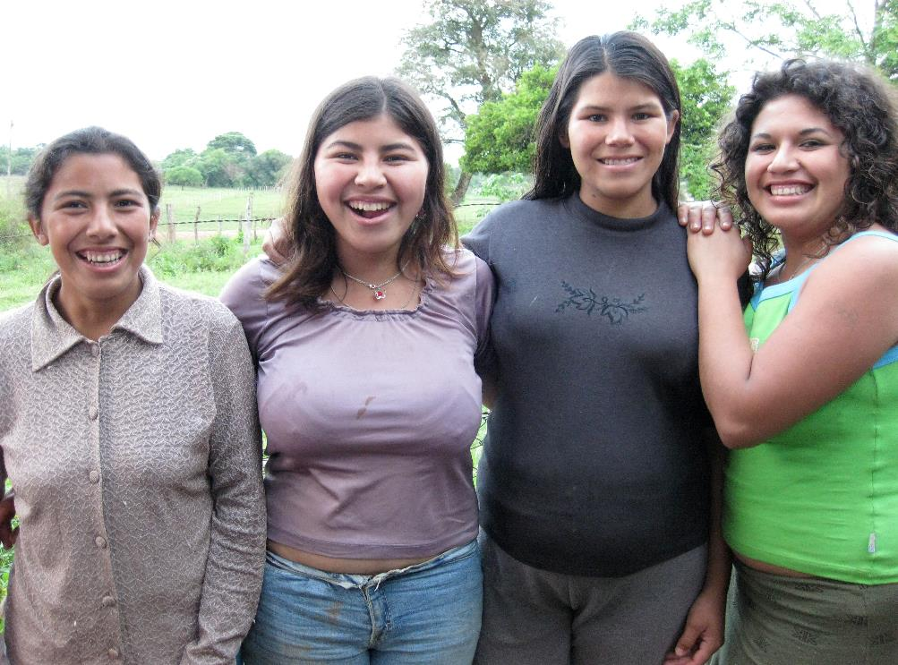
PRAYER REQUESTS FROM OUR SIM TEAM
Please pray…
Ministry teams to demonstrate God’s love for all.
effective conversations, teaching and training within young rural churches.

Slide 11
PRAYER REQUESTS FROM OUR SIM TEAM
Please pray…
Paraguayan believers to be equipped to lead others.
the sending of future Paraguayan missionaries to other countries.

Slide 12
MINISTRIES IN PARAGUAY:
Rural church planting
Youth ministry
Multimedia production
Education
Leadership training
Rural medical care
First Nations (indigenous peoples) ministry
Missionary services

Slide 13
Thank you for your prayers
For more information, prayer resources, or if you are interested in serving, please visit sim.co.uk

