Slide 1
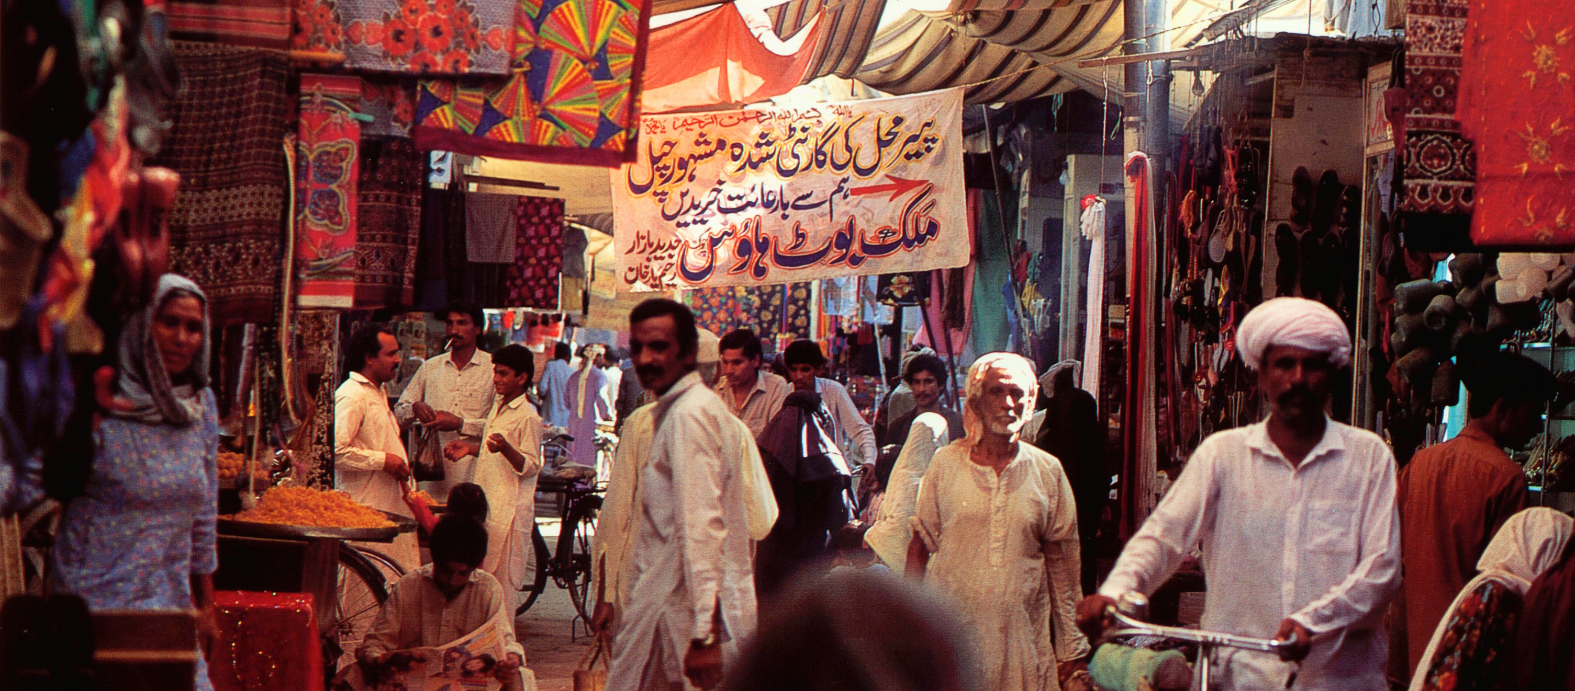
PRAY FOR PAKISTAN

Slide 2
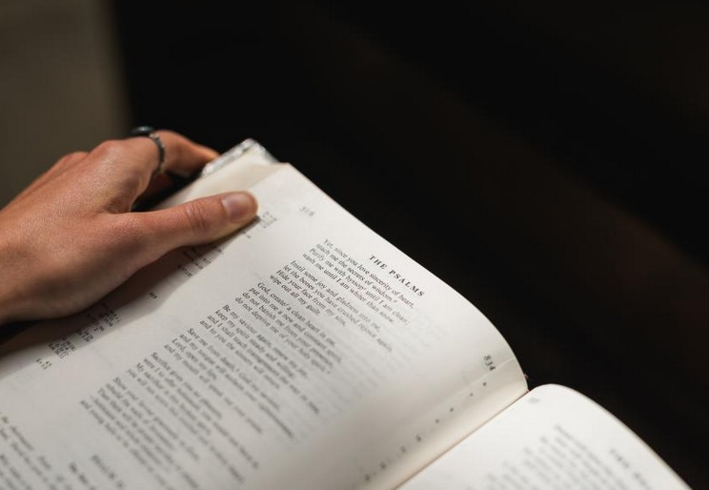
May God be gracious to us and bless us and make his face shine on us — so that your ways may be known on earth, your salvation among all nations. Psalm 67: 1-2

Slide 3
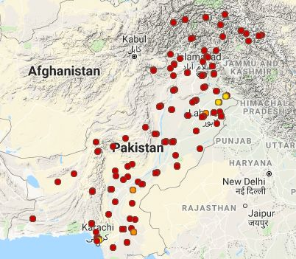
In Pakistan, there are 416 people groups.
Of these, 408 have not heard or responded to the gospel message.
Joshua project

Slide 4
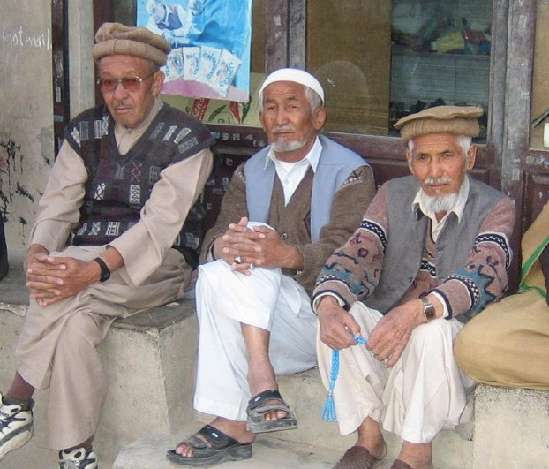
COMMUNITIES WHERE CHRIST IS LEAST KNOWN
The Hazara people, Quetta
They are believed to be of Mongol descent, with a population of 124,000. Most are Shia Muslims and have suffered greatly from terrorist attacks. They place a great importance on education.

Slide 5
COMMUNITIES WHERE CHRIST IS LEAST KNOWN
Prayer…
Praise God that some Pakistani Christians are reaching out to this community, which is currently difficult for our non-Pakistani workers to visit.

Slide 6
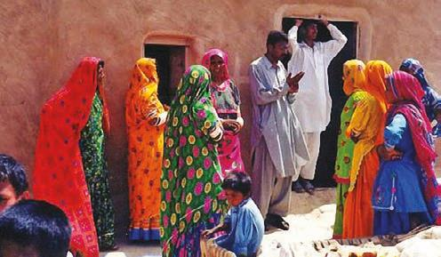
COMMUNITIES WHERE CHRIST IS LEAST KNOWN
Marwari Bhil and Mengwal peoples
They are predominantly Hindu with a population of 459,000. The Mengwal and Marwari Bhil are subsistence farmers with poor social standing and have limited access to education, health facilities and water

Slide 7
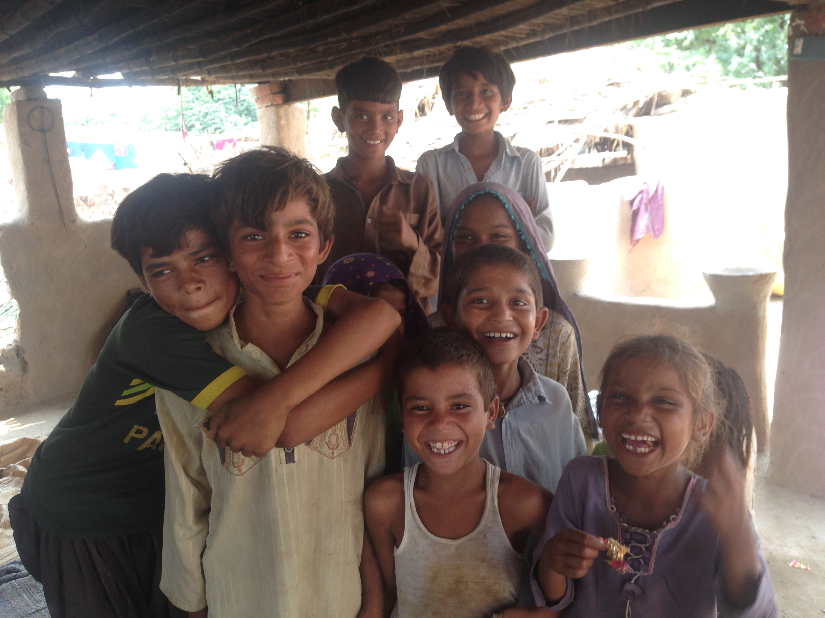
COMMUNITIES WHERE CHRIST IS LEAST KNOWN
Please pray…
Give thanks that, in recent years, the SIM team has seen increasing spiritual growth from their work which began in the 1960s. The number of small house churches has grown significantly.

Slide 8
COMMUNITIES WHERE CHRIST IS LEAST KNOWN
Please pray…
Pray for the house church leaders who are being trained.
In vast areas, people have still not heard of Jesus Christ. Pray for more workers.

Slide 9
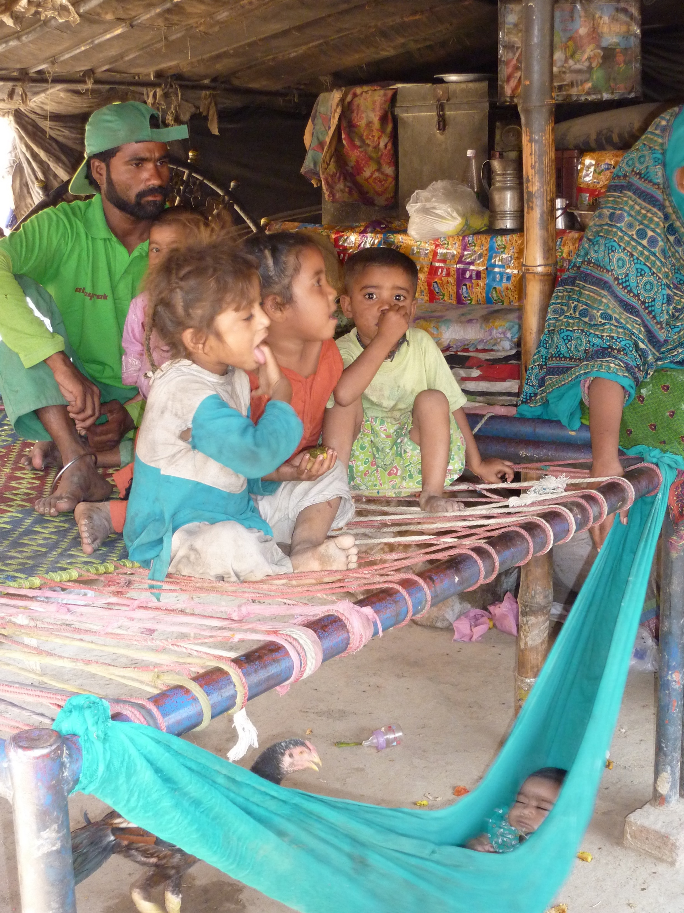
COMMUNITIES WHERE CHRIST IS LEAST KNOWN
The Gypsies of Lahore
Their population is about 500,000. They often live on the edge of society in tents making a living collecting rubbish. Parents do not want to send their children to school, because they prefer them to earn money for the family.

Slide 10
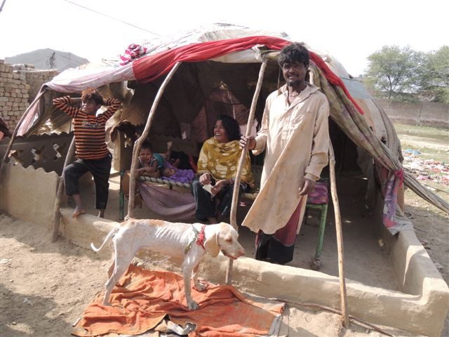
Communities where Christ is least known
The Gypsies of Lahore
Praise God that through SIM’s partner ministry, many young people are attending Sunday school and learning God’s word.

Slide 11
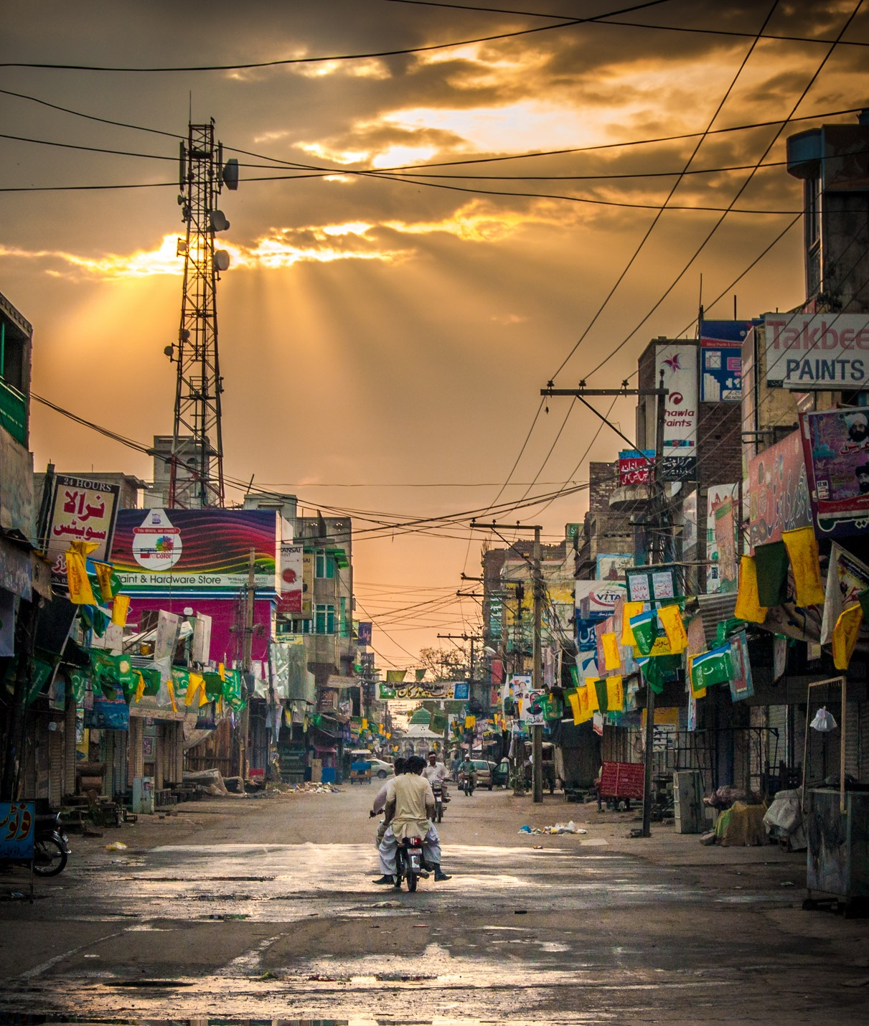
PRAYER REQUESTS FROM THE SIM TEAM
Visas for new personnel, and for visa renewals.
Further development of the current and future leadership.
The ongoing training of Christian leaders.
People from all ethnic backgrounds to know Jesus Christ.
Photo credit: http://bit.ly/2GEewXy

Slide 12
PRAYER REQUESTS FROM THE SIM TEAM
Our involvement in supporting church ministries and outreach.
Our teams to have power and wisdom from the Holy Spirit.
Integrity and wisdom for government officials.
Those suffering through poverty, injustice and terrorism.
Photo credit: http://bit.ly/2GEewXy

Slide 13
Thank you for your prayers
For more information, prayer resources, or if you are interested in serving, please visit sim.co.uk

