Slide 1
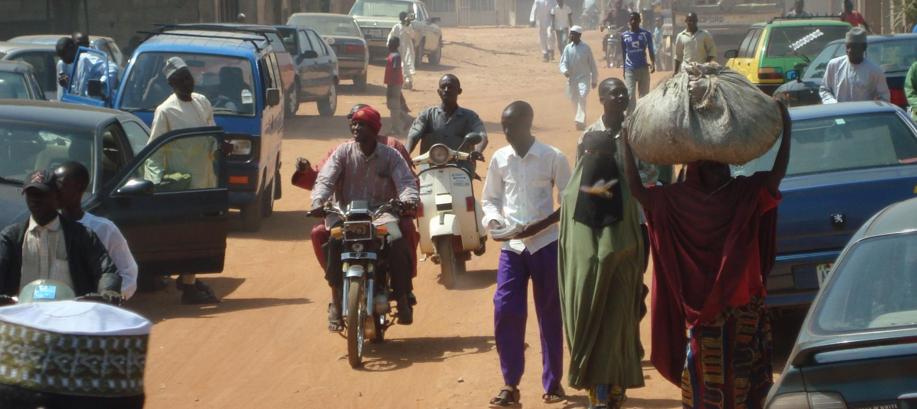
PRAY FOR NIGERIA

Slide 2
As long as it is day, we must do the works of him who sent me. Night is coming, when no one can work.
John 9:4

Slide 3
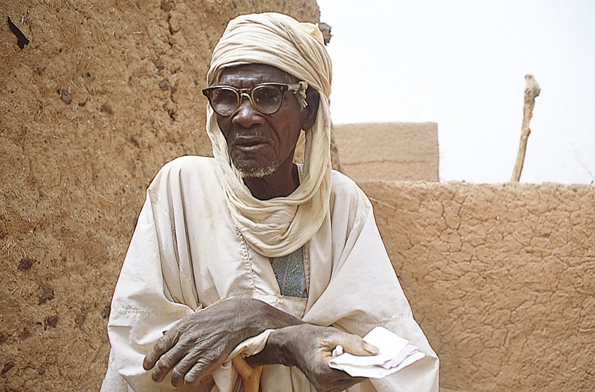
There are more than 75 million Muslims in Nigeria most of whom have not heard a clear gospel message.

Slide 4
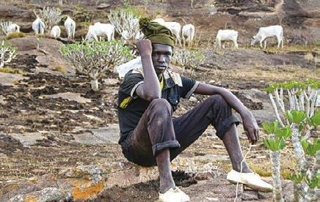
COMMUNITIES WHERE CHRIST IS LEAST KNOWN
Fulani
There are 16 million Fulani in Nigeria.
Most are Muslim.
May are open to friendship evangelism and Christian media.
Attacks by some Fulani herdsmen against Christian farmers have affected attitudes toward this people group.

Slide 5
COMMUNITIES WHERE CHRIST IS LEAST KNOWN
Please pray for…
More mission workers.
Christians to reach out to this community in love instead of retaliation.
Opportunities to support and disciple Fulani believers.

Slide 6
COMMUNITIES WHERE CHRIST IS LEAST KNOWN
Marginalised and vulnerable
SIM Nigeria ministers to youth, orphans, widows and those with disabilities.
Pray as they look to expand these ministries into the north where resources are limited and few trained workers reside.

Slide 7
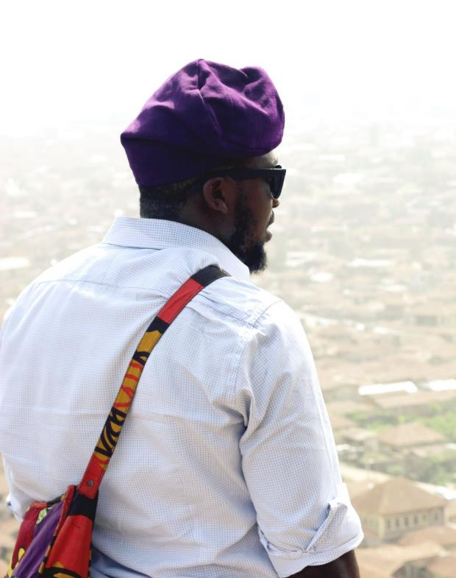
PRAYER REQUESTS FROM THE SIM TEAM
Please pray for:
The national Church to intensify its efforts to reach Muslims in the north while the door is open (John 9:4)
More workers
Muslims to be receptive to the gospel and for the discipleship of new Christians with a Muslim background.
The formation of new missionary teams with suitable team leaders to begin ministry in northern cities.
Our internship programme to yield lasting fruit for world missions.

Slide 8
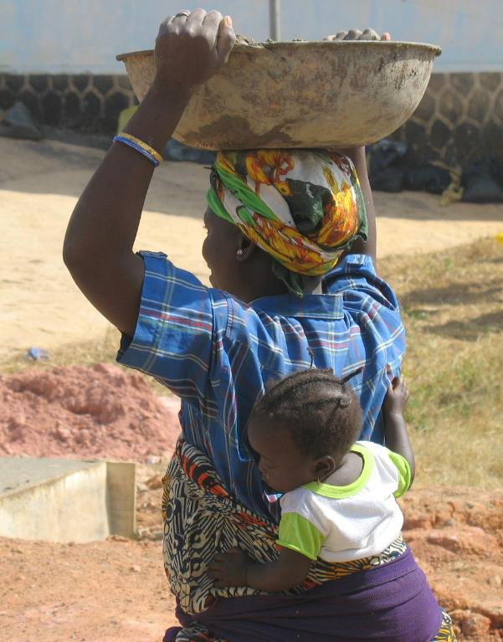
PRAYER REQUESTS FROM THE SIM TEAM
Please pray for:
Community rebuilding efforts in the northeast, a region impacted by violence.
Peace and stability in troubled regions.
Persecuted believers to endure hardship and practice love and forgiveness.
Effective and expanded ministries to widows, orphans, people with disabilities, the abused, and other vulnerable communities.
The Nigerian church to experience a powerful, Spirit-led revival.

Slide 9
Thank you for your prayers
For more information, prayer resources, or if you are interested in serving, please visit sim.co.uk

