Slide 1
PRAY FOR NIGER

Slide 2
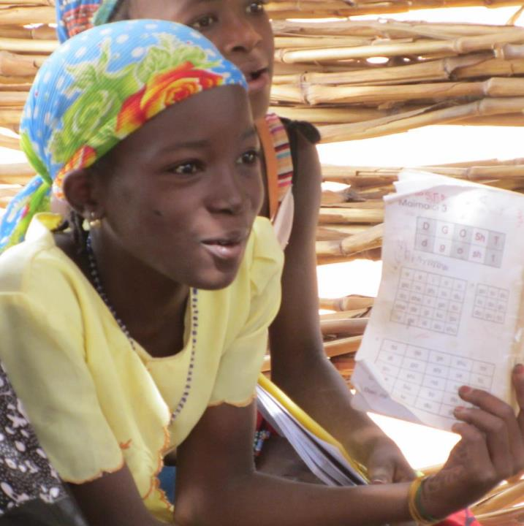
And who through the Spirit of holiness was appointed the Son of God in power by his resurrection from the dead: Jesus Christ our Lord. Through him we received grace and apostleship to call all the Gentiles to the obedience that comes from faith for his name’s sake.
Romans 1:4–5

Slide 3
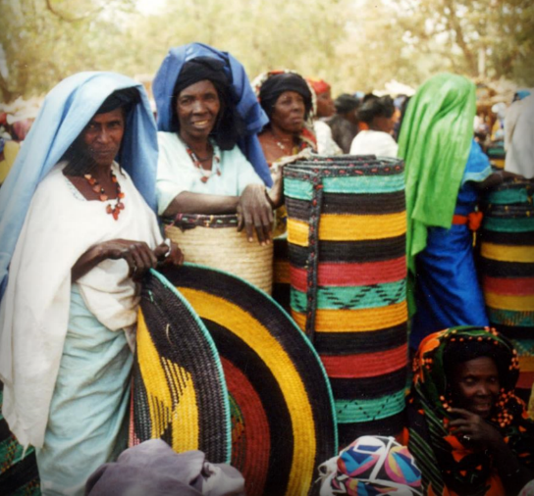
COMMUNITIES WHERE CHRIST IS LEAST KNOWN
Our vision
God has called SIM to help bring the message of salvation to Niger.
We are convinced that the gospel sets us free and no one should live and die without hearing the good news.
More than 17 million people are living and dying without Christ in Niger.
Are you called to serve within a diverse ministry team and help bring this life-changing message to Niger?

Slide 4
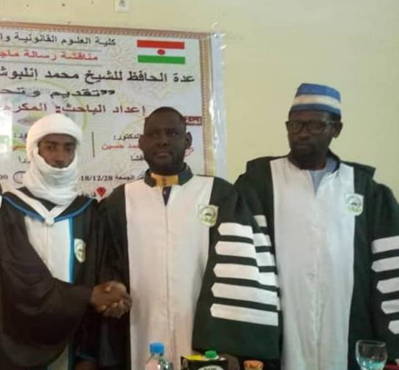
COMMUNITIES WHERE CHRIST IS LEAST KNOWN
University Students
Students at the Nigerien national university are open to new ideas and philosophies during their university years.
Several missionaries have Bible studies with groups of university students and churches are also seeking to include students in their activities and outreach.

Slide 5
COMMUNITIES WHERE CHRIST IS LEAST KNOWN
University Students
The Foyer Evangélique Universitaire (FEU):
Provides students with a quiet place to study and to access educational resources otherwise not available to them.
Hosts special evenings where students can learn more about a topic of interest and the gospel is presented.
Teaches English to students, which helps them develop the skills to understand online resources, which are often in English.
Runs a cooking class for female students.

Slide 6
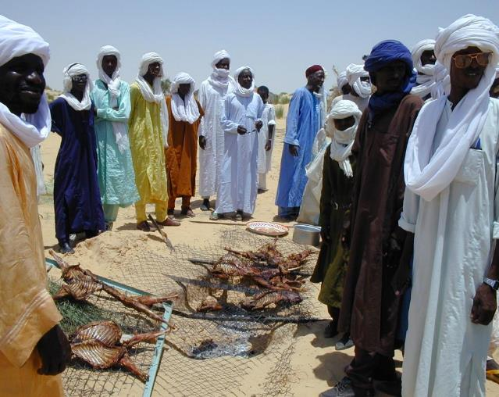
PRAYER REQUESTS FROM OUR SIM TEAM
The Songhai-Zarma, Fulani, Tamajaq, Hausa, Manga, Arab and Daza are all people groups in Niger where there is little or no witness to the gospel. Please pray that many will hear of the good news, and that the gospel will take root in their hearts.
Please pray for students who visit the FEU to be open to accepting Jesus as their Saviour. Pray that the Holy Spirit will speak through the Bible studies and for more local churches to reach out to university students.

Slide 7
PRAYER REQUESTS FROM OUR SIM TEAM
Please pray for the widows who are helped through the Dorcas Project. Many were left without income when their husbands passed away. Pray that the women’s small businesses will succeed and provide sufficient income for their families.

Slide 8
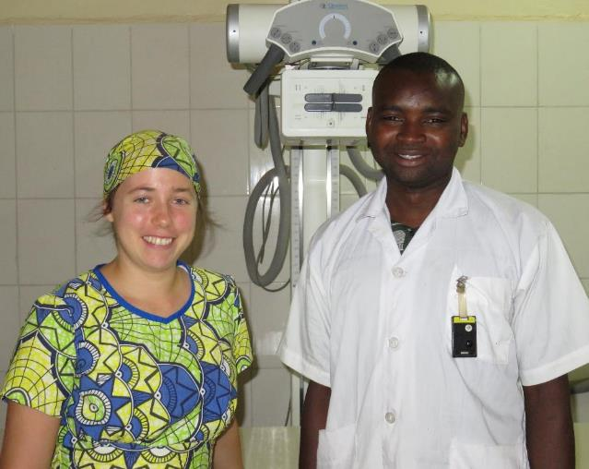
PRAYER REQUESTS FROM OUR SIM TEAM
Please pray for more administrative and management personnel to join our team. This includes directors for CSL, DFC and Sahel Academy, a finance manager for Galmi Hospital, facilities managers for CSL- DFC, Galmi Hospital and Sahel Academy, and a second treasurer for SIM Niger.
Pray for Nigerien evangelists working in very difficult places on very small incomes. Pray that they can find secondary sources of income to provide for their families and for their protection in the towns where they work.

Slide 9
PRAYER REQUESTS FROM OUR SIM TEAM
Please pray for patients at our three medical centres; that they will hear the good news and follow Jesus. Pray for courage when they return to their villages. Pray that follow-up visits can be made to former patients who are now believers.

Slide 10
Thank you for your prayers
For more information, prayer resources, or if you are interested in serving, please visit sim.co.uk

