Slide 1
PRAY FOR THE MIDDLE EAST

Slide 2
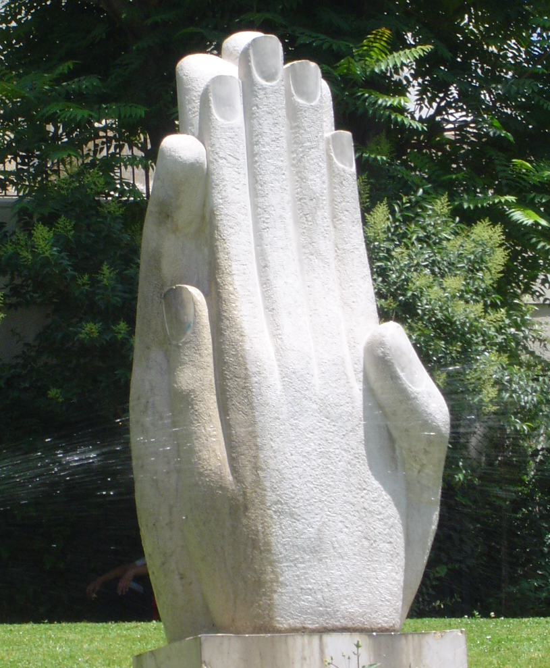
Devote yourselves to prayer, being watchful and thankful. And pray for us, too, that God may open a door for our message, so that we may proclaim the mystery of Christ, for which I am in chains.
Colossians 4:2-3

Slide 3
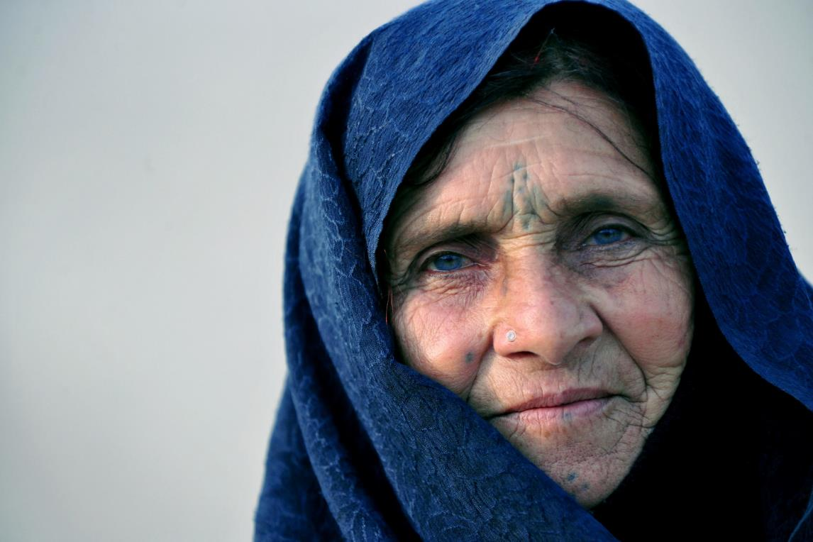
The vision of SIM Middle East is to see our region transformed by the love of Christ through the message of the gospel.
We encourage and partner with Middle Eastern Christians as they minister to their neighbours with the love and the hope of the cross.

Slide 4
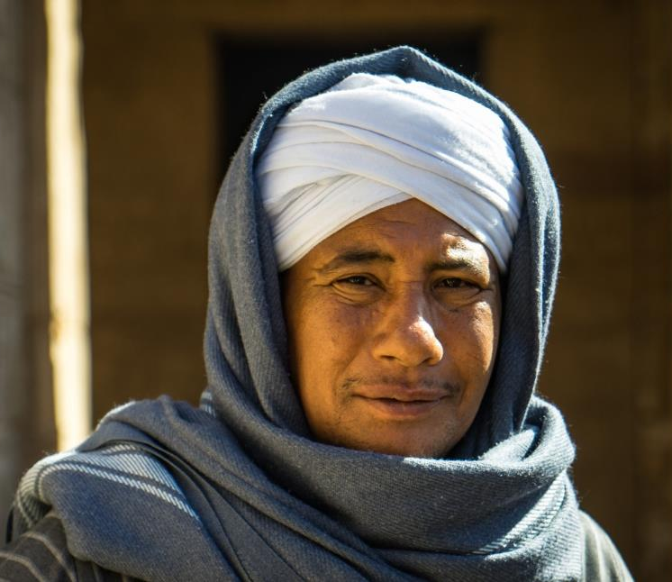
COMMUNITIES WHERE CHRIST IS LEAST KNOWN
Majorities
Islam is the majority religion. Economic and political turmoil, conflict and pandemic are prompting many to ask questions – they need to connect with scripture and with Christians can explain it to them.

Slide 5
COMMUNITIES WHERE CHRIST IS LEAST KNOWN
Majorities
Pray that believers will be bold in sensitively answering and discipling those who are seeking.
Give thanks for satellite, internet, print and church initiatives which support the vital witness of national believers.

Slide 6
COMMUNITIES WHERE CHRIST IS LEAST KNOWN
Refugees
Regional conflicts and economic challenges have prompted huge movements of refugees. Displaced people are in every area, and impact every ministry.
Churches are responding with practical assistance and trauma support, and by affirming dignity and providing spiritual nurturing.

Slide 7
COMMUNITIES WHERE CHRIST IS LEAST KNOWN
Please pray
Pray for justice, an end to conflict and for the displaced to be able to return to their homes.
Pray for persistence in compassion. And give thanks that as churches reach out, many are responding to Christ’s love.

Slide 8
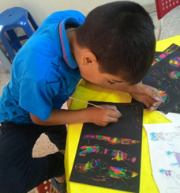
COMMUNITIES WHERE CHRIST IS LEAST KNOWN
Young People
Around one third of all people in the Middle East are under the age of 15. For the young people of the region, questions of identity, meaning and opportunity are increasingly complex.

Slide 9
COMMUNITIES WHERE CHRIST IS LEAST KNOWN
Please pray
Give thanks for church programmes and online initiatives for children and young people, and for Christian schools and education programmes.
Pray for young people of the Middle East to find hope, identity and security in Christ.

Slide 10
COMMUNITIES WHERE CHRIST IS LEAST KNOWN
Vulnerable and marginalised people
Refugees are not the only vulnerable people in the Middle East. Those with disabilities often face restricted opportunity. Many migrant workers routinely face abuse and unjust treatment. And growing economic hardship and inequality are driving more to the margins of society.

Slide 11
COMMUNITIES WHERE CHRIST IS LEAST KNOWN
Please pray
Pray for our colleagues who serve alongside Middle Eastern believers to bring hope to those who are vulnerable.
Pray that those who are marginalised will have their dignity affirmed in Christ and find life in him.

Slide 12
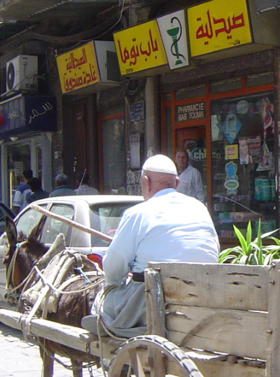
COMMUNITIES WHERE CHRIST IS LEAST KNOWN
Healthcare
Some of our colleagues serve in healthcare roles as we share Christ’s love in communities where he is least known. Many countries’ healthcare systems are stretched to breaking point, especially due to the pandemic and economic crisis.

Slide 13
COMMUNITIES WHERE CHRIST IS LEAST KNOWN
Please pray
Pray for more to come to serve in the region in medical and community healthcare roles.
As local and expatriate believers meet healthcare needs in their communities, pray that many they serve will encounter Jesus and find healing and wholeness in him.

Slide 14
COMMUNITIES WHERE CHRIST IS LEAST KNOWN
Education & Theological Training
As we partner with schools and education centres, we influence lives, share truth and bring hope.
And as we serve with theological study programmes, we equip local believers for ministry and church leadership.

Slide 15
COMMUNITIES WHERE CHRIST IS LEAST KNOWN
Please pray
Ask the Lord for more teachers who can reach out to people at all levels of society.
Pray for the witness of Middle Eastern churches to be strengthened through faithful ministry training.

Slide 16
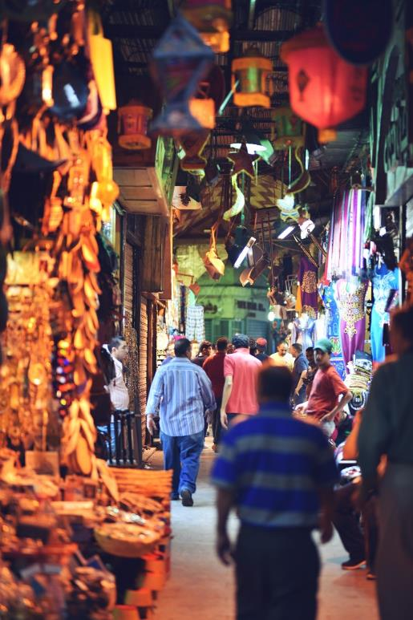
COMMUNITIES WHERE CHRIST IS LEAST KNOWN
Please pray for:
stamina and wisdom for local Christians witnessing to Christ under pressure
patience and wisdom as we negotiate visa and residency challenges
theological and practical ministry training to equip leaders to build Christ’s church in unsettled and sometimes volatile circumstances

Slide 17
COMMUNITIES WHERE CHRIST IS LEAST KNOWN
Please pray for:
people who will pray with and for Middle Easterners everywhere
flexible and godly people to respond to the Lord’s call to serve in the region
relationships with local leaders and networks, as we explore suitable opportunities to serve with them.

Slide 18
Thank you for your prayers
For more information, prayer resources, or if you are interested in serving, please visit sim.co.uk

