Slide 1
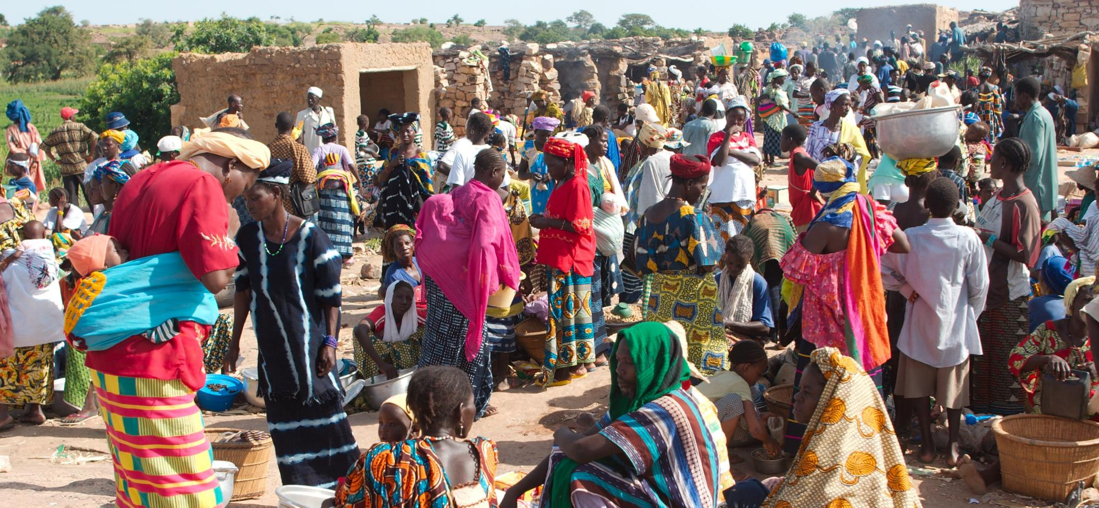
Join us in prayer for
MALI
Photo credit : http://bit.ly/2pyYmZW

Slide 2
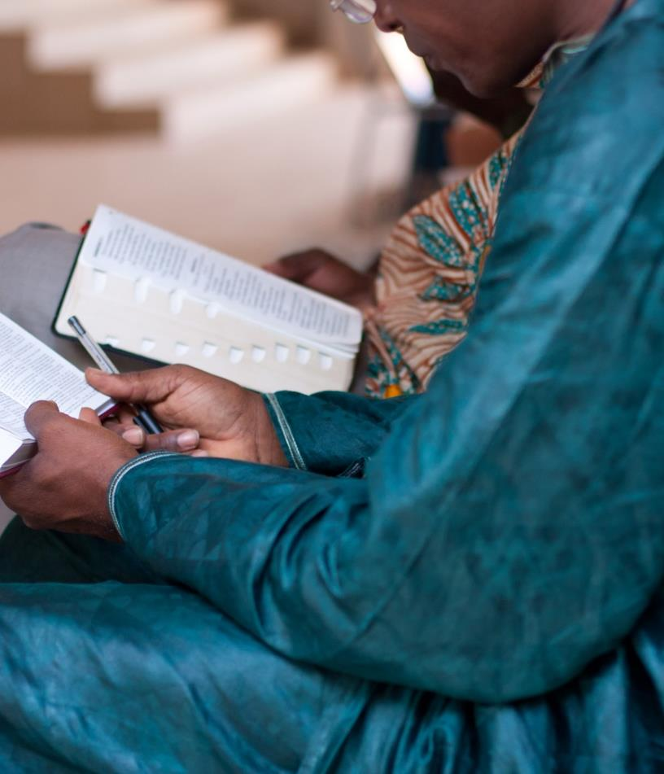
“For we are to God the pleasing aroma of Christ among those who are being saved and those who are perishing.” 2 Corinthians 2:15

Slide 3
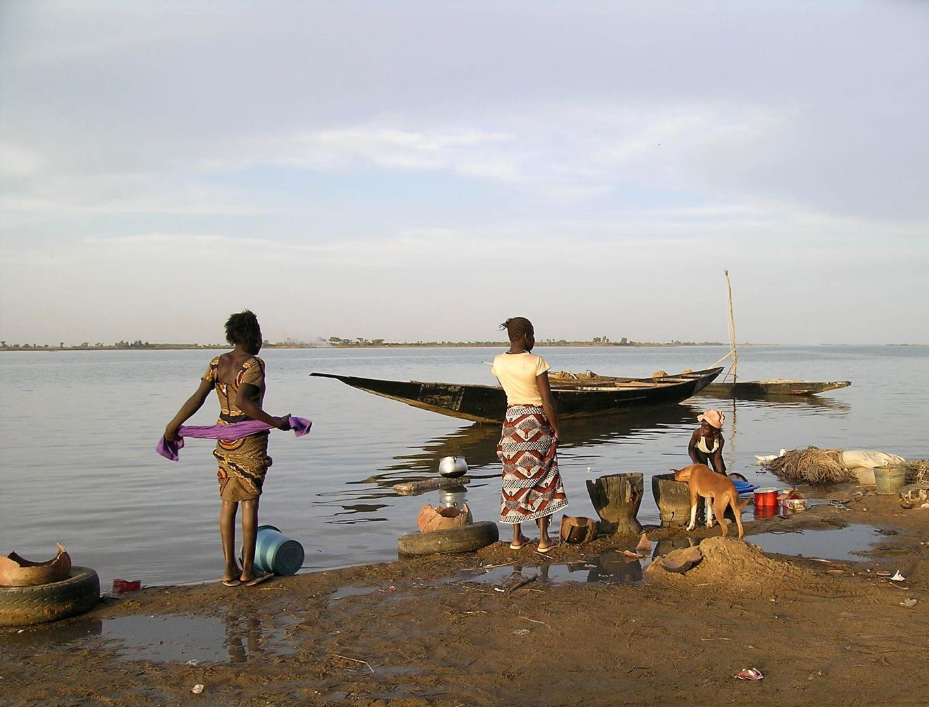
SIM Mali would love to see the transformation of communities, through planting churches where Christ is least-known and increasing the number of disciple-makers.
Photo credit: http://bit.ly/2ILNWOl

Slide 4
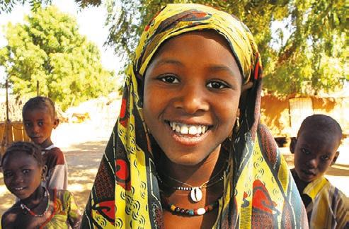
Pray for communities where
Christ is least known
THE MAURES (MOORS)
The Maures are 100 per cent Muslim
They live a nomadic lifestyle in tents and are a closed society
Their social structure divides them into two major groups - religious leaders and warriors

Slide 5
Please pray for the Maures
that the Lord will open the hearts of the Maure people to the love of Jesus Christ.
that the Lord will destroy the stronghold of Islam, mysticism, and animistic practices among the peoples in Mali.
for God’s leading and unity in decision-making as the Malian church and the SIM team reaching out to the Maure people work together.

Slide 6
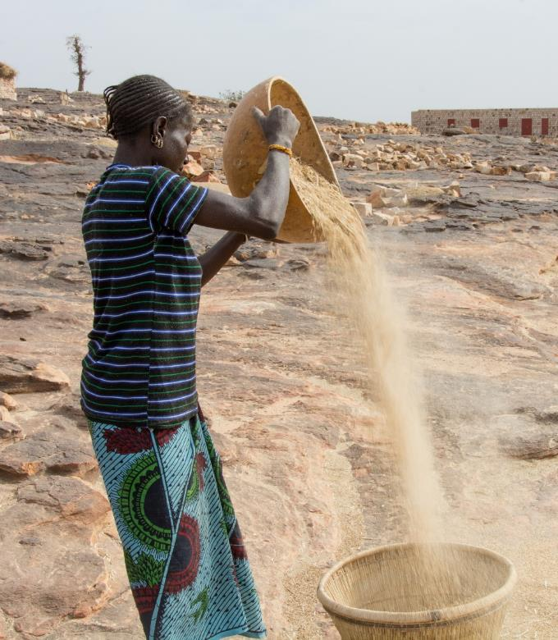
Please pray with the SIM Mali team
Pray the Lord will raise up labourers to serve in Mali.
Pray the grace of God and the power of the Holy Spirit will rest strongly on the few mature believers in Mali, so they are compelled to share their faith boldly with those who do not know Christ.
Pray God will increase house church movements in the Niamana area and that believers in these house churches will grow spiritually.
Photo credit: http://bit.ly/2DPtQzb

Slide 7
Thank you for your prayers
For more information, prayer resources, or if you are interested in serving, please visit sim.co.uk

