Slide 1
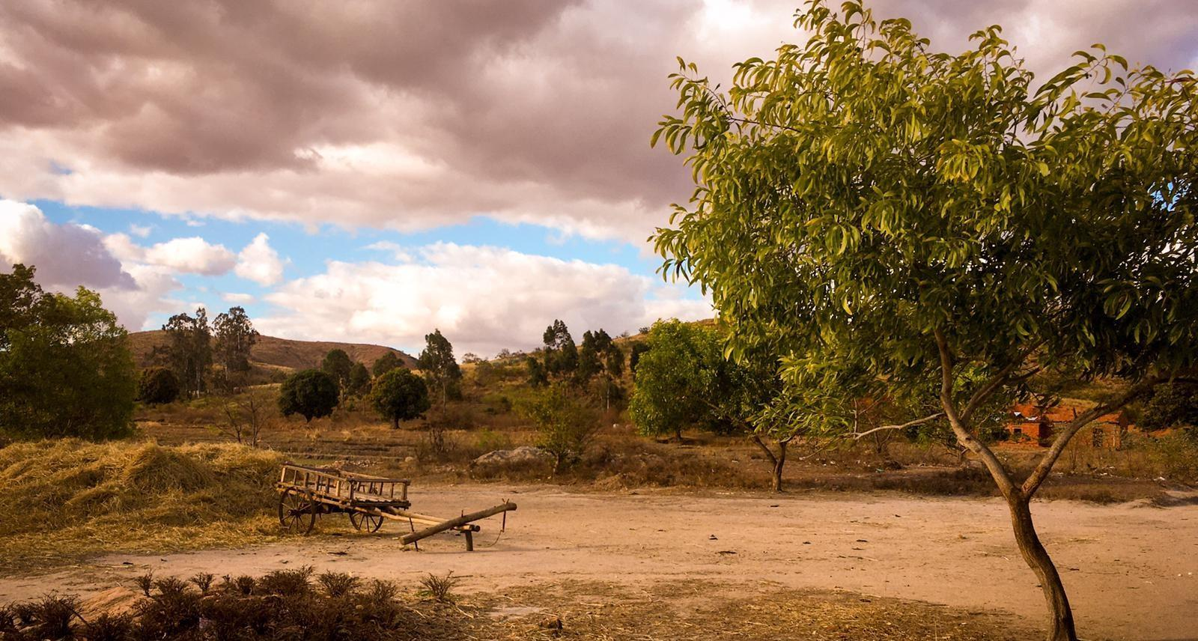
Pray for Madagascar

Slide 2
And the God of all grace, who called you to his eternal glory in Christ, after you have suffered a little while, will himself restore you and make you strong, firm and steadfast.
1 Peter 5:10

Slide 3
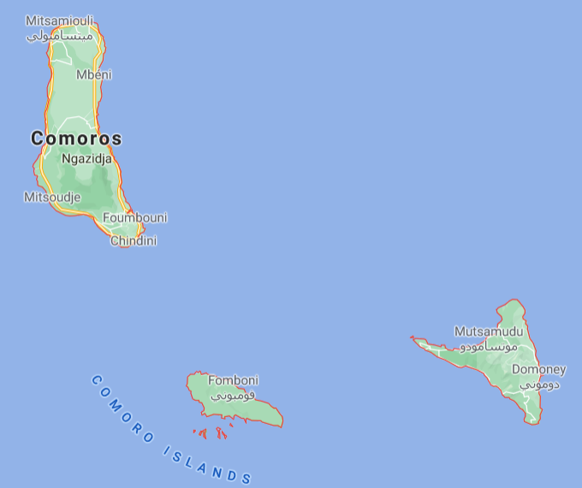
Pray for communities where Christ is least known
COMOROS
The Comorians live on a chain of islands in the Indian Ocean between Madagascar and Mozambique.
Major challenges: poverty, disease, and hunger.
Educational levels are low. Children help with farming, fishing, and animal care.
Polygamy is acceptable.
Most are Muslim, but occultism and spirit possession are mixed with their Islamic practices.
Resistant to any kind of religious change.
Christian resources are limited, and as a result, the number of Comorian believers is very small

Slide 4
Pray for communities where Christ is least known
COMOROS
PLEASE PRAY FOR
More workers to serve the Comorian people.
More workers to build and disciple the Madagascan church to help them work together to reach those living and dying without Christ in Madagascar and beyond.
People willing to commit long term to develop resources that will help lift the eyes of the Comorian people to the Lord.

Slide 5
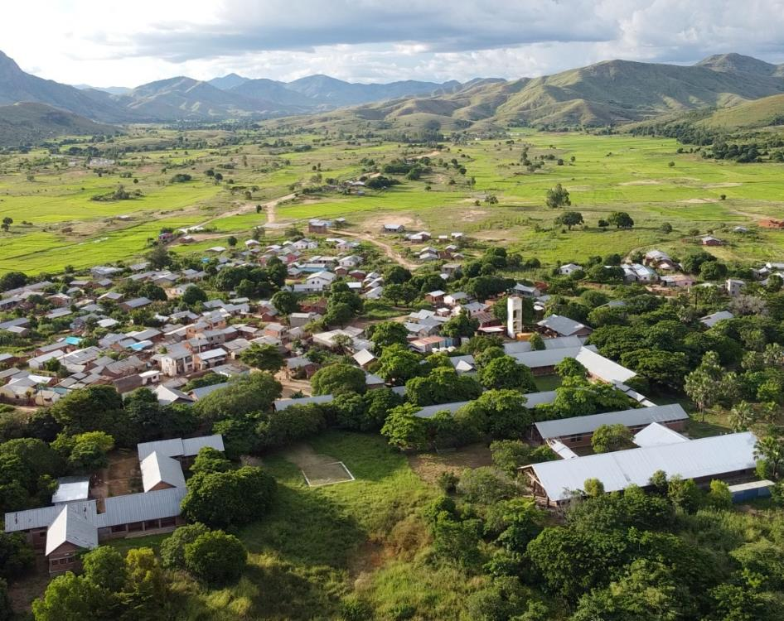
Pray for the Good News Hospital
The Good News Hospital launch a PAACS programme in January 2022, training Malagasy Junior Doctors to be skilled, compassionate, Jesus loving, mission minded surgeons.
Pray for God’s wisdom and grace in the planning.
Pray all serving would make the most of every opportunity to share the gospel with patients.
Pray for patients that hear the good news at the hospital, that they may grow in faith even in remote villages where there are no other Christians.

Slide 6
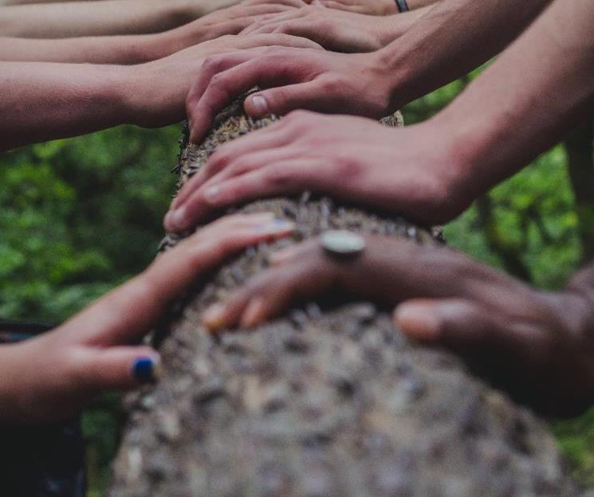
Pray for Bible translation
There are 18 people groups in Madagascar and approximately 25 languages. The Bible is only available in Official Malagasy.
A translation project called Together in Bible Translation (TiBT) works with 12 of the minority languages, facilitating and guiding small groups as they translate the Word of God into their own respective languages.
Most of the groups comprise of 4 or 5 mother-tongue translators working alongside missionaries. They come from all walks of life from teachers to pastors and from farmers to shop keepers.

Slide 7
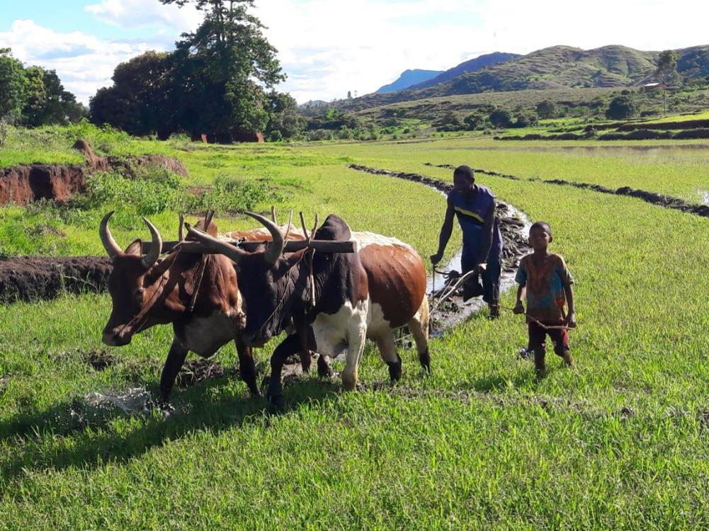
Pray for Bible translation
Give thanks for the enthusiasm of the Malagasy translators and pray for wisdom, insight and perseverance for each team.
Pray that as they translate the Bible, they would translate not just the words but the meaning contained within the texts.
There is currently a team of six non-Malagasy missionaries working in translation based in Madagascar. Pray for grace and understanding as their cultures interact.
Give thanks for portions of scripture now available in each of the minority languages Pray that the teams are led to people of peace as they check completed sections.
May the Lord prepare the hearts and minds of the Malagasy people to receive his word.

Slide 8
Prayer requests from
our SIM team
PLEASE PRAY FOR
Unity and reconciled relationships between the evangelical denominations, that they would work together to reach those living and dying without Christ in Madagascar and beyond.
More missionary doctors for the Good News Hospital.
The Lord to call out missionaries to establish a local SIM administration that serves our missionaries with financial, administrative, and personnel services and leadership.
Local co-workers at the Timothy Centre to continue the activities (theological education, community development, outreach, and discipleship) after the departure of the missionary currently leading the centre.
A clear and courageous vision for SIM Madagascar as mission strategies are developed.

Slide 9
Thank you for your prayers
For more information, prayer resources, or if you are interested in serving, please visit sim.co.uk

