Slide 1
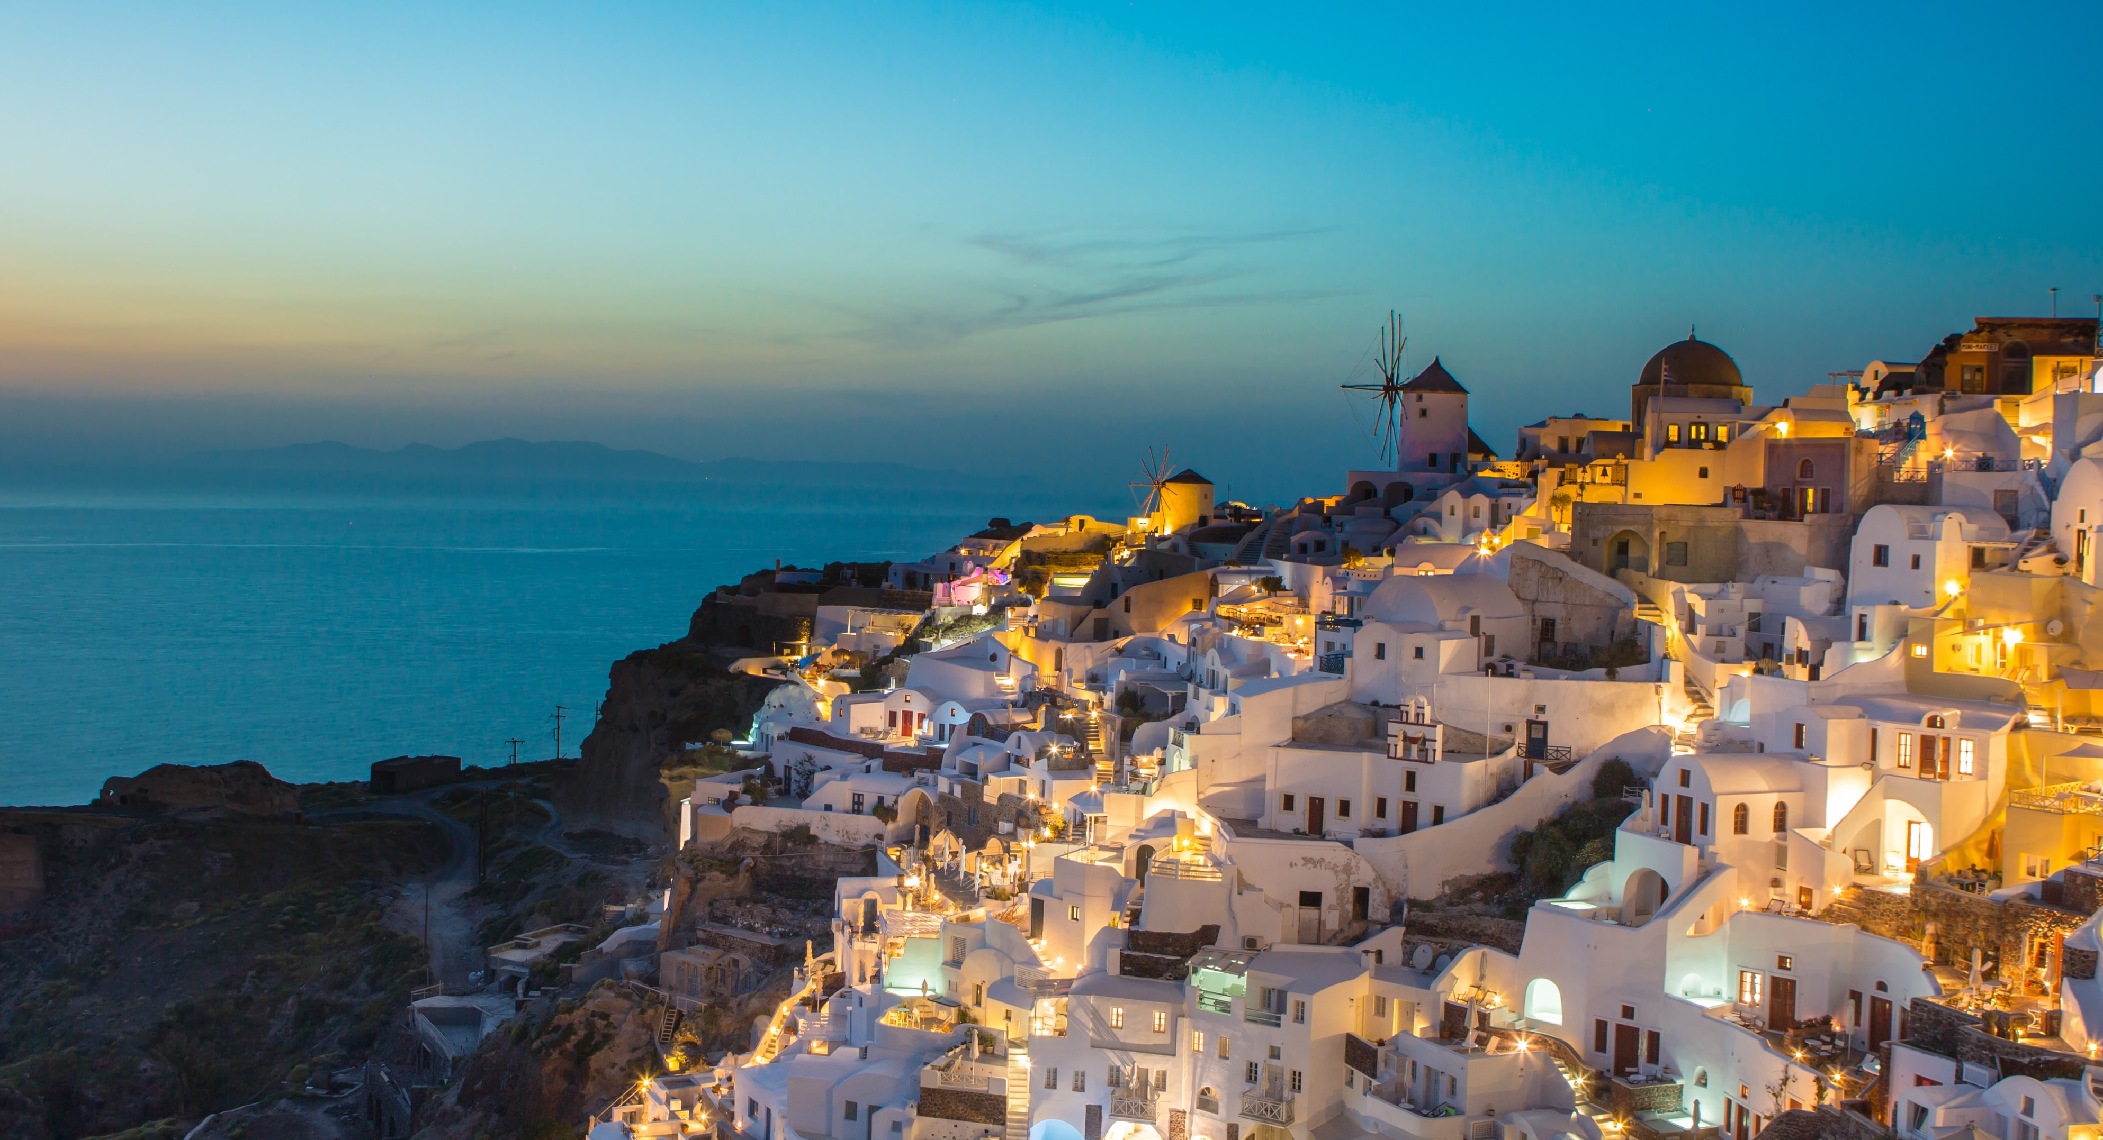
Pray for Greece
Photo credit James Ting

Slide 2
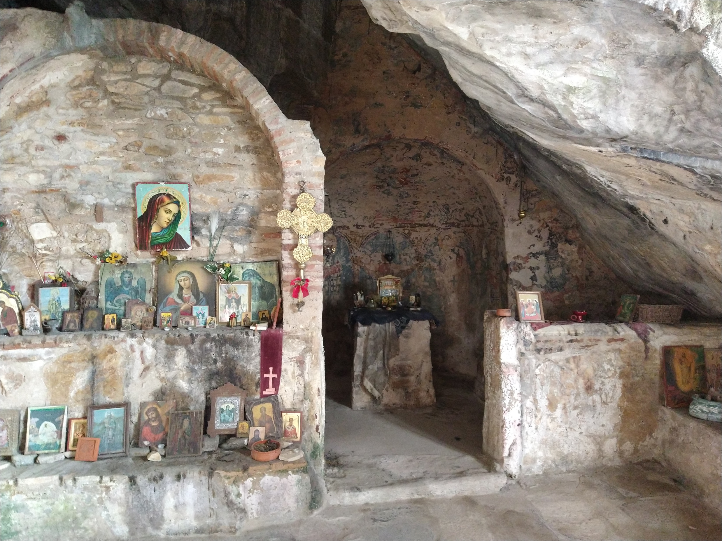
Cultural context
Outwardly, Christianity is everywhere: from impressive, well-resourced churches and priests paid by the state; to roadside shrines, religious icons in shops (even some very modern ones) and public holidays with large crib scenes in many squares at Christmas - all bearing witness to the enduring idea of Greece as a 'Christian country'.
But in reality, there is a deep complacency which has led to a powerful inoculating effect that makes it impossible for many to accept the good news when it’s truly encountered.
Photo credit MacInnes family

Slide 3
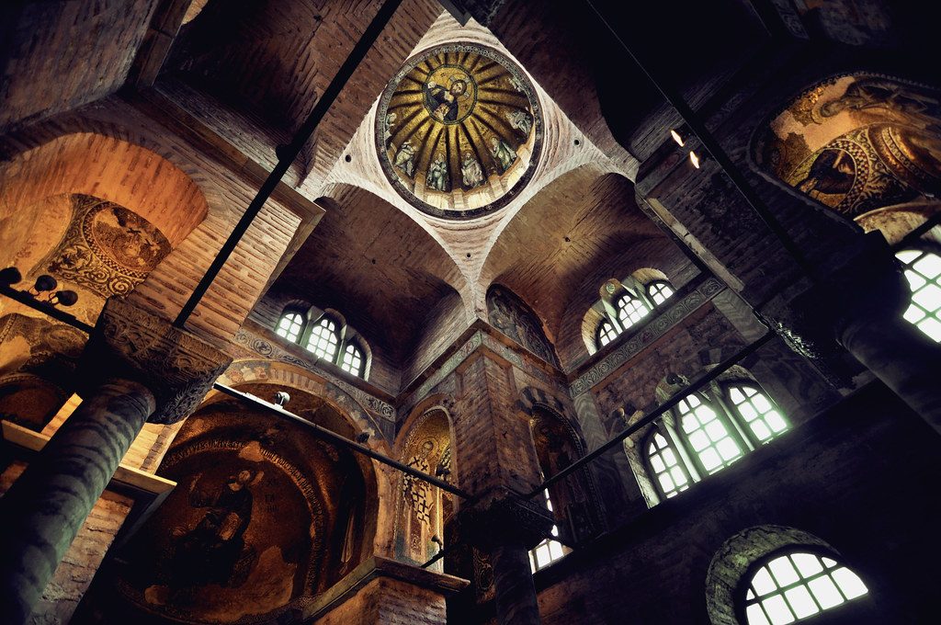
Theological context
Theologically, the nuances of Greek Orthodoxy remain a mystery to many, including ordinary Greek evangelicals who’ve grown up in the evangelical church.
Worldwide, evangelicals are more familiar with Roman Catholicism, yet that church split from the East almost 1,000 years ago, so there are important differences.
Photo credit Fusion of horizons

Slide 4
GIVE THANKS FOR…
the growth in church planting among the evangelical churches of Greece in the last decade and pray this would continue, not just in Athens but across the mainland and the islands.
the ministry of the Greek Bible College outside Athens where many evangelical church and ministry leaders are trained.
Photo credit Phil Aicken

Slide 5
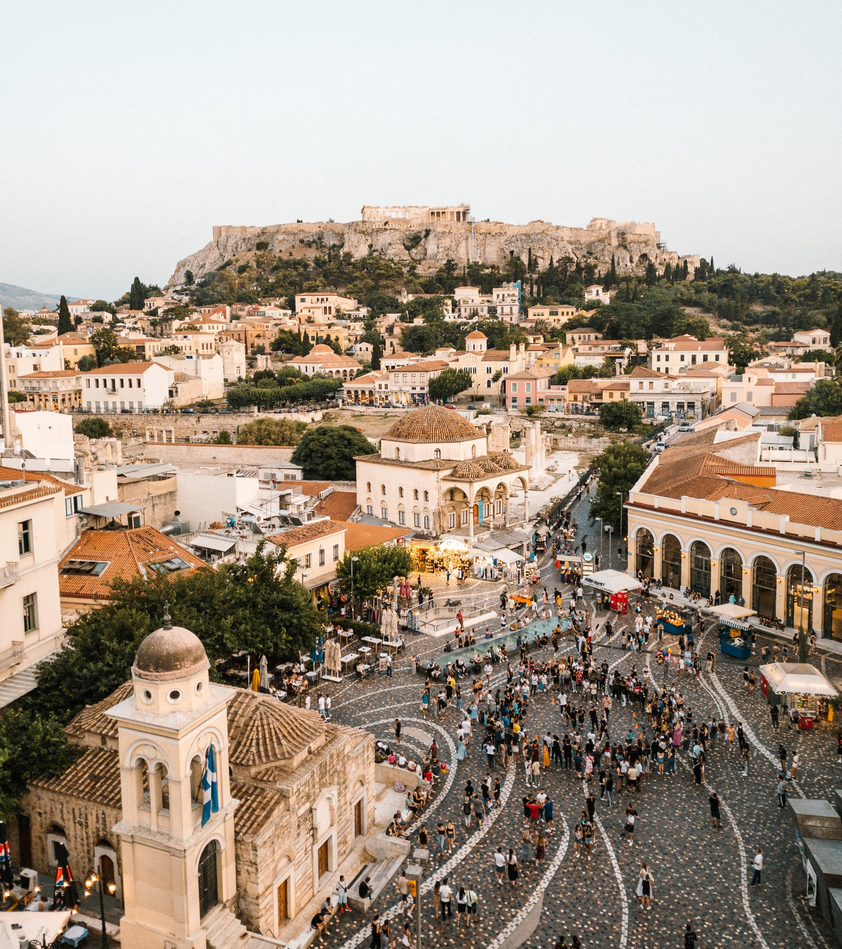
PLEASE PRAY FOR…
growth in quality scholarship focusing on the distinctives of Greek Orthodoxy and for wisdom in applying these insights to reaching people who follow these traditions.
ordinary evangelicals to be better equipped to reach their friends, neighbours and families for Christ.
Photo credit Andrea Leopardi

Slide 6
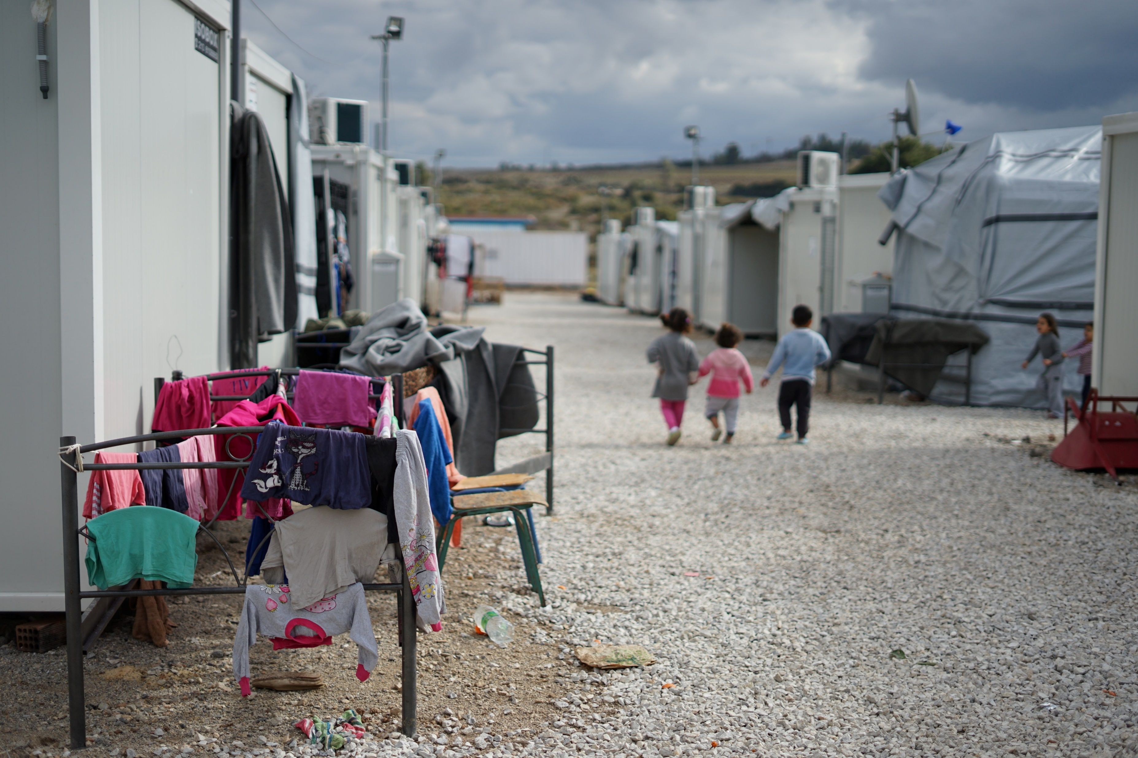
Refugees and migrants
For years, Greece has been at the epicentre of the movement of people into and across Europe. Many Greeks remember the waves of migration that brought themselves or their parents and grandparents from the diaspora to their mother country throughout the 20th century and they have shown amazing compassion for the most part, despite their own economic struggles.
Photo credit Julie Ricard

Slide 7
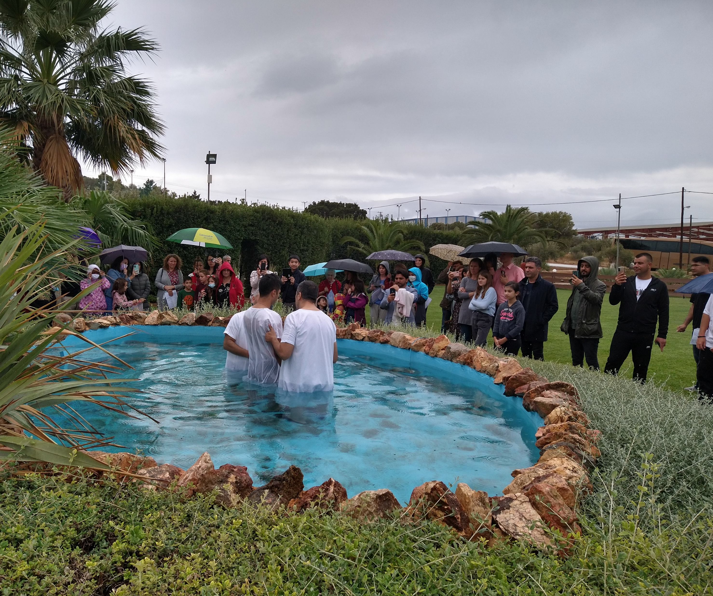
GIVE THANKS THAT…
so many evangelical churches and organisations have been at the forefront of helping refugees.
many, many diaspora churches have sprung up in Athens especially in the last few years and that many people have come to Christ.
PLEASE PRAY…
that there would be good discipleship and that HowWillTheyHear would be able to establish a training hub to help equip migrants to take the gospel elsewhere.
for wisdom for those serving and reaching out to refugees as public opinion has turned somewhat in the last few years.
Photo credit MacInnes family

Slide 8
Financial hardship
Greece has been through some very difficult and much-publicised financial trials over more than a decade. The effects of this are hard to quantify but still very much in the consciousness of the population.
Some of the more obvious consequences are:
a high incidence of very visible poverty on the streets through rough-sleeping and begging
many younger, educated Greeks have left the country
a wariness about outsiders
Photo credit Christian Dubovan

Slide 9
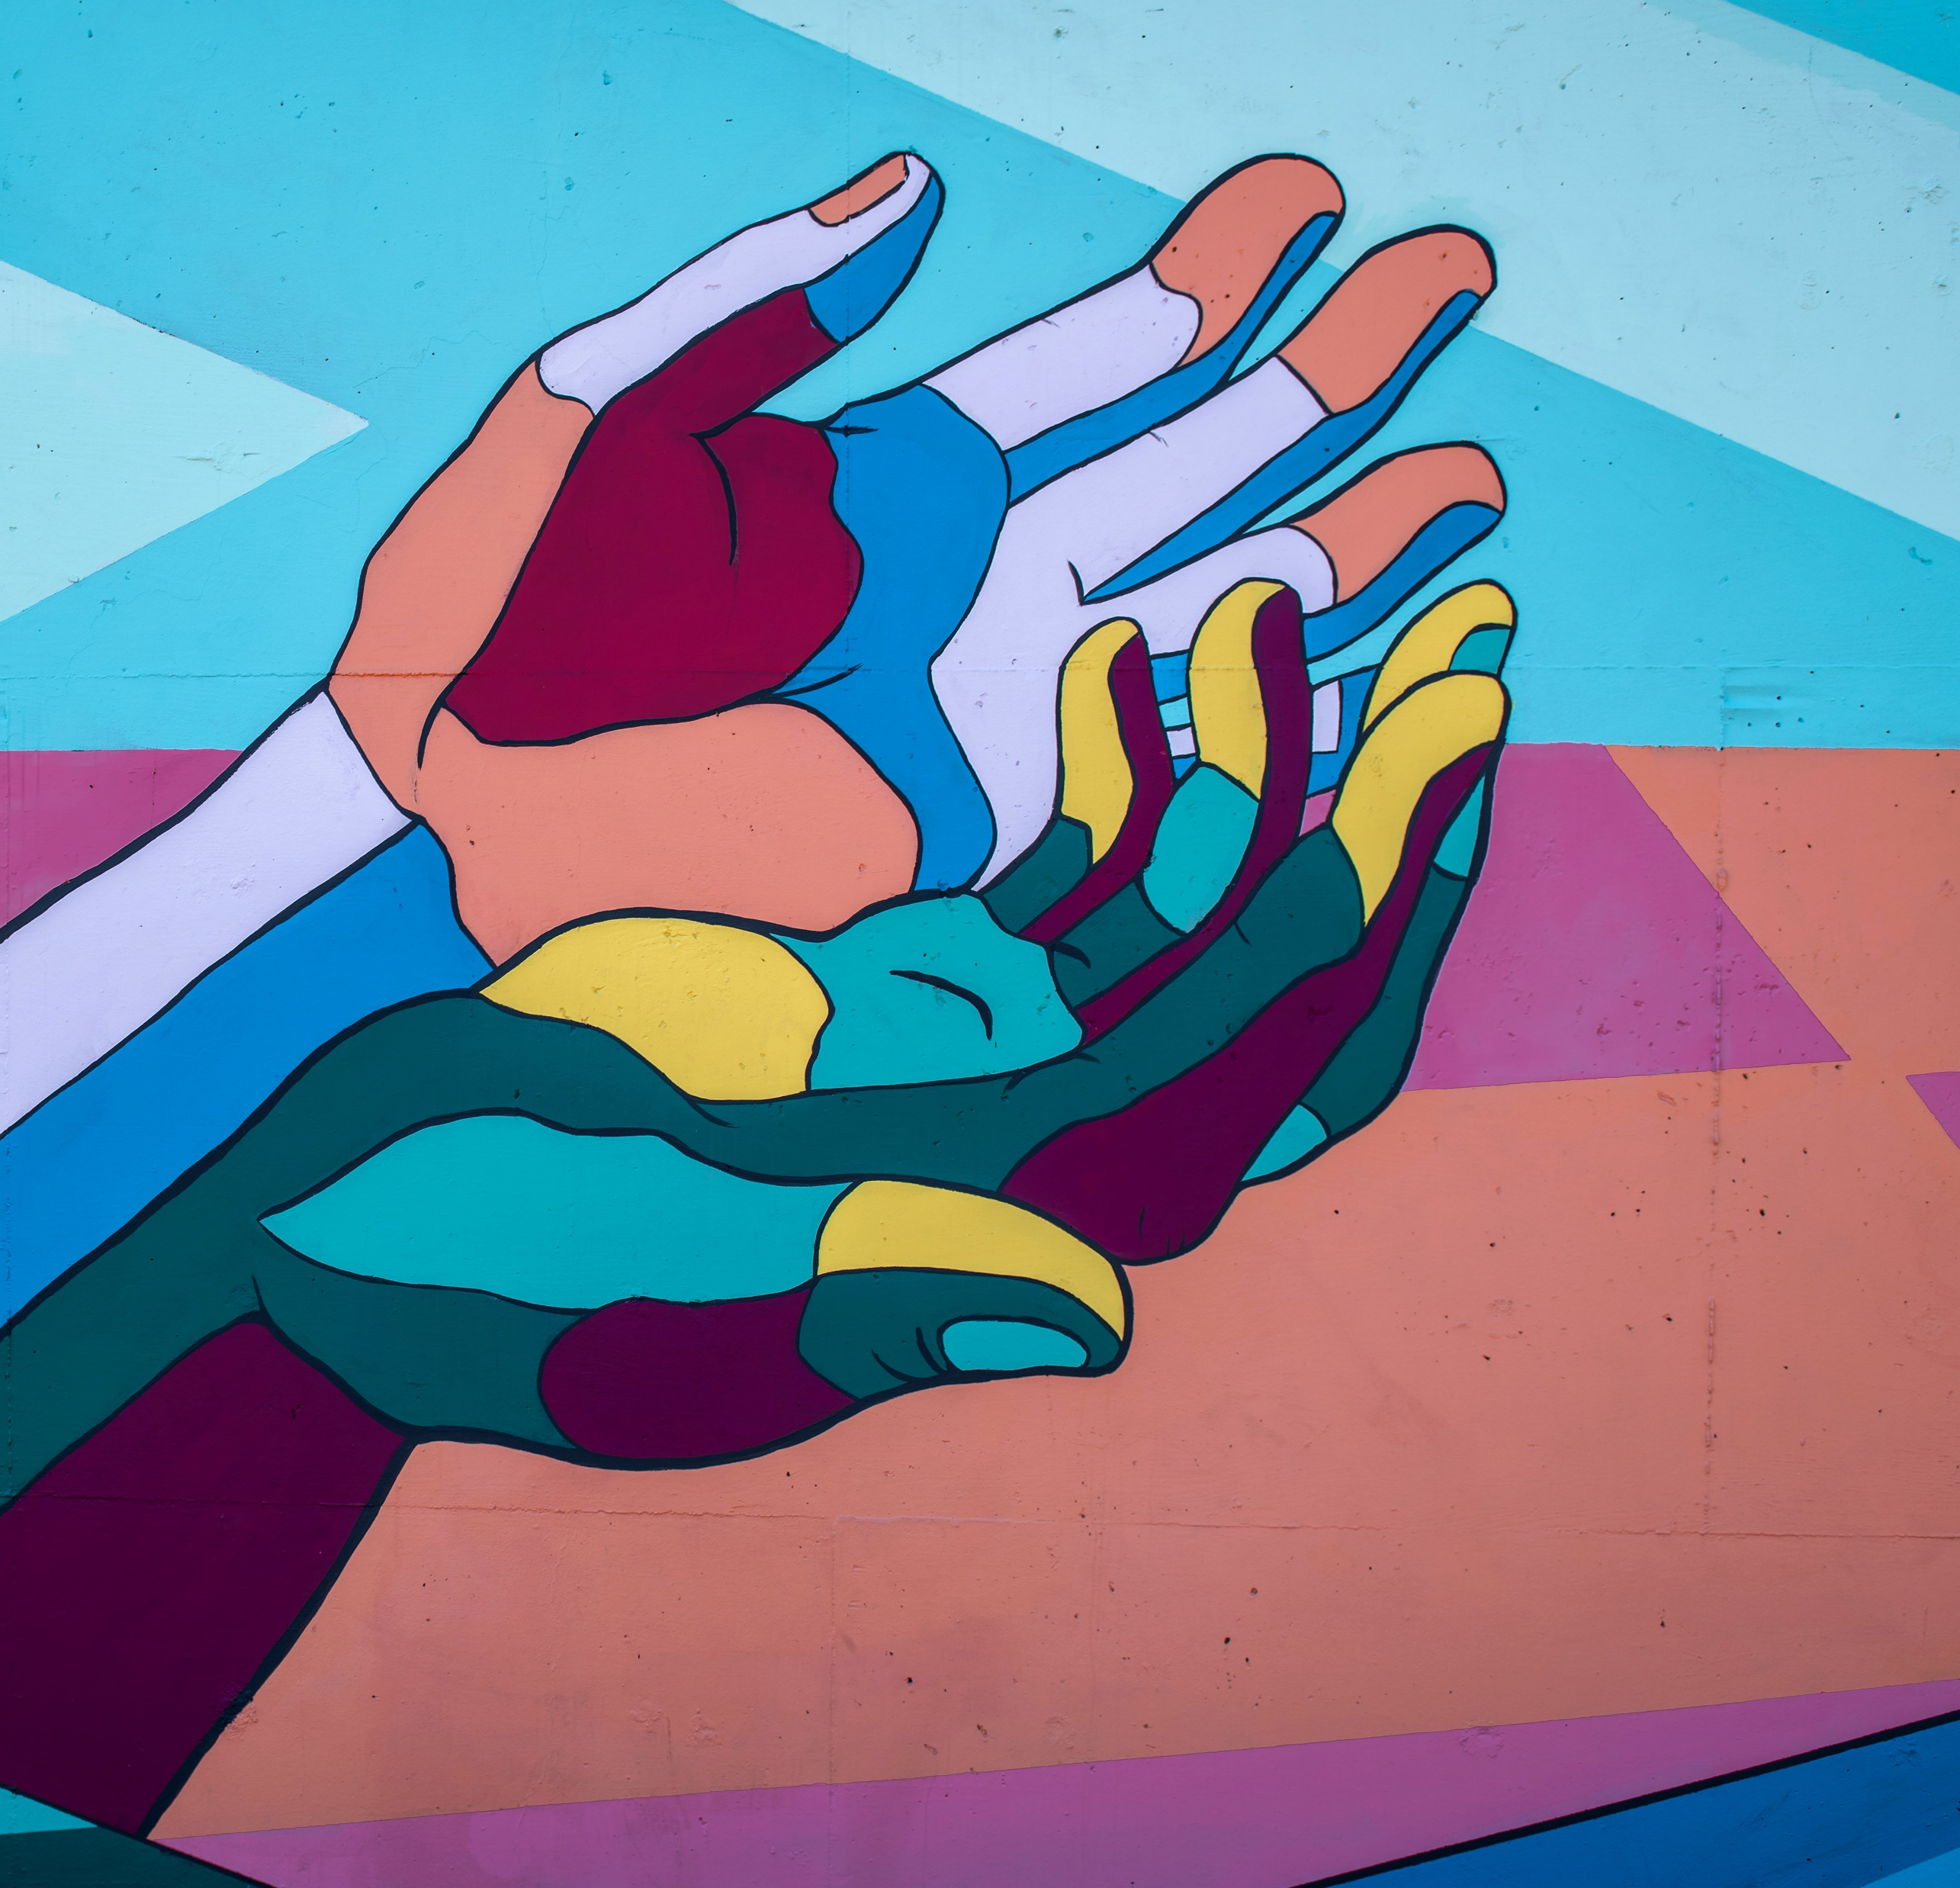
Photo credit Tim Mossholder
GIVE THANKS THAT…
evangelical churches have engaged with many of the social problems of Greece in more recent years.
PLEASE PRAY…
this compassion would continue and be used by the Lord as a means to share the gospel message.
the Lord would use the humbling of the nation to open more hearts to his message of salvation.

Slide 10
Thank you for your prayers
For more information, prayer resources, or if you are interested in serving, please visit sim.co.uk
With thanks to Al MacInnes for content

