Slide 1
JOIN US IN PRAYER FOR
FRANCE

Slide 2
IT HAS ALWAYS BEEN MY AMBITION TO PREACH THE GOSPEL WHERE CHRIST WAS NOT KNOWN, SO THAT I WOULD NOT BE BUILDING ON SOMEONE ELSE’S FOUNDATION.
ROMANS 15:20

Slide 3
COMMUNITIES WHERE CHRIST IS LEAST KNOWN
International students
There are 358,000 international students in France –with Moroccans, Algerians, Chinese and Tunisians among them.
Students are often open to the gospel, but more workers are needed to minister in this area as currently, there is only one SIM worker doing so.

Slide 4
COMMUNITIES WHERE CHRIST IS LEAST KNOWN
Pray…
Give thanks for the opportunity to reach people – whose home countries are hard for mission workers to access – with the good news.
Give thanks for those open to hearing more about Jesus. Pray for leading of the Holy Spirit for the one SIM worker engaged in this ministry.
For God to bring more workers to come alongside the many international students studying in France.

Slide 5
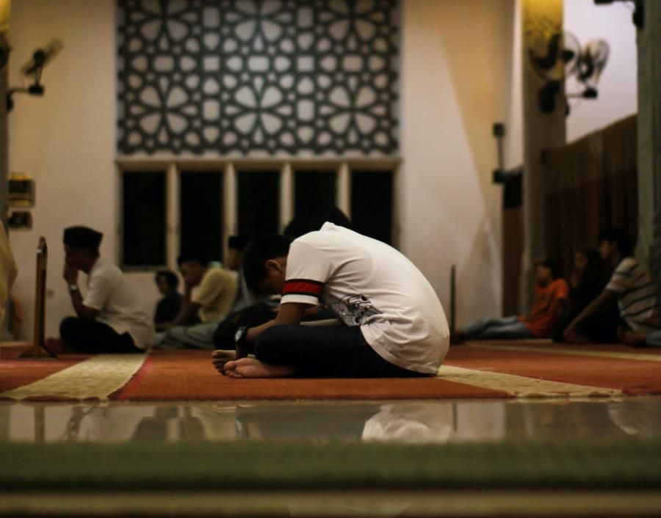
COMMUNITIES WHERE CHRIST IS LEAST KNOWN
Muslim community
The 2016 influx of refugees is challenging European Christians to find ways to show Christ’s love.
Muslim background believers are often persecuted by their families and relatives, but terrorist violence has led to more opportunities to discuss our Christian beliefs with Muslims.
Since 2016 and the rise in terrorist attacks, the Muslim community has begun to question Islam.

Slide 6
COMMUNITIES WHERE CHRIST IS LEAST KNOWN
Pray…
Give thanks that more Muslims seem open to conversations about faith since the terror attacks.
For those seeking truth, that they would hear and respond to the message of Christ.
For protection for new Christians and boldness in sharing their new found faith.
For churches in France as they prayerfully consider how best to reach their refugee communities.

Slide 7
PRAY WITH THE TEAM
Pray for…
Revival of the missionary vision in French churches.
Fruitful partnerships for SIM France with church denominations, Bible institutes and other mission organisations.
Sincere and ongoing commitment to missions amongst French Christians.
An effective training programme for spiritual growth.
Strength in prayer, good relationships with churches and potential mission workers and for fruitful ministry for those whom God sends

Slide 8
Thank you for your prayers
For more information, prayer resources, or if you are interested in serving, please visit sim.co.uk

