Slide 1
Help us take the gospel to communities where there is no Christian witness

Slide 2
We send teams
of gospel workers
to communities where none exist

Slide 3
GOD IS AT WORK
MALI | CHAD | THAILAND

Slide 4
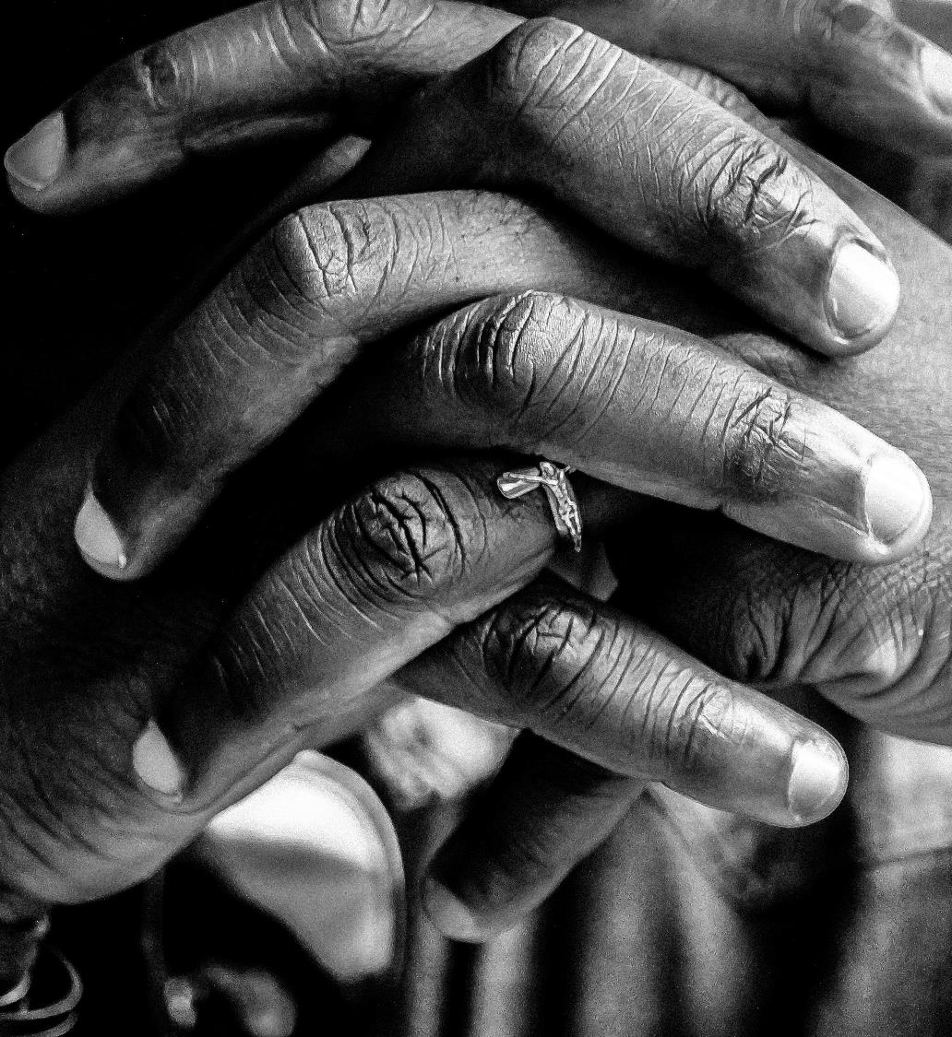
A year ago we asked you to pray
For the communities that would receive the first three teams.
That the Lord would raise up workers for this harvest.
That the teams would be led to people of peace.

Slide 5
GOD IS AT WORK
MALI | CHAD | THAILAND

Slide 6
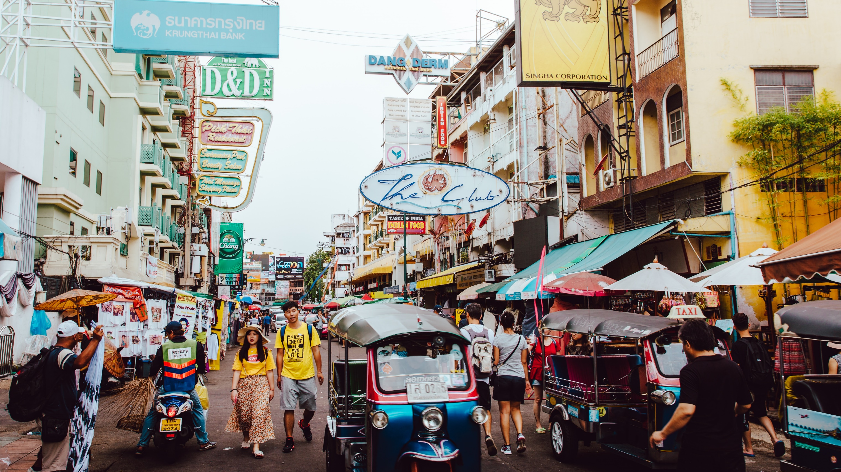
AYUTTHAYA
THAILAND

Slide 7
Ayutthaya is home to a large Muslim population.
There is no know Christian engagement with this group.

Slide 8
In this culture, building relationship is key.
We are focussing in three areas to enable this:
RADICAL GRACE
Family health ministry.
THE CENTRE
Student ministry.
SPORTS FRIENDS
Sport ministry

Slide 9
PRAY WITH US
MALI | CHAD | THAILAND

Slide 10
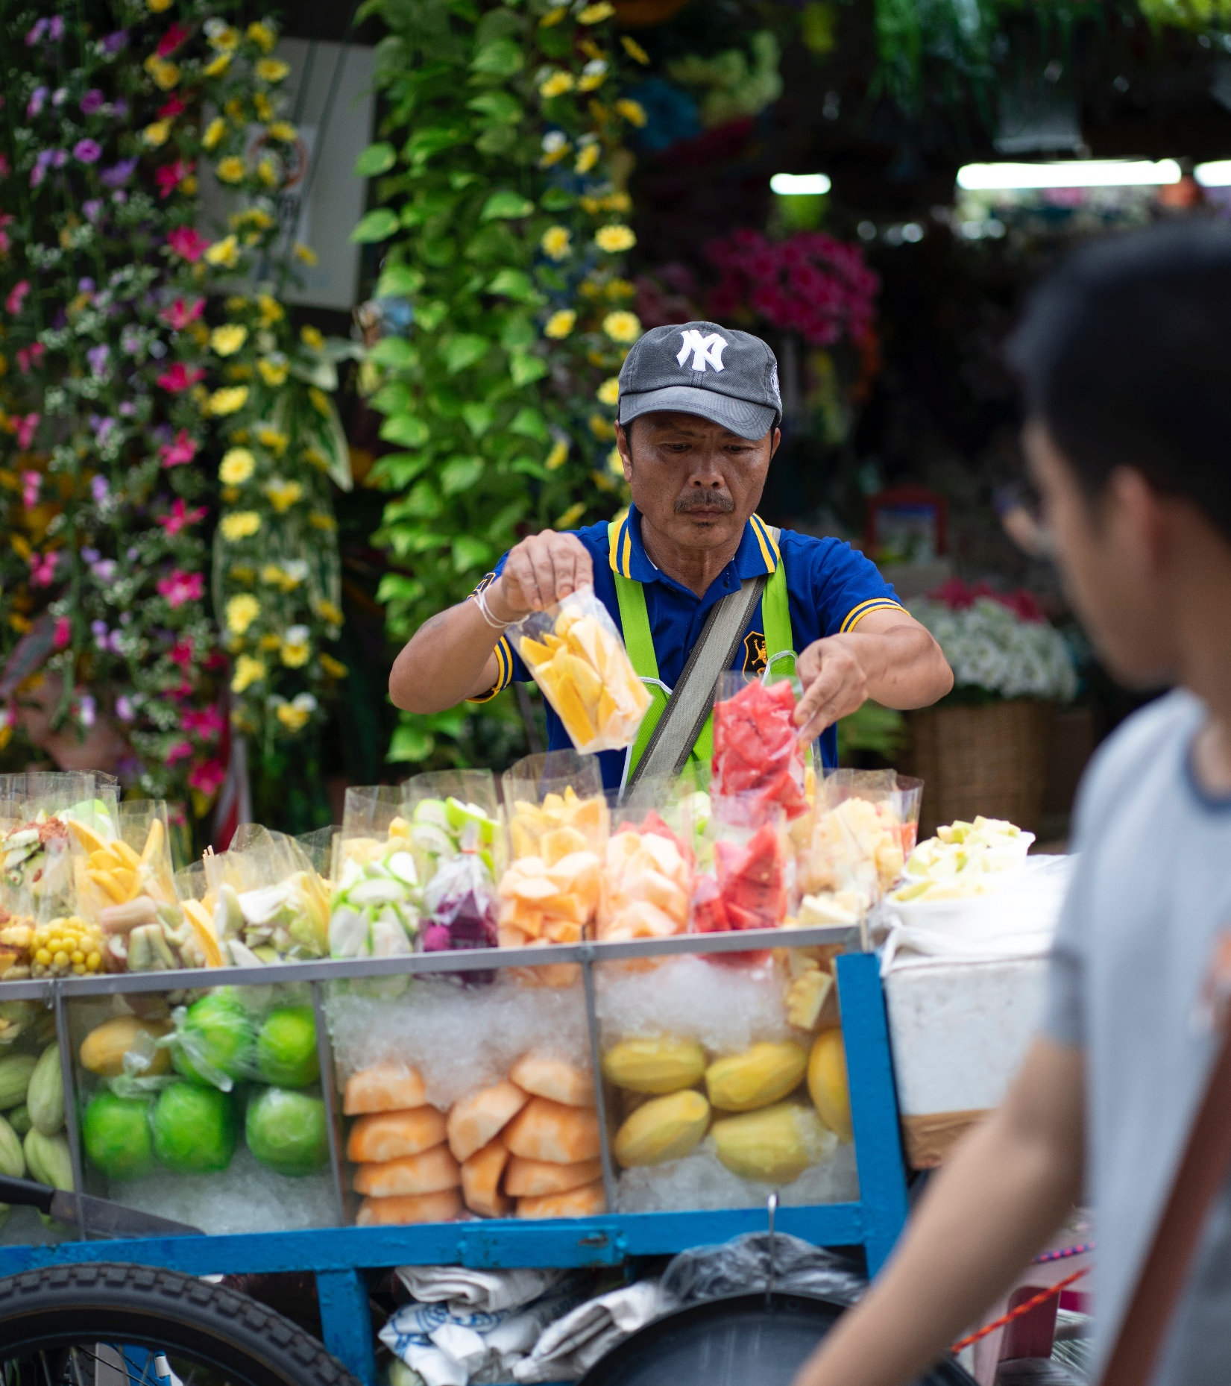
That God would prepare the hearts of the people of Ayutthaya for the gospel and many would turn to Christ.
Pray God would create a multiplying movement of leaders and church communities throughout Ayutthaya.

Slide 11
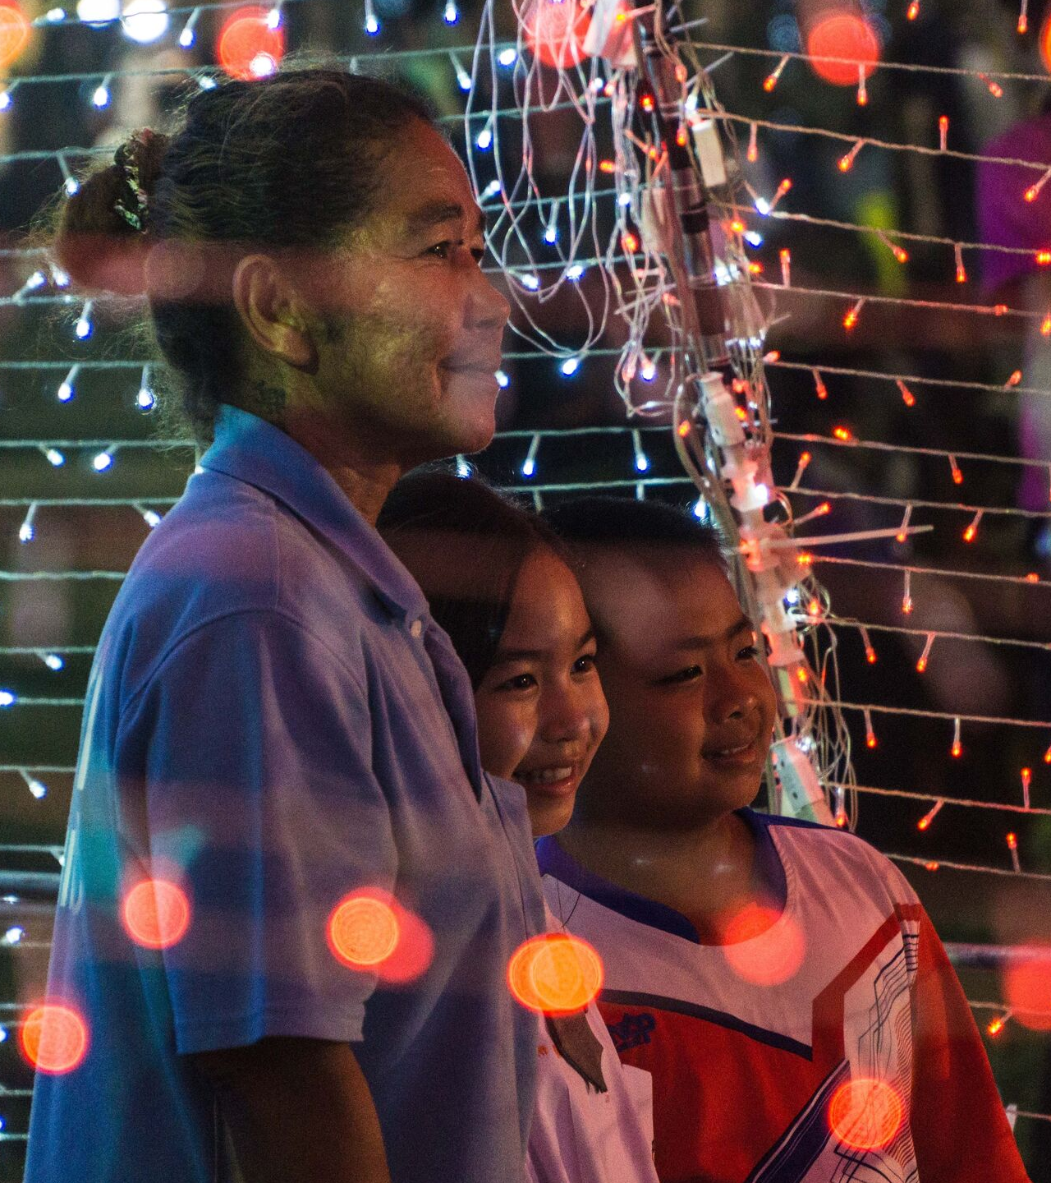
For discernment in how to engage Ayutthaya’s thousands of young people.
The team meet weekly with schools to teach God-honouring morals and values.
Ministry in a juvenile detention centre has led to great conversations.
Pray these relationships will open doors to share the gospel.

Slide 12
Pray for the team:
For unity in diversity.
For good inter-cultural communication and strong relationships.
That in the midst of spiritual battle, the team support and encourage one another.

Slide 13
Could God use your skills on this team?
There is still a need in:
Teaching
TEFL
Evangelism and discipleship
Hospitality
Community health

Slide 14
THANK YOU FOR YOUR PRAYERS
Find out more information on serving in mission or donate in support of this ministry at sim.org/faithfulwitness

