Slide 1
Help us take the gospel to communities where there is no Christian witness

Slide 2
We send teams
of gospel workers
to communities where none exist

Slide 3
GOD IS AT WORK
MALI | CHAD | THAILAND

Slide 4
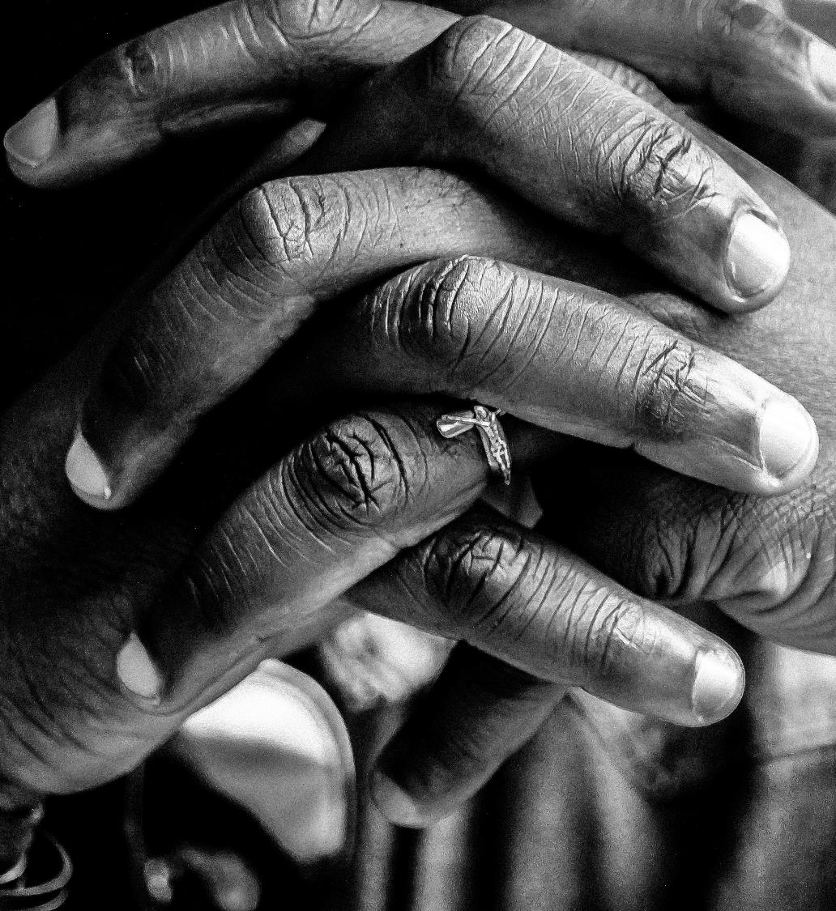
A year ago we asked you to pray
For the communities that would receive the first three teams.
That the Lord would raise up workers for this harvest.
That the teams would be led to people of peace.

Slide 5
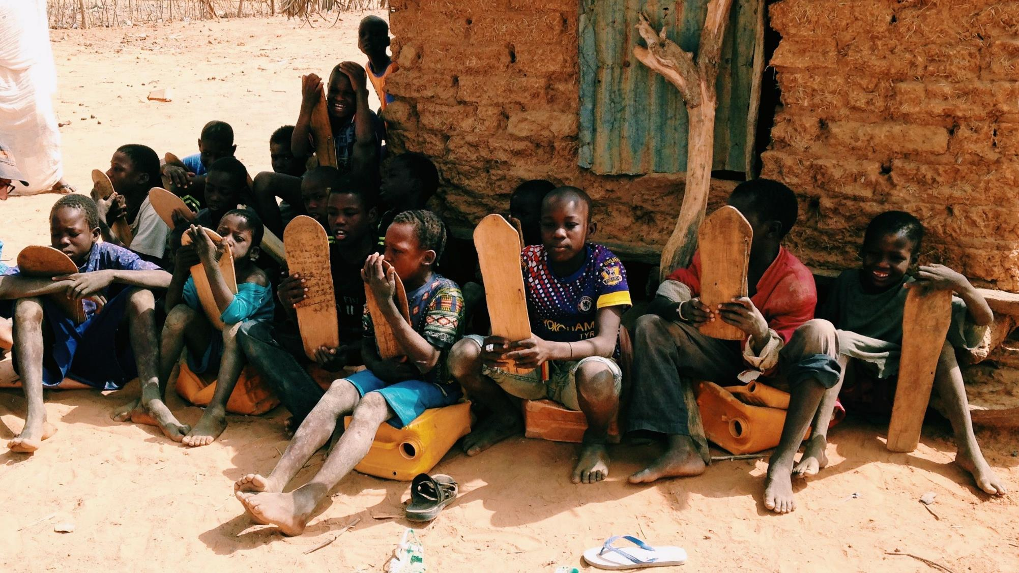
MALI

Slide 6
In a place with few social amenities, devoid of words such as comfort, peace or security,
God is building a team of Faithful Witnesses.

Slide 7
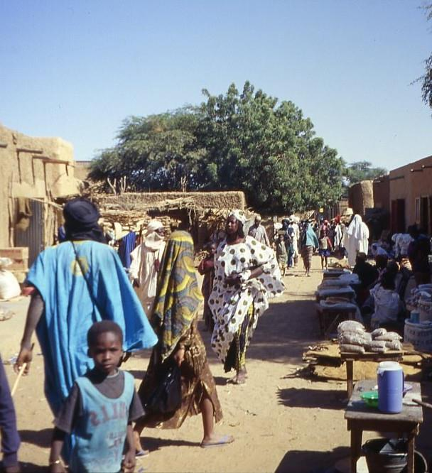
“
There are no known believers
amongst the Hassaniya,
and less than a handful amongst the Soninke and Fulani
Joshua, SIM Mali Director
https://search.creativecommons.org/photos/6e462de0-c716-4368-af45-e90d1c9e26ca
”

Slide 8
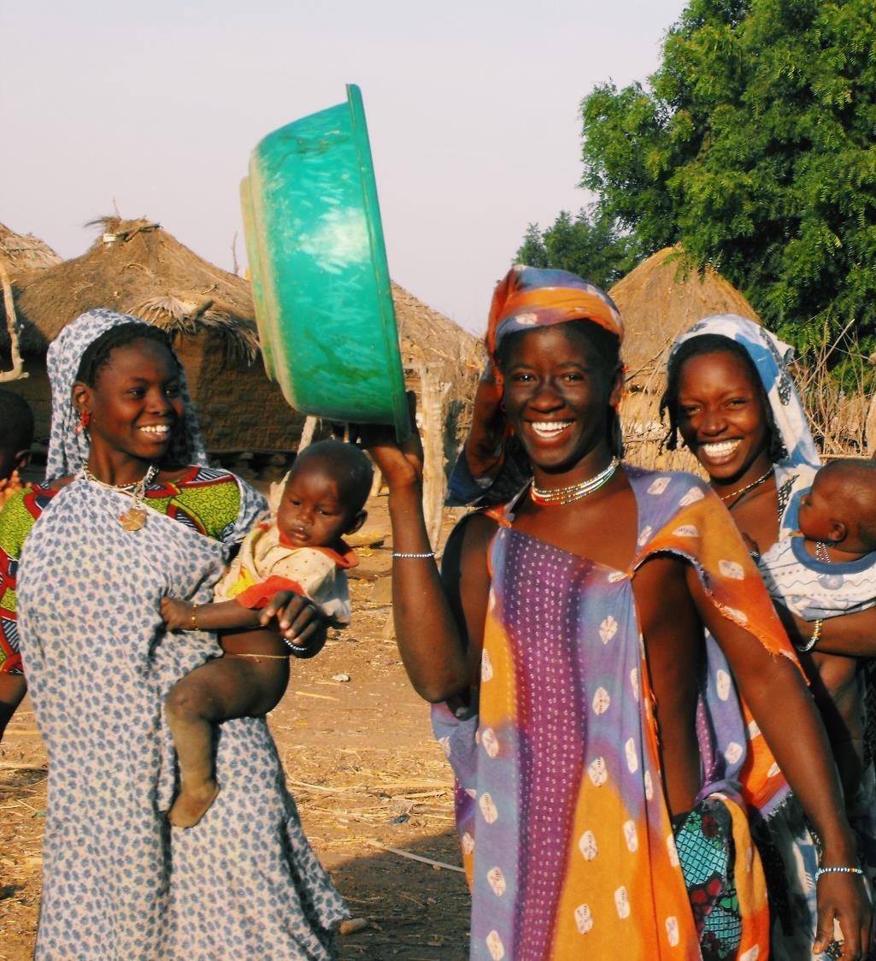
The Faithful Witness team
visited Hassaniya villages and were welcomed with open arms

Slide 9
Previous gospel workers had paved the way, showing God’s love through acts of compassion
– they provided famine relief, wells, schools and children’s clubs.
Church teams had shown the Jesus film and distributed tracts.
They held medical clinics, and learnt language and culture…

Slide 10
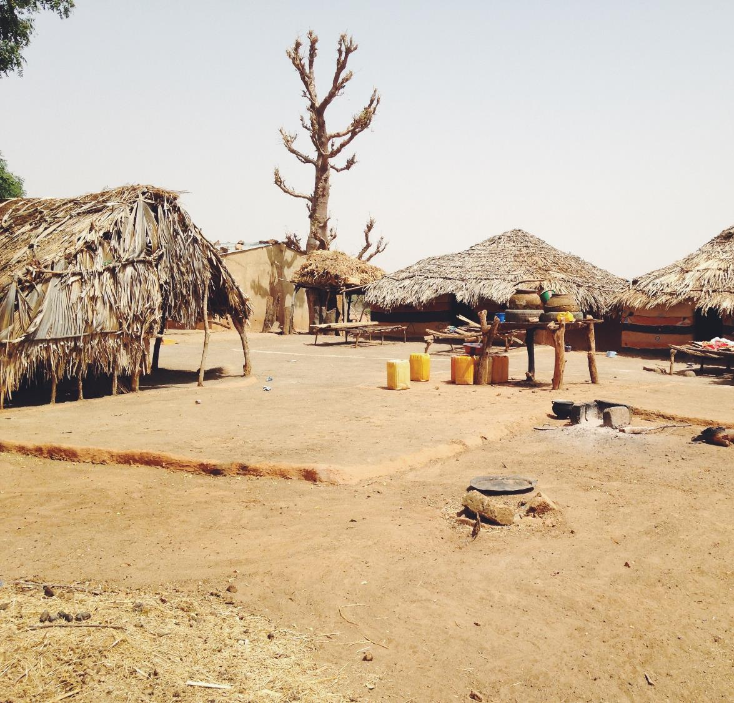
And yet, there are no believers.
There is no church.
There are no books of the Bible available in Hassaniyya.

Slide 11
PRAY WITH US
MALI | CHAD | THAILAND

Slide 12
For opening doors to this community.
For openness from the Hassaniya for workers to live among them and learn their language.
For numerous requests for help from the team
That this field is ripe for harvest and in need of labourers.
PRAISE GOD

Slide 13
• God’s spirit to prepare the hearts of Hassaniya herdsmen to receive the gospel.
• God’s love and unity to grow among the gospel workers.
• God’s intervention in the health and economic crisis due to COVID-19.
• Financial provision for the team.
PRAY FOR

Slide 14
God to bring more workers to the team.
Peace in Mali and other West African states threatened by Islamic extremists.
Protection for all gospel workers.
PRAY FOR

Slide 15
Could God use your skills on this team?
There is still a need for:
Adult literacy teachers
Medics
Children’s workers

Slide 16
THANK YOU FOR YOUR PRAYERS
Find out more information on serving in mission or donate in support of this ministry at sim.org/faithfulwitness

