Slide 1
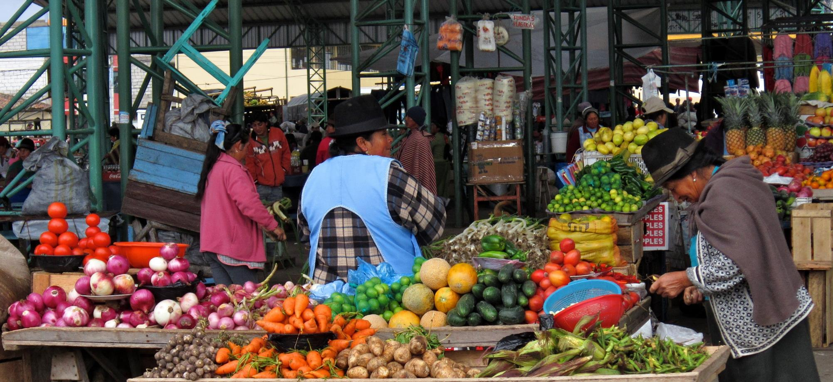
Join us in prayer for
ECUADOR

Slide 2
We are therefore Christ’s ambassadors, as though God were making his appeal through us. We implore you on Christ’s behalf: Be reconciled to God.
2 Corinthians 5:20

Slide 3
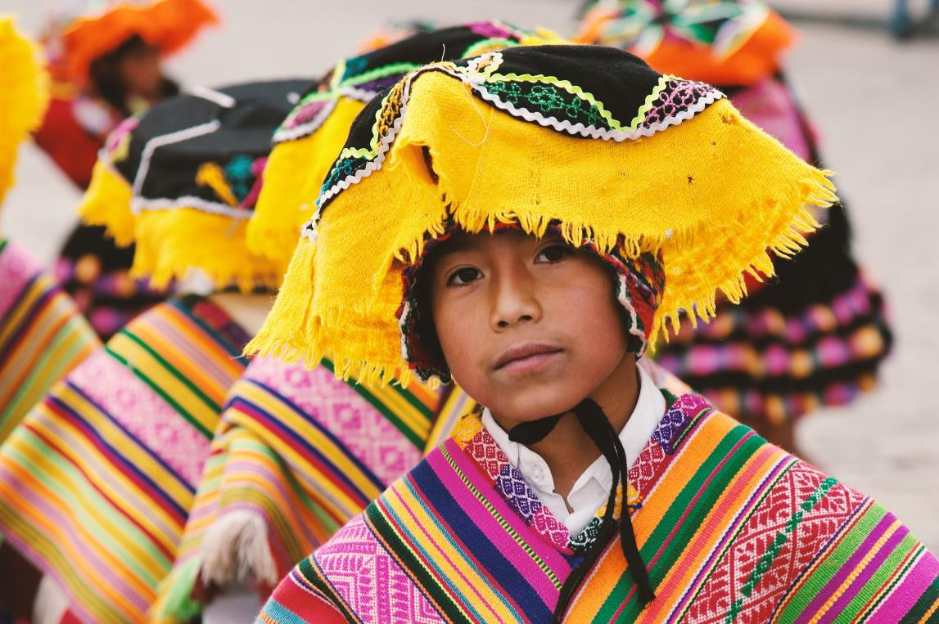
In partnership with the church, SIM Ecuador seek to make disciples of the Lord Jesus Christ in communities where he is least known.

Slide 4
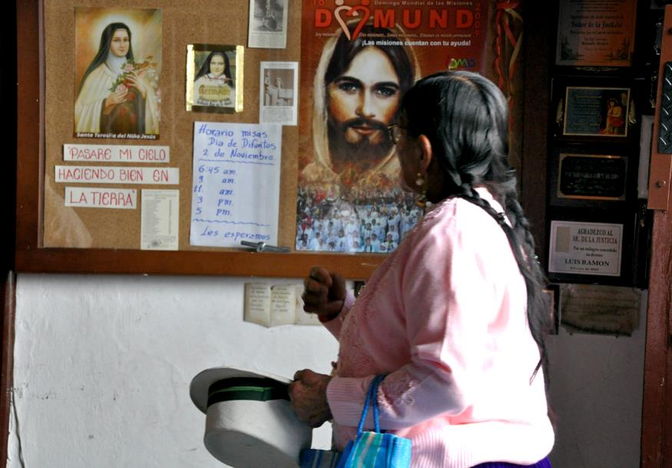
Pray for communities where Christ is least known
Southern cantons of Loja Province
Many remain strongly tied to Roman Catholicism, or practice Folk-Catholicism.
Healers, shamans, and superstition are as important as the practices of the traditional church.
These beliefs still impact the lives of evangelical believers, who face opposition when they deny traditional beliefs.
12 -15% of this area’s population are illiterate.

Slide 5
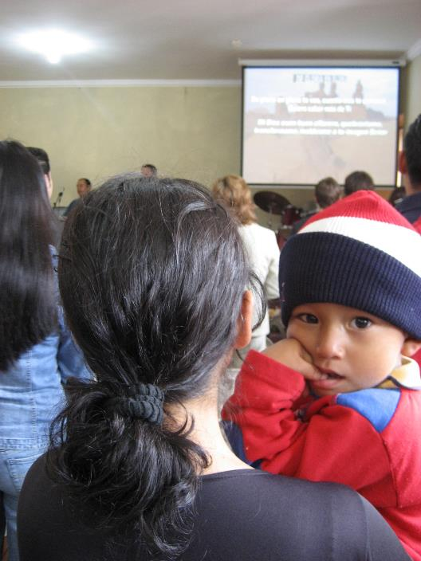
Pray for communities where Christ is least known
Please pray:
The few small churches that exist need resources and training in evangelism, discipleship, church planting, and doctrine in order to make an impact in their communities.
The churches need a vision for the lost and scattered people of their own region.
A major obstacle are the many present sects, which distort the teaching of the gospel and confuse the believers.
Pray for more workers to teach, disciple and mentor believers.

Slide 6
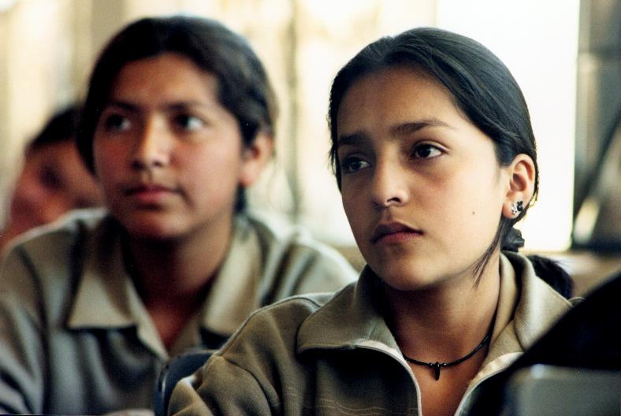
Pray for communities where Christ is least known
College students and youth
SIM Ecuador have a clear vision to disciple university students and establish a ministry in the two main university campuses in Loja.
Students and young workers are looking for a brighter future and, through relationships, we seek to reach this community.
Pray for student workers able to build relationship with and disciple those with whom they have contact.

Slide 7
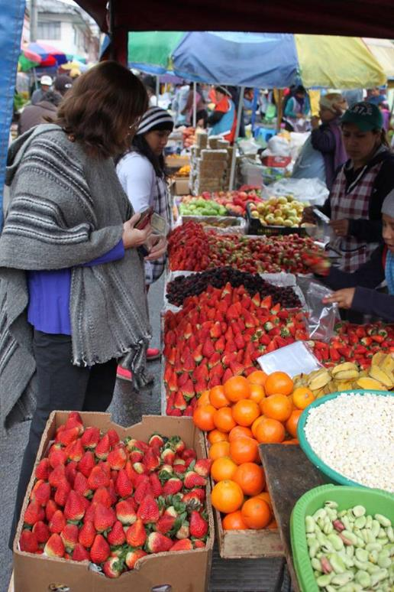
Prayer requests from
our SIM team
Please pray for:
believers in rural areas to be courageous ambassadors for Christ.
efforts in rural Loja Province to connect with and support churches through teaching, resources and outreach.
wisdom and direction, as we work with others to establish a ministry on the two university campuses.
continued work in urban areas, alongside the local church.
wisdom as we consider new ministries to least reached areas of Ecuador.

Slide 8
Feel called to serve?
Where could my skills be used?
SIM Ecuador have ministries in:
Radio Evangelism
Evangelism, disciple-making, and training
Church planting
Mobilising the church to mission
Theological education
Growing Pastors bookshop and training centre
Reaching out to women and children
Youth and student outreach
Medicine, counselling, and drama
Trauma Healing - earthquake relief ministry
Internship training
TCK education

Slide 9
Thank you for your prayers
For more information, prayer resources, or if you are interested in serving, please visit sim.co.uk

