Slide 1
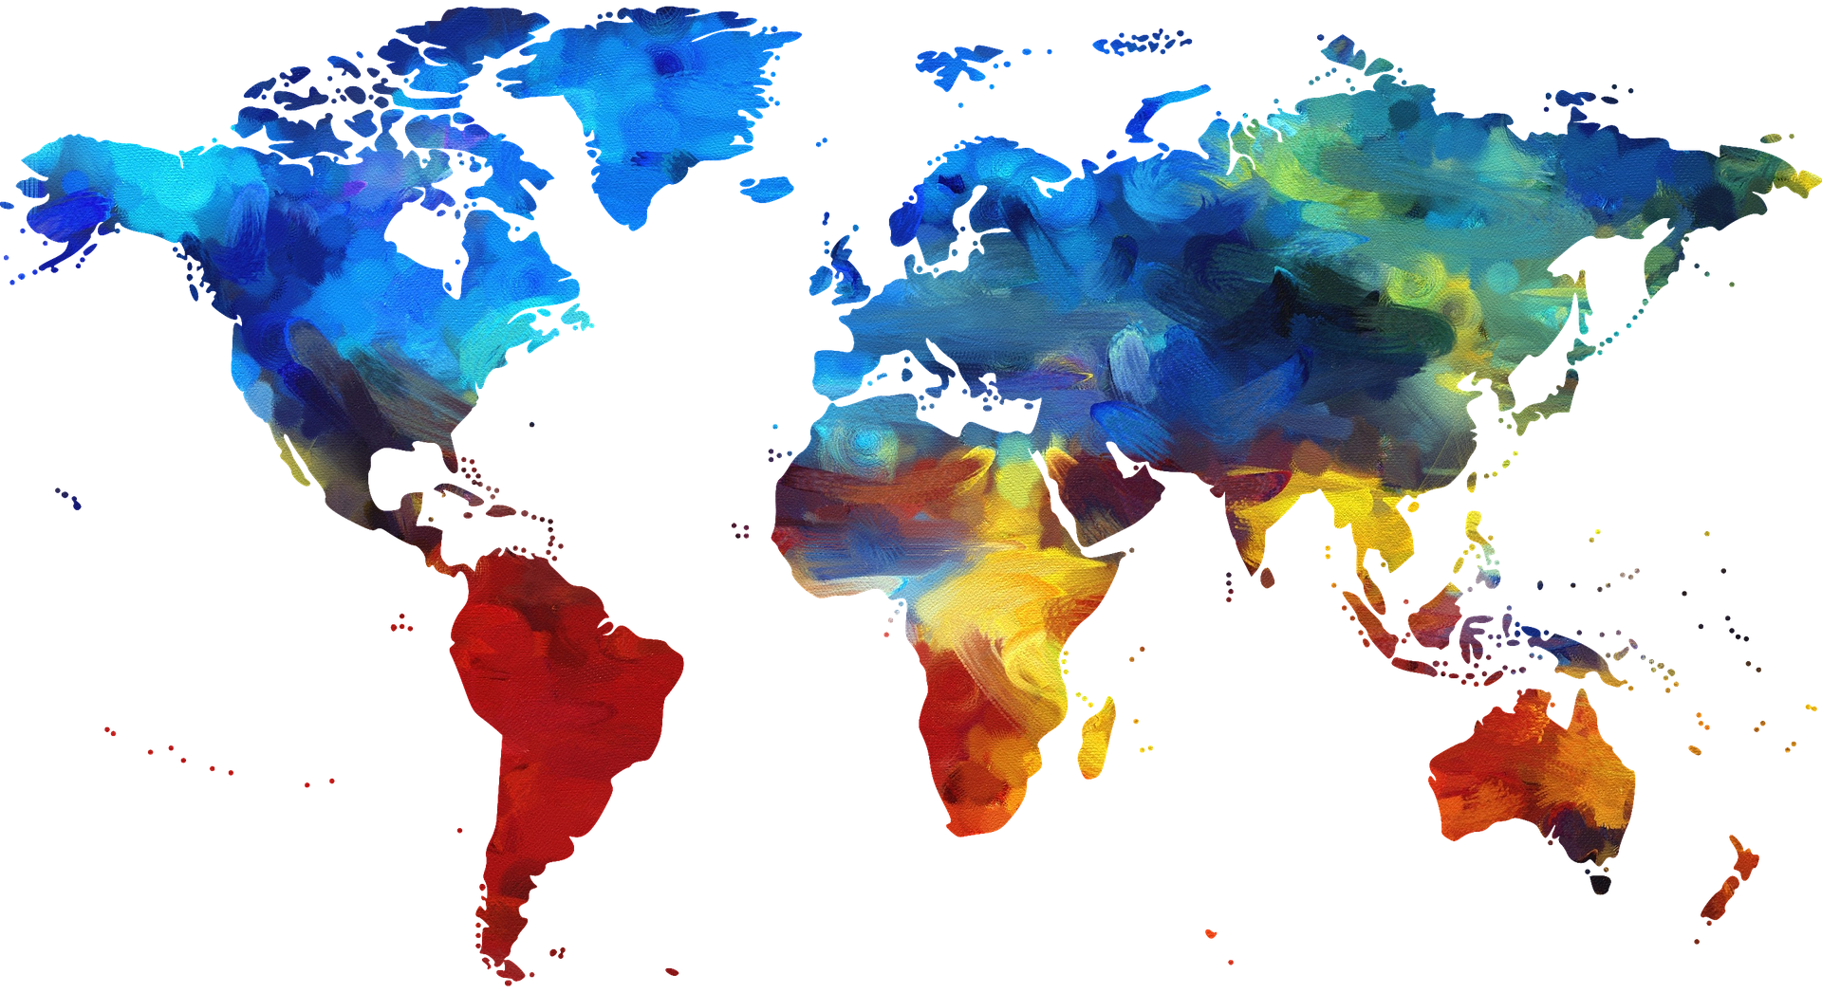
Pray for Bible translation teams
SERVING COMMUNITIES WHO’VE NEVER READ GOD’S WORD IN THEIR MOTHER TONGUE

Slide 2
AS TEAMS ARE ESTABLISHED PRAY…
For the right people - godly men and women with a reverent attitude towards the Word of God.
For good, supportive, prayerful relationships with their churches.
AS A TEAM GROWS PRAY…
For unity in vision.
That each member will recognise and respect the gifts of all their teammates.

Slide 3
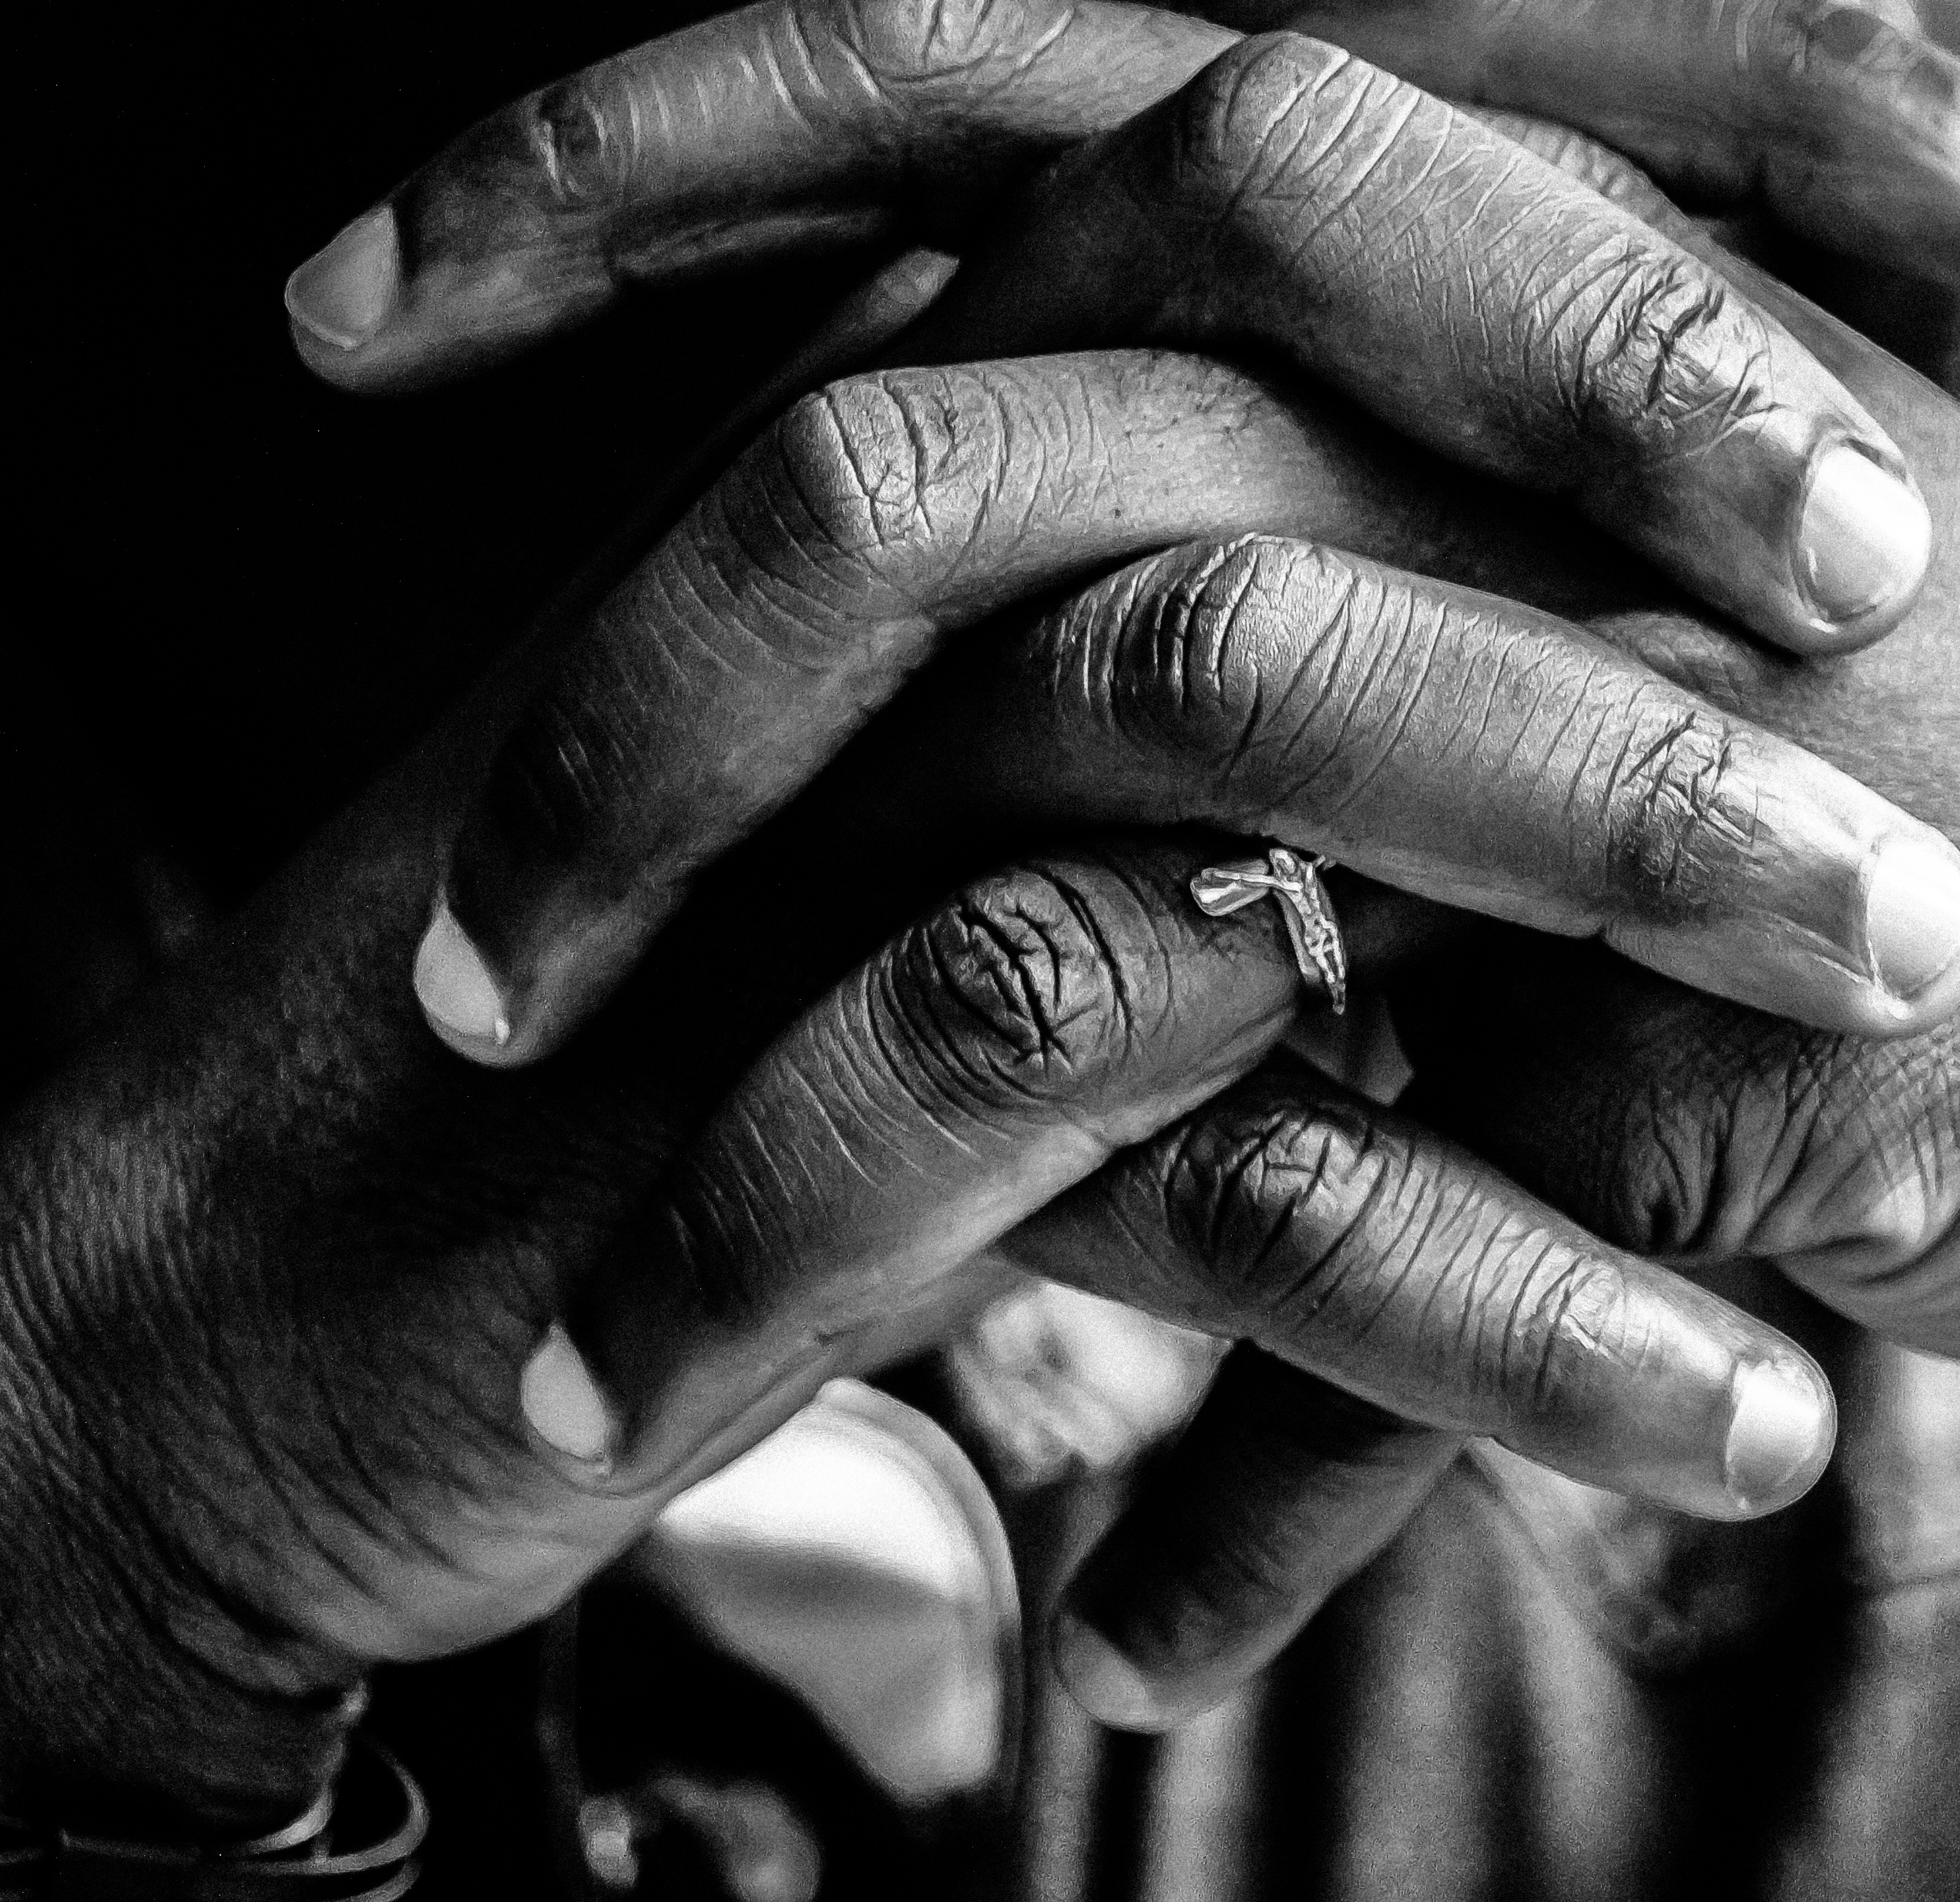
AS CHALLENGES COME, PRAY…
For safety from hostile people in their community.
The team will support each other and rely on God's strength.
For relevant good quality training.
Practically, for good access to electricity and a reliable internet connection.
For the funding needed to pay translators and buy equipment like computers, printers etc.

Slide 4
Pray for Bible translation consultants
Each Bible translation team needs a consultant with whom they work regularly. Bible translation consultants are few and far between. As a result, they are often overworked and find it hard to manage their priorities.

Slide 5
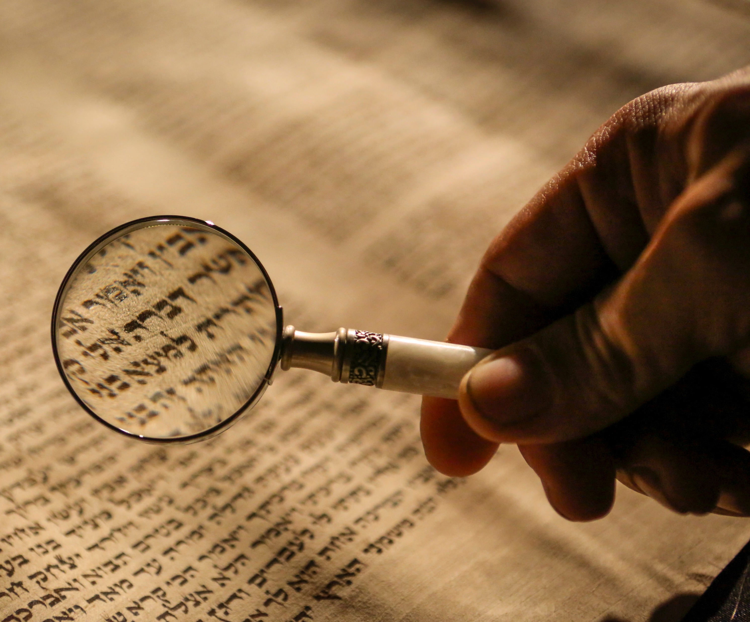
PRAY FOR BIBLE TRANSLATION CONSULTANTS
For God’s guidance in which work to take on.
Wisdom in how to encourage and train the team effectively.
Safety in travel.
Sensitivity in intercultural relationships and patience and grace with the teams.
Humility, but also trust in God's sovereignty as they bear the responsibility of working with the Word of God and knowing that decisions made could have an impact on entire communities.

Slide 6
Pray for communities who’ve never read God’s Word

Slide 7
Sept 2021
www.wycliffe.net/resources/statistics

Slide 8
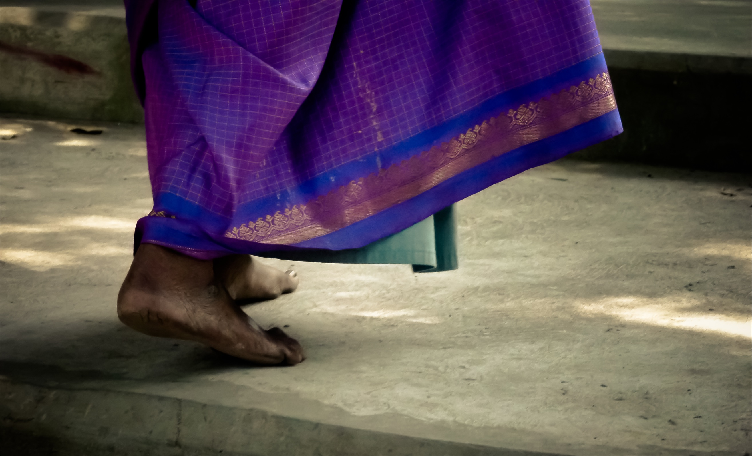
FOR COMMUNITIES WHERE CHRIST IS LEAST KNOWN, PRAY…
That the Lord of the harvest will send out workers into his harvest field (Luke 10:2).
That those who are called will be obedient, even when that means going out of their comfort zones or perhaps even putting themselves in danger.
For a hunger and thirst within these communities for the Word of God.
For communities without translated Scripture, pray those who speak other languages might hear the Word of God, respond and share the Good News with others in their own language.

Slide 9
Thank you for your prayers
For more information, prayer resources, or if you are interested in serving, please visit sim.co.uk

