Slide 1
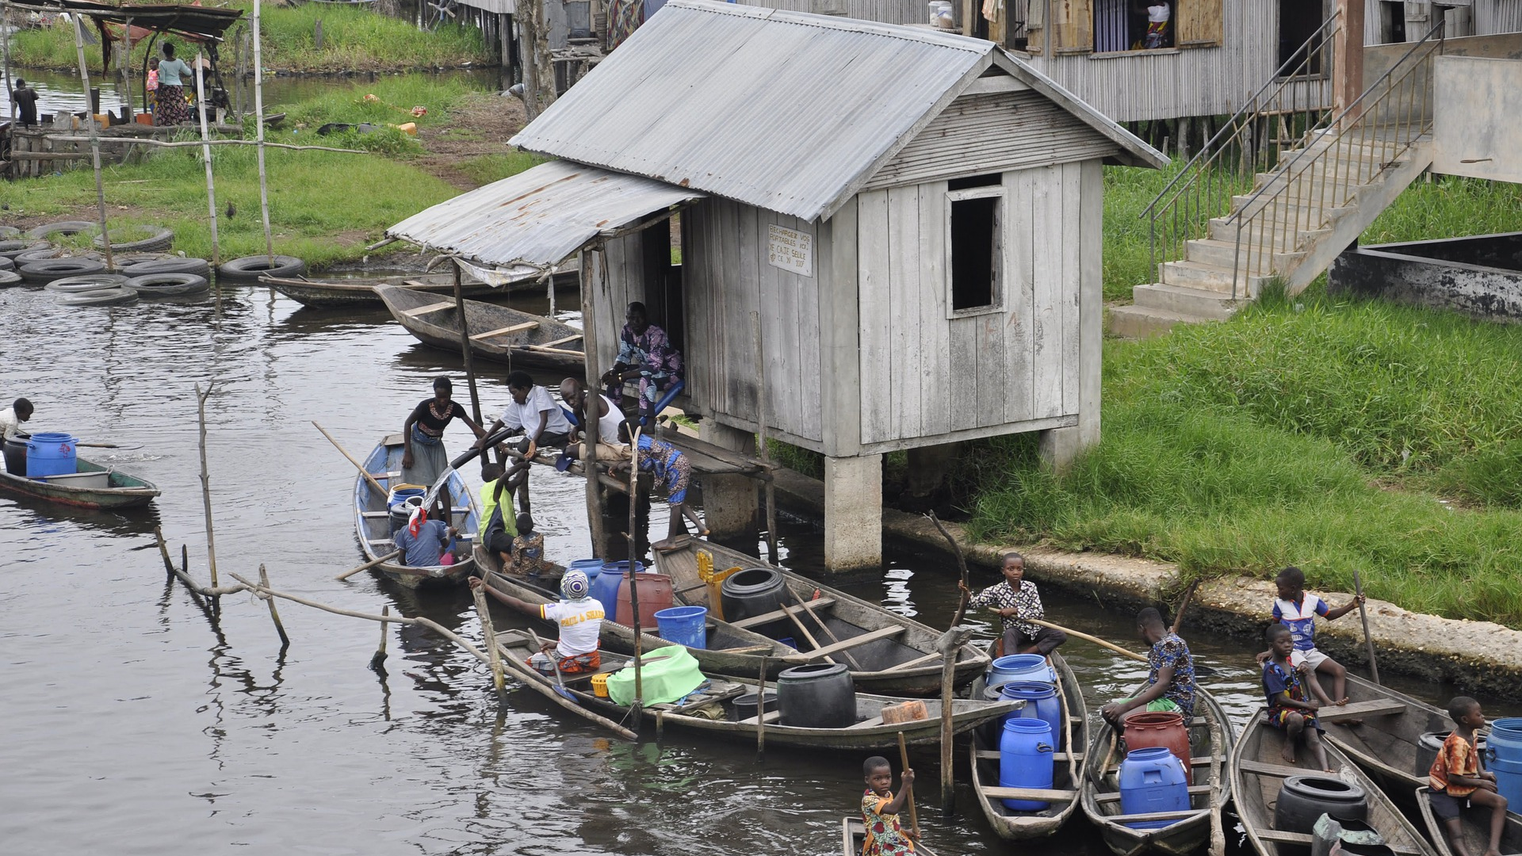
Pray for Benin
Image by Bluetaleb on Pixaby

Slide 2
As the rain and the snow come down from heaven, and do not return to it without watering the earth and making it bud and flourish, so that it yields seed for the sower and bread for the eater, so is My word that goes out from My mouth: It will not return to Me empty, but will accomplish that I desire and achieve the purpose for which I sent it.
Isaiah 55: 10-11
Image by Doungtepro on Pixaby

Slide 3
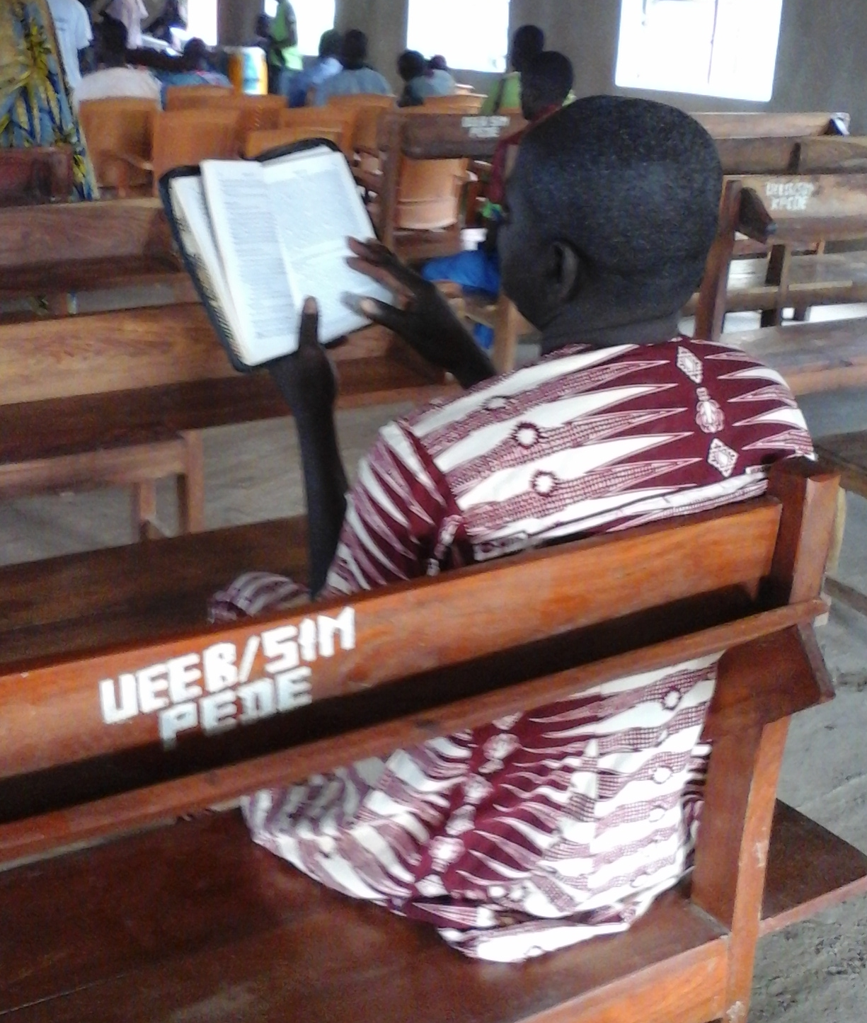
Pray for communities where Christ is least known
Monkolé
40,000 Monkolé people live Benin. Mainly subsistence farmers, they follow the majority religion of Benin, but many combine this with traditional beliefs and practices.
In the 1970s, a handful of Monkolé men became Christians, and today there are two Monkolé churches, with several hundred members.

Slide 4
Pray for communities where Christ is least known
Monkolé
The New Testament in the Monkolé language was published in 2007, and the complete Bible is projected to be ready for distribution in early 2022.
The New Testament was recorded in 2018, and Christian messages in Monkolé are broadcast three times a week from a community radio station.
For many years, there has only been one trained Monkolé pastor, but a young Monkolé Christian is now in his second year of theological training in Benin.

Slide 5
Pray for communities where Christ is least known
PLEASE PRAY FOR
The younger generation of Monkolé believers, that they will have a firm personal faith and a desire to share the Good News of Jesus with those around them.
The Monkolé Bible to be read, studied, and understood by Monkolé believers and those who do not yet believe.
Listeners, who will be ready and willing to accept the truth of the gospel as it is broadcast via community radio stations.
More personnel and resources to strengthen the administrative capacity of local Bible schools and church partners.
Labourers willing to work among the Monkolé, Weno and Sola people groups.

Slide 6
Thank you for your prayers
For more information, prayer resources, or if you are interested in serving, please visit sim.co.uk

