Slide 1
Pray for Canada

Slide 2
To the weak I became weak, to win the weak. I have become all things to all people so that by all possible means I might save some.
1 Corinthians 9:22

Slide 3
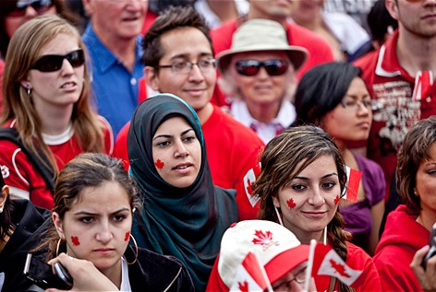
SIM Canada’s vision and desire
A witness to Christ’s love where he is least known.
Disciples expressing God’s love.
Christ-centred churches, especially among new Canadians and marginalised communities.

Slide 4
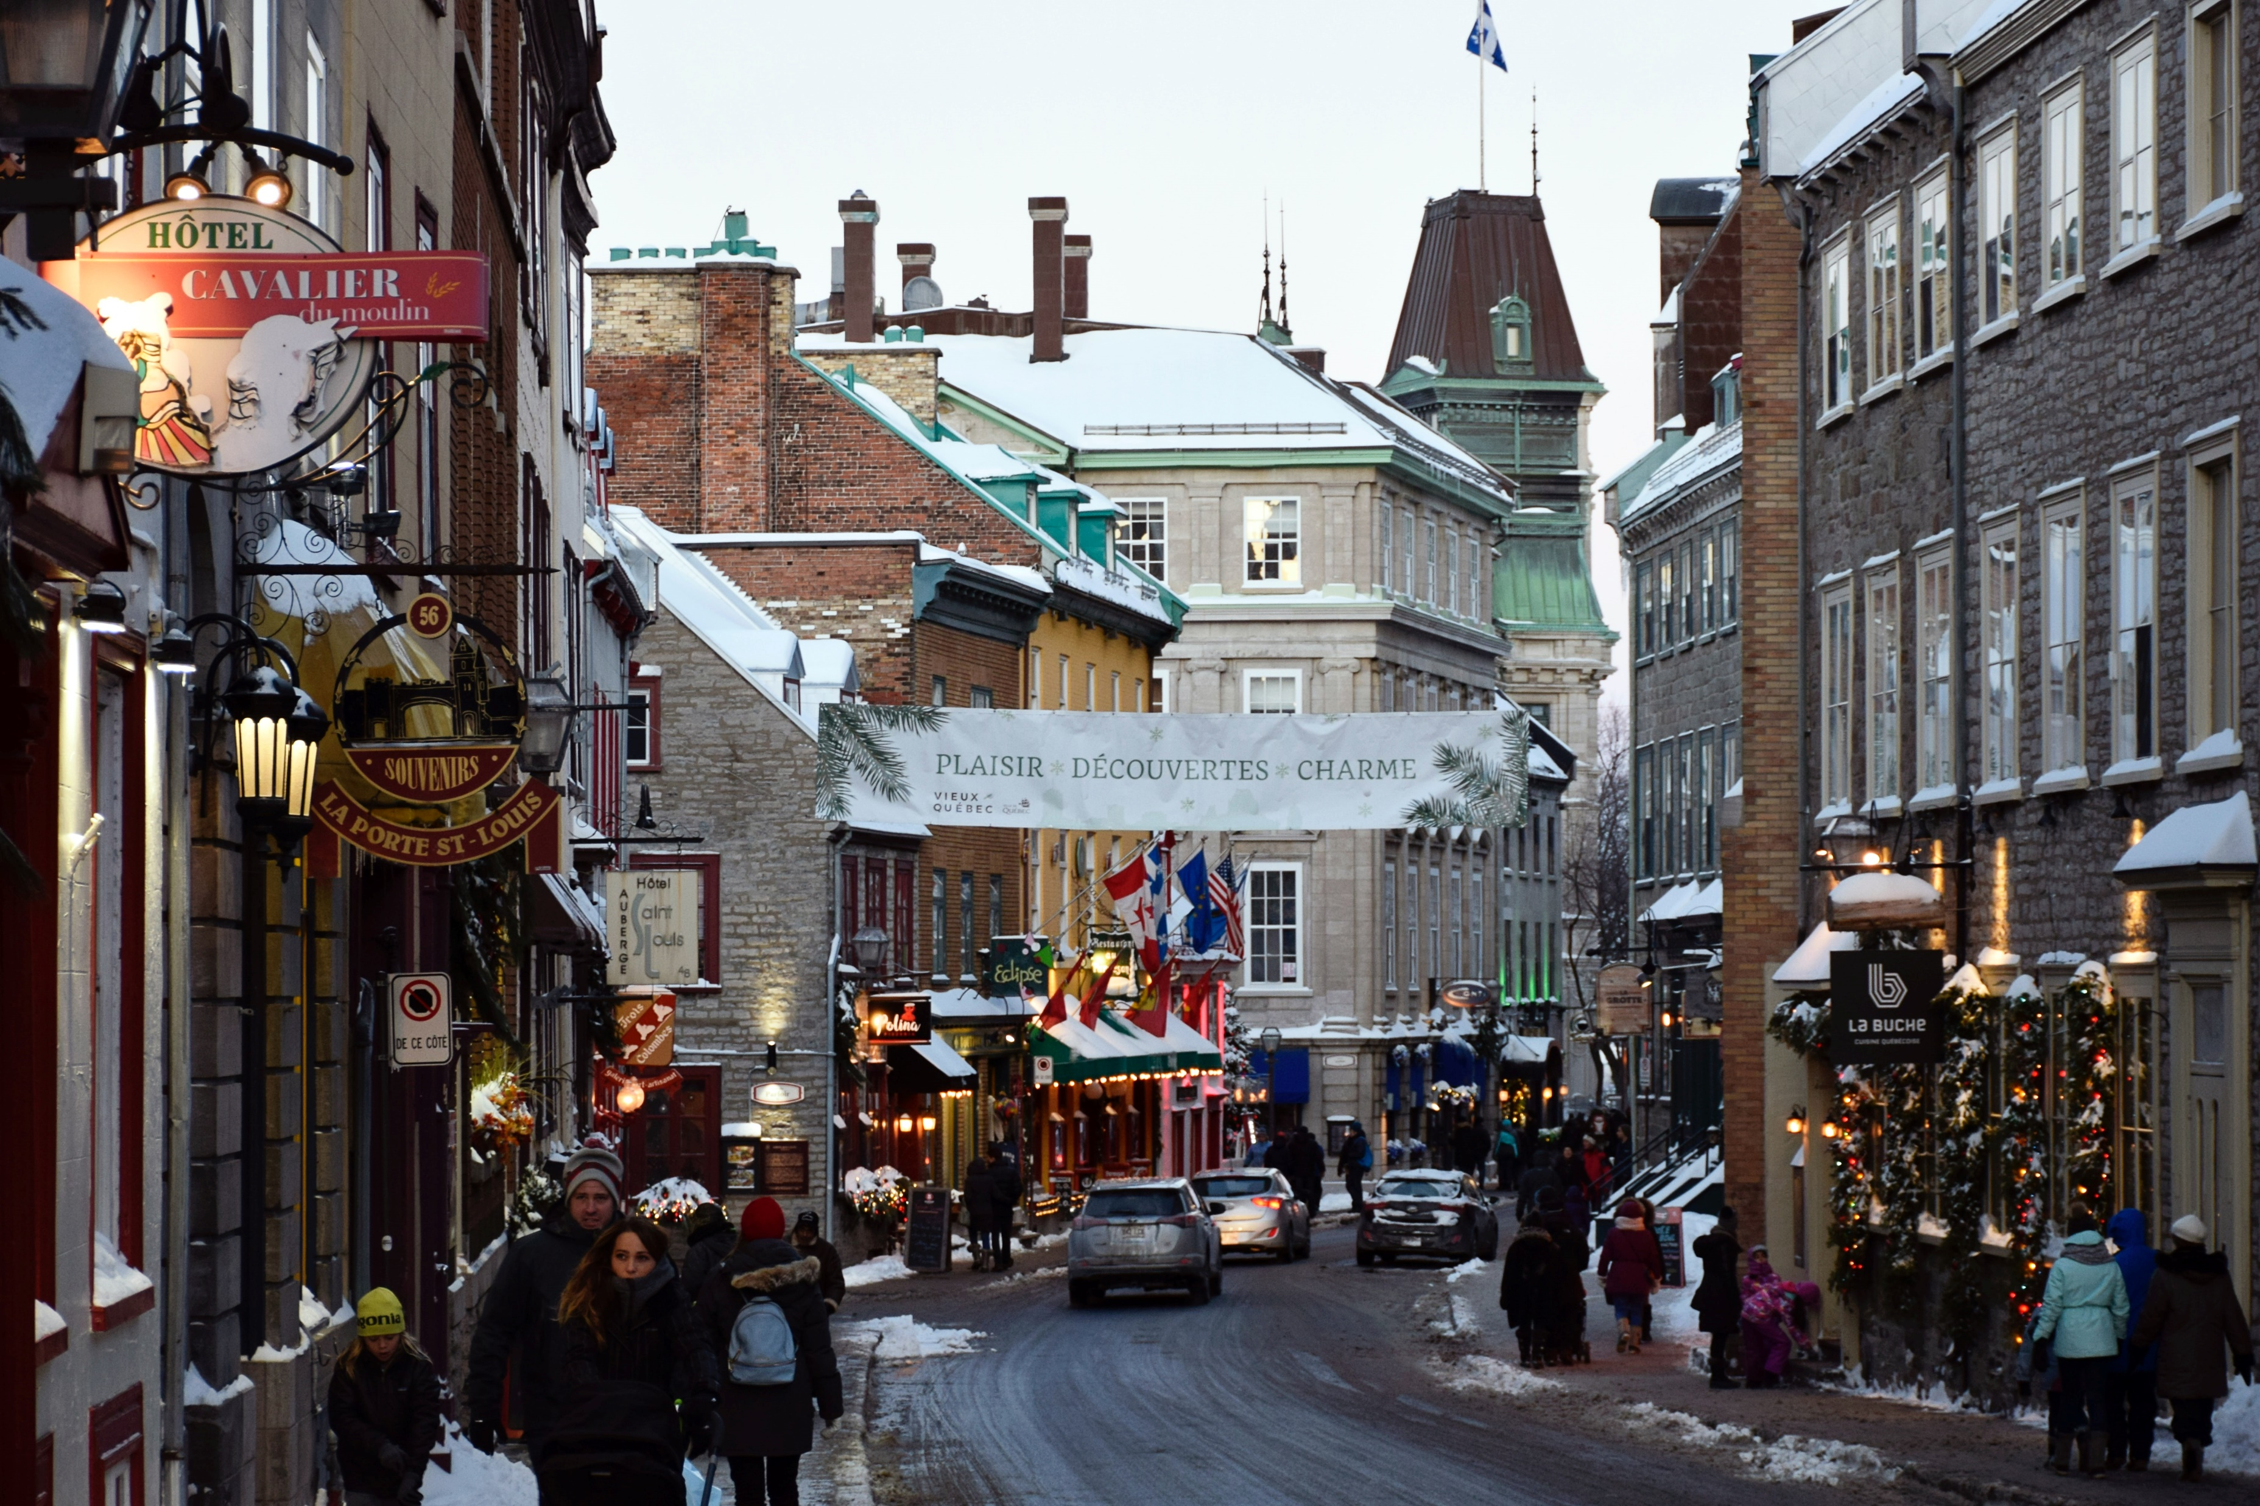
Communities where Christ is least known
New Canadians
1 in 5 people in Canada was born overseas, with immigrants coming from over 200 different nations.
Pray for our workers in their cross-cultural ministries, helping newcomers feel welcome and sharing the gospel.

Slide 5
Communities where Christ is least known
French Canadians
French Canadians live primarily in Québec. Most are Roman Catholic but do not know the gospel.
Pray for French speaking workers to join the team.

Slide 6
Prayer requests from SIM Canada
Please pray for:
Canadian workers serving in difficult contexts.
People to hear and respond to the gospel where it has been misrepresented.
More workers to join the field
SIM to partner well with local Canadian churches.
Wisdom in engaging numerous enquirers for service in Canada and overseas.

Slide 7
Ministries in SIM Canada
Refugee settlement
First Nations ministry
Sex trafficking prevention and awareness
Church partnerships
English as a Second Language (ESL) ministry
Deaf community ministry
University outreach
Hip hop outreach among rappers, DJs and break dancers
Mobilising, training and providing support services to mission workers

Slide 8
Thank you for your prayers
For more information, prayer resources, or if you are interested in serving, please visit sim.co.uk

